Slide 1





v
v
CUSTOMER SELL IN
Business to Business
v
Insert Customer’s logo

Slide 2
AT WORK SELL IN STORY – B2B
TIPS BEFORE START!
1
Foster Customer and our logo:
In opening page and across template
Put customer logo first
2
Be simple and concise:
In this deck you will find many examples for inspiration purpose. Each and every selling story is unique, focus on your objective and based, on that, craft the story.
3
Open with clear agenda:
How to unlock the potential?
Let’s bring it to life together – proposal for Customer XYZ
4
Follow up!:
Once activated, track results, present the findings
Remind the Customer - build your future stories on successful practices from the past

Slide 3

THE SELLING STORY FLOW – INTERNAL SLIDE
A. Objective
  Primary
  Secondary
B. Sale
Understand Customer needs. Summarise the situation, opportunity or gap
State BIG IDEA
Explain how solution works. Reinforce key benefits
Deal with objections
Close
C. Ideas and inspirations
Existing insights support
Specific programs examples
Building habit
Other examples

Slide 4
A SHORT RECAP OF TODAY’S MEETING
OBJECTIVE
AGENDA
Positioning Metro C&C as preferred supplier for office pantry solutions and as a true business partner through their competence and insight
Increase like for like sales, both in basket size and frequency of purchase
Through leveraging the strong emotional connection customers have with Coca-Cola and make aware of the comprehensive offer for Services, Companies and Offices customers
Why “At Work” is an opportunity?
Business value proposition
Development model and collaboration
Your feedback and next steps
Note: Targeted channels - Cash&Carry and Wholesale

Slide 5

WHY AT WORK IS A BIG OPPORTUNITY?
DRINKING WHILE WORKING IS THE SECOND LARGEST OCCASION IN VALUE DURING ‘MY DAY TO DAY’ MOMENTS AND 3RD OVERALL
Value Share AH Occasions
Volume Share AH Occasions
19%
Value Share OOH Occasions
Volume Share OOH Occasions
17%
15%
15%
13%
13%
12%
10%
10%
9%
7%
7%
6%
6%
6%
5%
4%
3%
4%
3%
2%
2%
3%
3%
3%
1%
2%
1%
At School
On the Go
Physical Activity AFH
Socializing at Home
Snack time
Breakfast
Routine Habits at Home
My Moment at Home
Hanging Out
Screen Time
Eating Out
At Work
Meals at Home
Drinking Out
Drinking Moments in Value – Central Eastern Europe (CEE)
AH: At Home
OOH: Out of Home

Slide 6
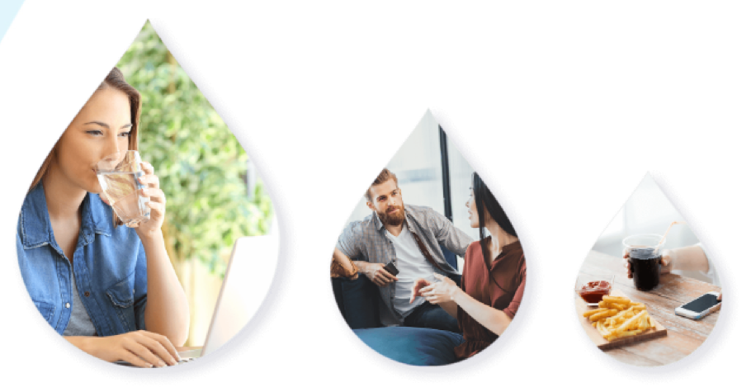
WHY AT WORK IS A BIG OPPORTUNITY?
CONSUMERS OFTEN HAVE VERY DIFFERENT NEEDS FROM BEVERAGES ACROSS
‘AT WORK’ SUB‑OCCASIONS AND IT IS IMPORTANT TO OFFER A BROAD RANGE OF CATEGORIES AND PACKS TO FULLY SATISFY THEIR NEEDS
Coffee
43.6%
CONSUMER TRENDS
Water
21.7%
WHILE
WORKING
WHILE TAKING
A BREAK
WHILE
EATING
SSDs
14%
58%
31%
11%
Source: InSites Consulting

Slide 7
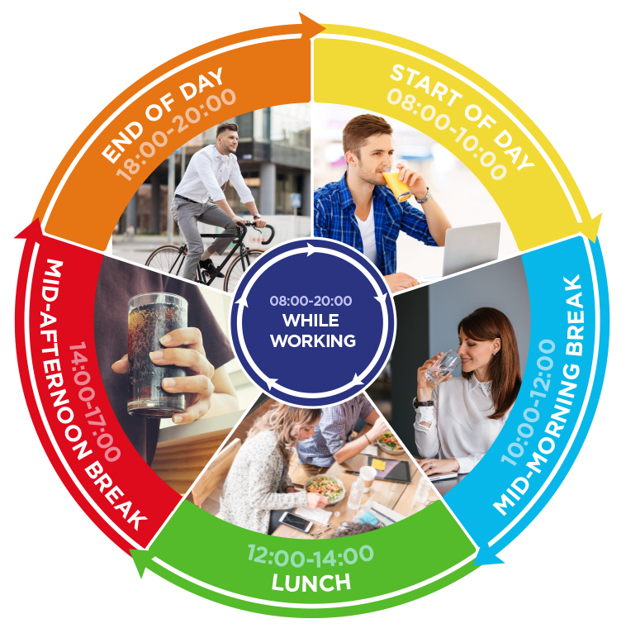
WHY AT WORK IS A BIG OPPORTUNITY?
STAYING HYDRATED AND REFRESHED AT WORK IS VITAL TO OUR WELLBEING AND OUR ABILITY TO PERFORM TASKS SAFELY AND EFFICIENTLY THROUGHOUT THE DAY
40% of employees are not satisfied with beverages @ Work
70% of consumers feel it is very important to stay hydrated during the day at the workplace.
Choice & availability can drive satisfaction & consumption
‘At Work drinkers’ are looking for increased variety within the category
Consumers have a variety of needs
Soft drinks at 10% daily consumption although only available in 50% sites
Consumers cross-markets stress the importance of health-conscious, natural, sugar-free and organic drinks that are rich in vitamins and energy
Consumers are increasingly environmentally conscious, and want to see sustainable solutions in their workplace
2/3 of consumers are preferring small packs
CONSUMER TRENDS
Source: InSites Consulting

Slide 8

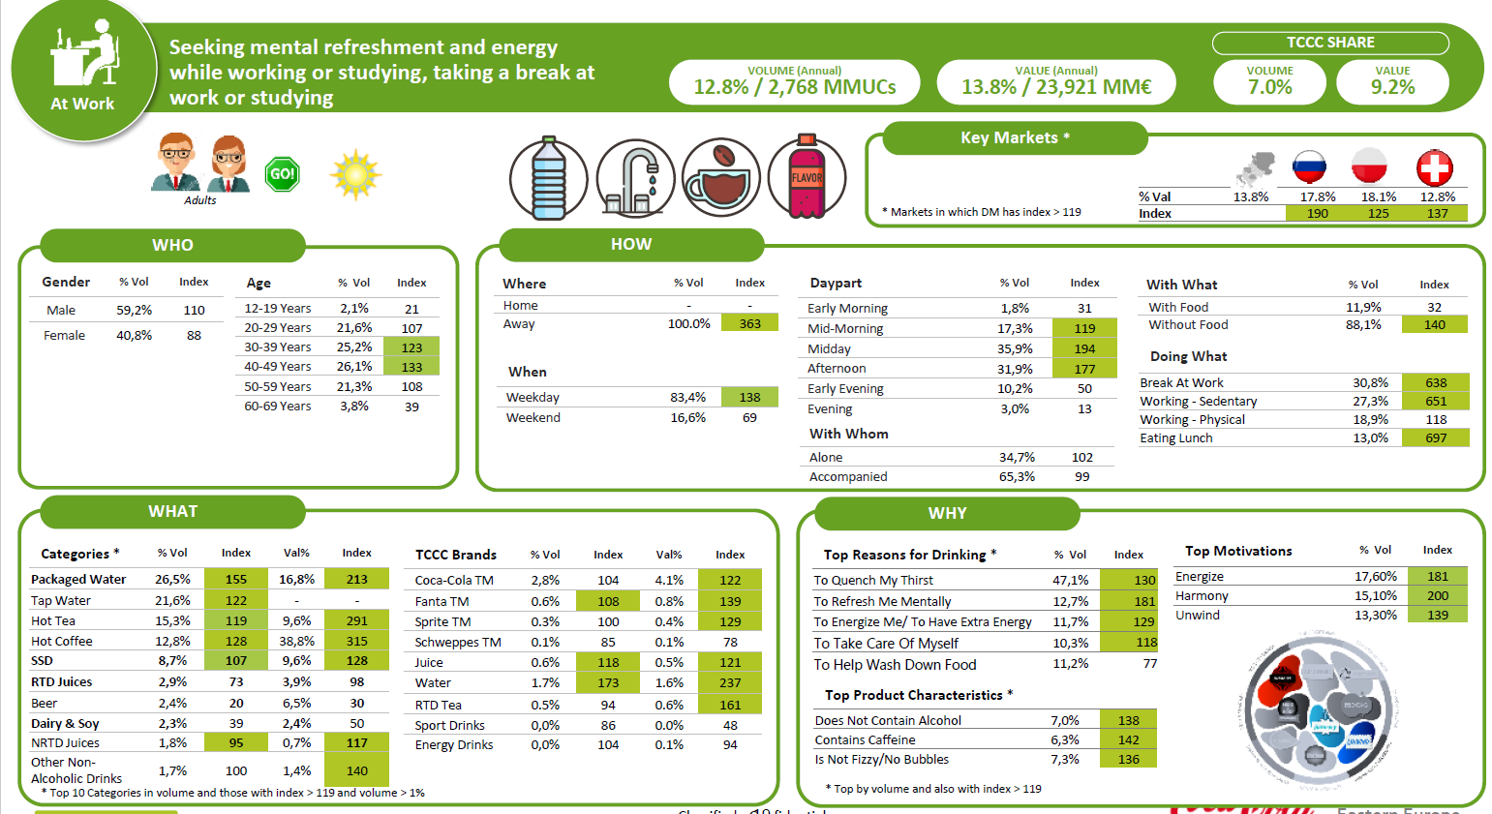
WHY AT WORK IS A BIG OPPORTUNITY?
OUR RESEARCH PROVIDES A DETAILED PROFILE OF CONSUMERS AND IDENTIFIED HOW AND WHEN THEY DRINK DURING THE DAY
Seeking mental refreshment and energy while working or studying, taking a break at work or studying
VOLUME (Annual)
12.8% / 2,768 MMUCs
VALUE (Annual)
13.8% / 23,921 MM€
TCCC SHARE
VOLUME
7.0%
VALUE
9.2%
Key Markets*
CONSUMER TRENDS
% Val | 13.8% | 17.8% | 18.1% | 12.8%
Index |  | 190 | 125 | 137
WHO
Age | % Vol | Index
12-19 Years | 2,1% | 21
20-29 Years | 21,6% | 107
30-39 Years | 25,2% | 123
40-49 Years | 26,1% | 133
50-59 Years | 21,3% | 108
60-69 Years | 3,8% | 39
HOW
Where | % Vol | Index
Home | - | -
Away | 100,0% | 363
With What | % Vol | Index
With Food | 11,9% | 32
Without Food | 88,1% | 140
Daypart | % Vol | Index
Early Morning | 1,8% | 31
Mid-Morning | 17,3% | 119
Midday | 35,9% | 194
Afternoon | 31,9% | 177
Early Evening | 10,2% | 50
Evening | 3,0% | 13
When | % Vol | Index
Weekday | 83,4% | 138
Weekend | 16,6% | 69
Doing What | % Vol | Index
Break At Work | 30,8% | 638
Working - Sedentary | 27,3% | 651
Working - Physical | 18,9% | 118
Eating Lunch | 13,0% | 697
Gender | % Vol | Index
Male | 59,2% | 110
Female | 40,8% | 88
With Whom | % Vol | Index
Alone | 34,7% | 102
Accompanied | 65,3% | 99
WHAT
Categories* | %Vol | Index | Val% | Index
Packaged Water | 25,6% | 155 | 16,8% | 213
Tap Water | 21,6% | 122 | - | -
Hot Tea | 15,3% | 119 | 9,6% | 291
Hot Coffee | 12,8% | 128 | 38,8% | 315
SSD | 8,7% | 107 | 9,6% | 128
RTD Juices | 2,9% | 73 | 3,9% | 98
Beer | 2,4% | 20 | 6,5% | 30
Dairy & Soy | 2,3% | 39 | 2,4% | 50
NRTD Juices | 1,8% | 95 | 0,7% | 117
Other Non-Alchoholic Drinks | 1,7% | 100 | 1,4% | 140
TCCC Brands | %Vol | Index | Val% | Index
Coca-Cola TM | 2,8% | 104 | 4,1% | 122
Fanta TM | 0,6% | 108 | 0,8% | 139
Sprite TM | 0,3% | 100 | 0,4% | 129
Schweppes TM | 0,1% | 85 | 0,1% | 78
Juice | 0,6% | 118 | 0,5% | 121
Water | 1,7% | 173 | 1,6% | 237
RTTD Tea | 0,5% | 94 | 0,6% | 161
Sport Drinks | 0,0% | 86 | 0,0% | 48
Energy Drinks | 0,0% | 104 | 0,1% | 94
WHY
Top Motivations | % Vol | Index
Energize | 17,60% | 181
Harmony | 15,10% | 200
Unwind | 13,30% | 139
Top Reasons for Drinking* | % Vol | Index
To Quench My Thirst | 47,1% | 130
To Refresh Me Mentally | 12,7% | 181
To Energize Me / To Have Extra Energy | 11,7% | 129
To Take Care Of Myself | 10,3% | 118
To Help Wash Down Food | 11,2% | 77
Top Product Characteristics* | % Vol | Index
Does Not Contain Alcohol | 7,0% | 138
Contains Caffeine | 6,3% | 142
Is Not Fizzy / No Bubbles | 7,3% | 136
*Top 10 categories in volume and those with index >119 and volume >1%
*Top by volume and also with index >119
Source: InSites Consulting

Slide 9





WHY AT WORK IS A BIG OPPORTUNITY?
ALTHOUGH PEOPLE DO DRINK WHILST AT WORK, ONLY 20% OF BEVERAGES ARE BOUGHT ON PREMISE, AS EMPLOYEES ARE NOT HAPPY WITH THE BEVERAGE CHOICE IN THE WORKPLACE
ALMOST
1/2
80%
SHOPPER TRENDS
Beverages consumed
at work are purchased outside of the workplace
Of consumers are not currently satisfied with
the beverage choice in
the workplace.
Beverage Purchase
Country Weight
Organised Trade
KIOKS
& Petrol
QSR
(Fast Food)
HORECA
Workplace
Total
100.0%
31.4%
9.7%
8.8%
25.4%
20.5%

Slide 10
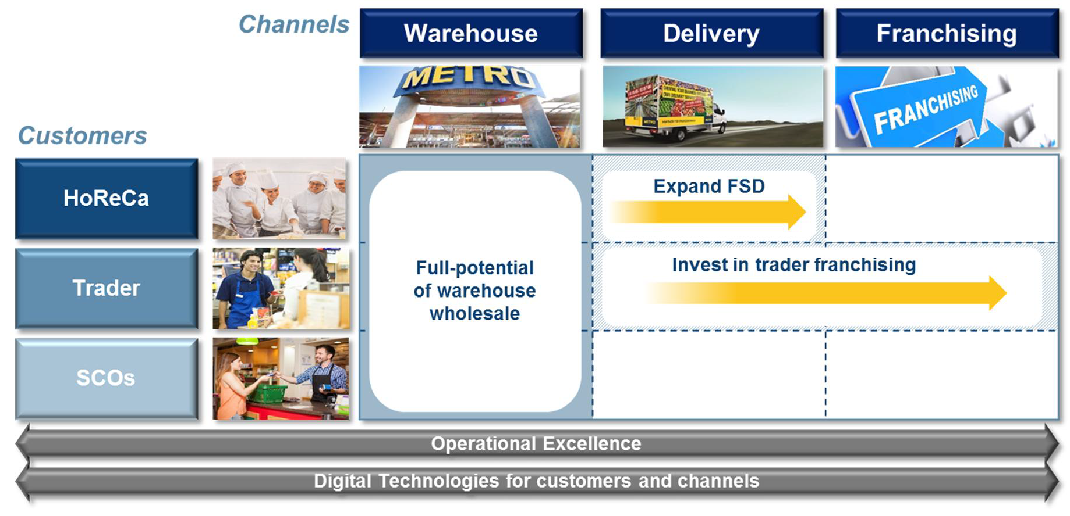
BUSINESS VALUE PROPOSITION
AT WORK (SCOS*) IS HIGH ON THE METRO C&C AGENDA AS WELL
!
Note for the countries:
Use your customer
strategy showing relevance of the At Work Channel or how strategy fits with proposal
EXAMPLE
Channels
WAREHOUSE
DELIVERY
FRANCHISING
Customers
HoReCa
Expand FSD
CUSTOMER STRATEGY
Trader
Full-potential
of warehouse wholesale
INVEST IN TRADER FRANCHISING
SCOs
Operational Excellence
Digital Technologies for customers and channels
(*) – Services, Companies and Offices

Slide 11
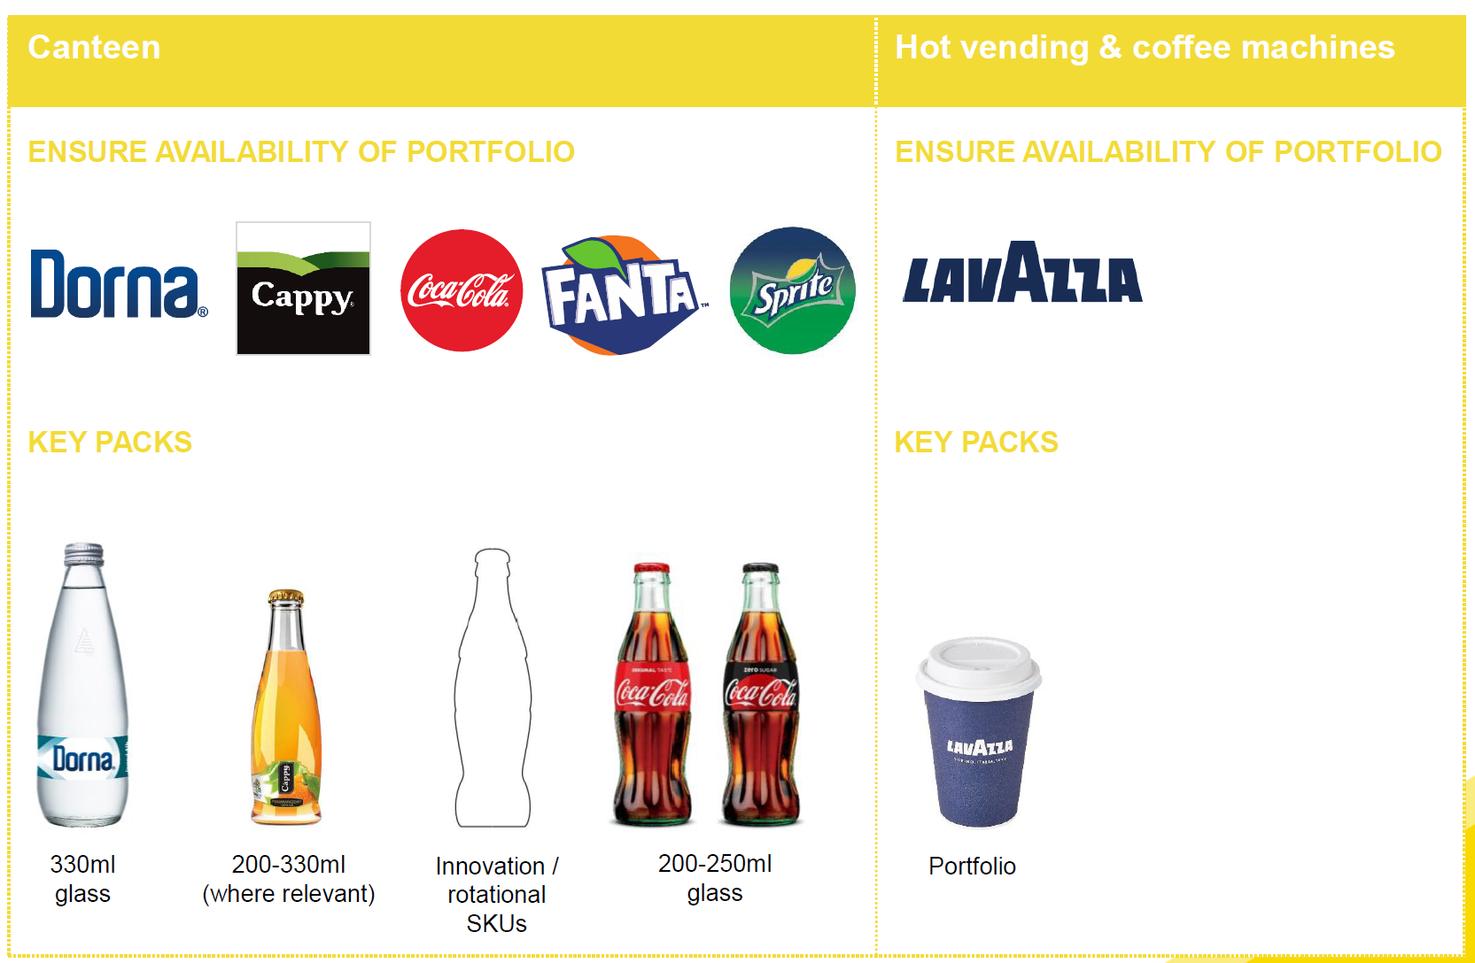
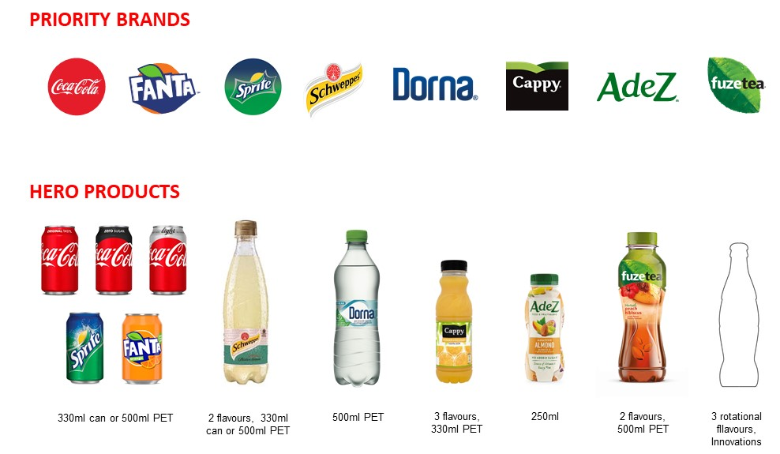
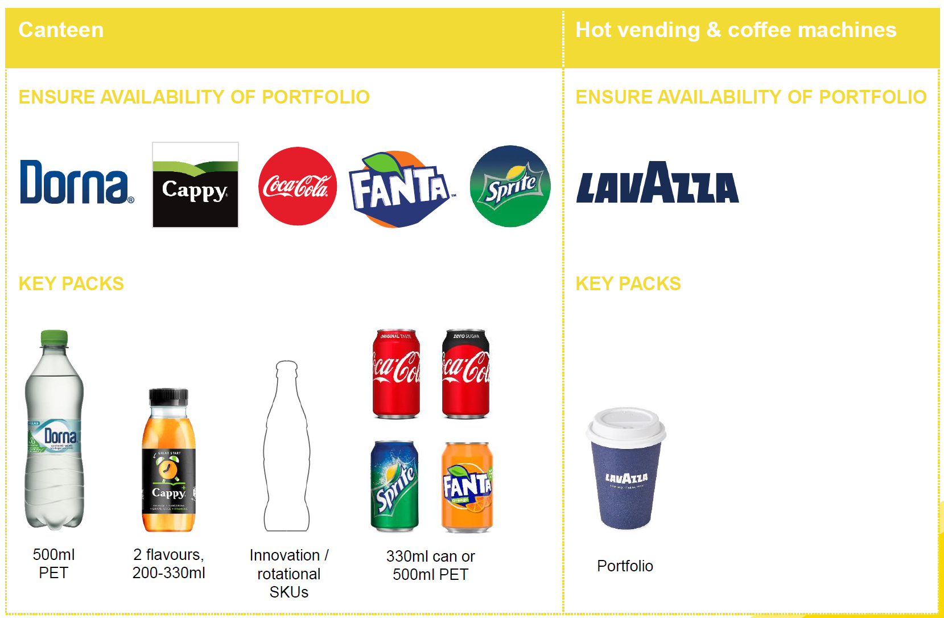
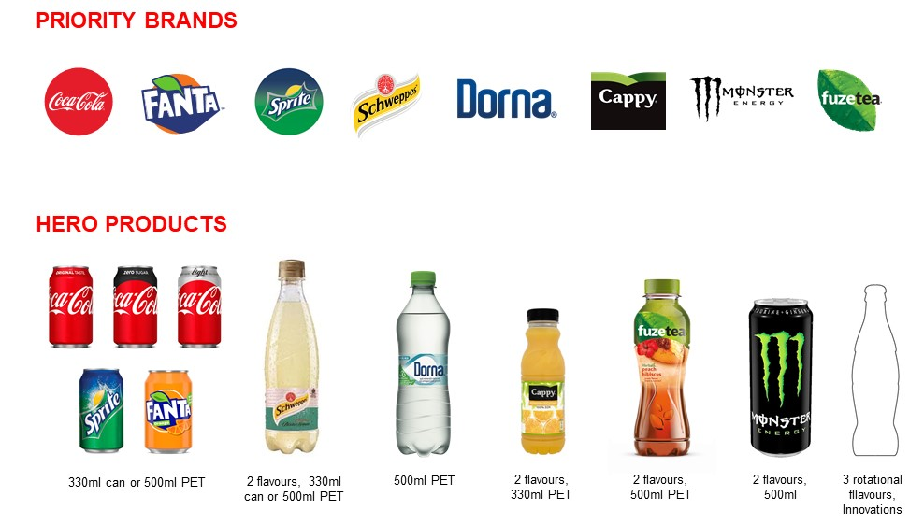
BUSINESS VALUE PROPOSITION
WE CAN OFFER A BALANCED RANGE OF DRINKS AND PACK SIZES TO MEET CONSUMER REFRESHMENT NEEDS
ENABLING CATEGORIES
PRIORITY
BRANDS
RANGE
WHITE COLLAR
COFFEE
HERO
PRODUCTS
WATER
3 rotational flavors, innovations
330ml can or 500ml PET
2 flavors, 330ml can or 550ml PET
550ml PET
3 flavors 330ml PET
250ml
2 flavors 500ml PET
ENABLING CATEGORIES
PRIORITY
BRANDS
COFFEE
RANGE
BLUE COLLAR
HERO
PRODUCTS
WATER
3 rotational flavors, innovations
330ml can or 500ml PET
2 flavors, 330ml can or 550ml PET
550ml PET
3 flavors 330ml PET
500ml
2 flavors 500ml PET
Drive availability in At Work channel for full portfolio through key enabling categories Water and Coffee
Drive incidence for all categories (except coffee) through relevant solutions throughout the working day
Leverage At Work channel to drive Metro Customers recruitment (for other channels and occasions) for Lavazza

Slide 12
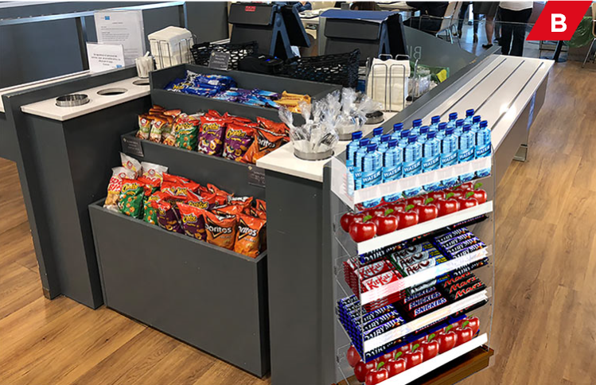
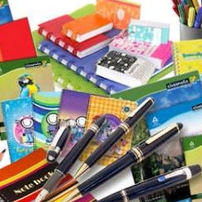

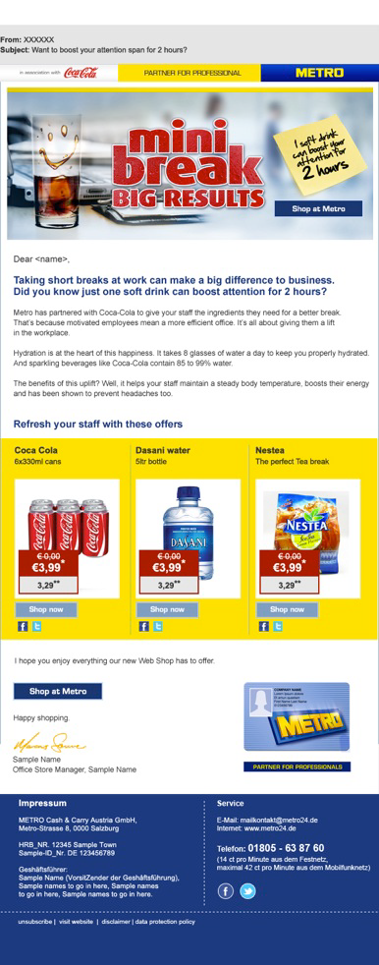
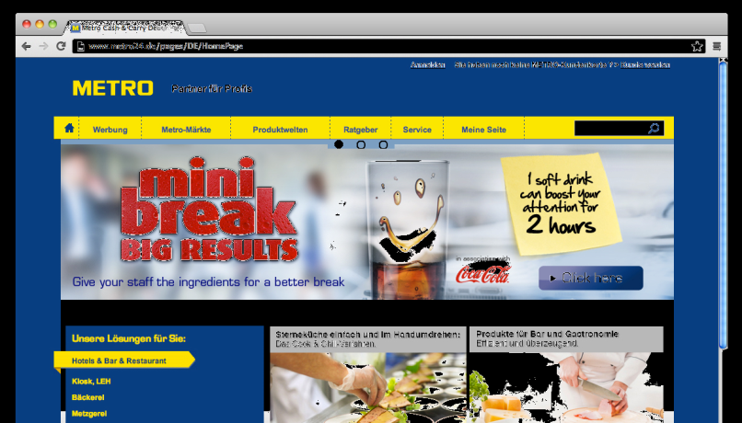
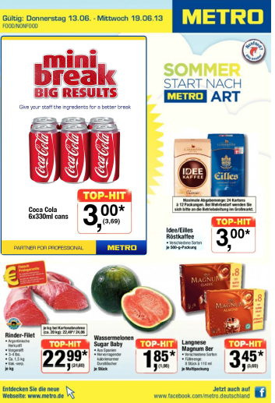
BUSINESS VALUE PROPOSITION
OUR UNIQUE SELLING PROPOSITION (USP) CAN BE COMBINED WITH SCO COMPLEMENTARY CATEGORIES
Focusing on key category for At Work we are increasing efficiency and improve cost per call
Order process done based on customer segmentation criteria or IT capabilities
  Face to Face
  Tell Sell
  Online ordering
Activate all relevant touchpoints
NARTD & Coffee
Confectionary
Stationery
Cleaning
Food
Non-Food
Communication touchpoints
METRO Internet Sites
Leaflets
Direct Mailing

Slide 13

BUSINESS VALUE PROPOSITION
THE OPPORTUNITY LIES IN:
A) EXPANDING CATEGORIES IN ACTUAL UNIVERSE
B) ACQUIRING DRAY OUTLETS
!
Numbers need to be adapted to specific market
EXAMPLE: From one store data and size of the prize
For all stores universe (36)
potential revenue size of the prize is
11 Mil.€
METRO Customer Scorecard Store 12 Voluntary
 | Customer Mix | #Customers |  |  |  | Total Bev Sales |  | VOP/Year
 | % | Active |  | Non-Buying |  | M€ |  | K€
Traders | 54% | 430 |  | 113 |  | 1.41 |  | 3.28
HORECA | 28% | N/A
SCOs’ (*) | 18%
Sive of the prize for SCOs’
Increase VPO +10% | 430 |  |  | 1.55 | 1.55 | 3.61 | 3.61
New Customers | 50 | 63 | 63 | 0.18 | 0.18 | 3.61 | 3.61
Incremental vs PY |  |  |  | 0.32 | 0.32
TOTAL | 480 | 63 | 63 | 1.73 | 1.73
CUSTOMER AGENDA
Incremental
Cash Margin
2.2Mil.€
Assumptions
Increase SCOs’ VPO with 10%
New customers
Source: Customer website, Data Sharing, customer universe Shared presentation, Meeting minutes etc.

Slide 14
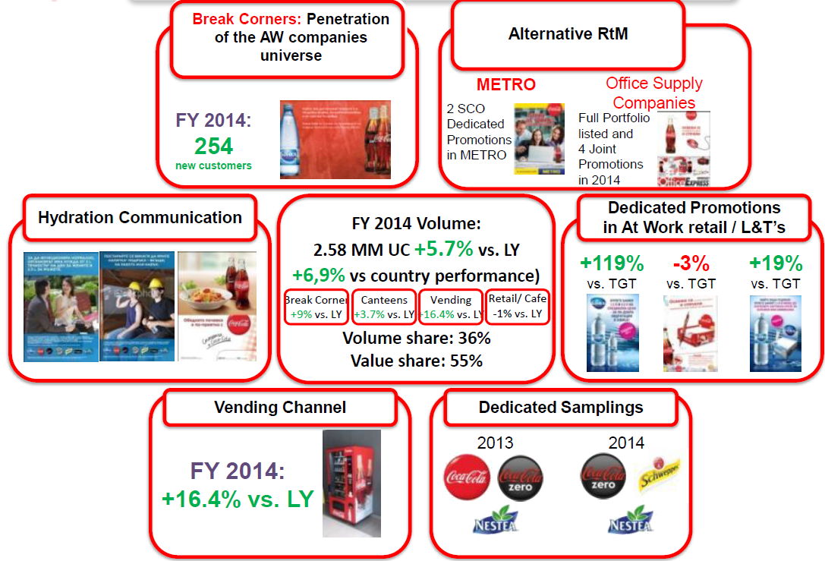
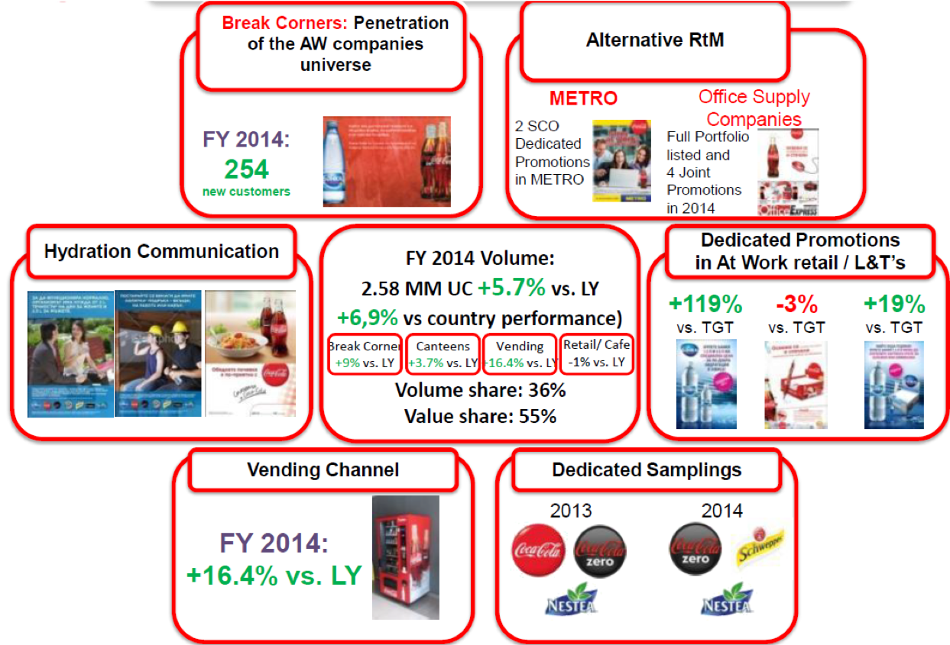
DEVELOPMENT MODEL AND COLLABORATION
PROOF POINT
One test customer added +5.7% (154k€) to the business by activating all selling points and communicating ‘refreshment at work’ via available touchpoints
EXAMPLE
!
Note for the countries:
Use relevant examples
from the market be creative to proof your point
Break Corners: Penetration of the AW companies universe
Alternative RtM
FY 2014:
254
new customers
METRO
2 SCO Dedicated Promotions in METRO
Office Supply Companies
Full Portfolio listed
and 4 Joint Promotions in 2014
Hydration Communication
FY 2014 Volume:
2.58 MM UC +5.7% vs. LY
+6,9% vs country performance
Dedicated Promotions in
At Work retail / L&T’
FACTS
TESTS etc.
+119%
vs. TGT
-3%
vs. TGT
+19%
vs. TGT
Break corner
+9% vs. LY
Canteens
+3.7% vs. LY
Vending
+16.4% vs. LY
Retail / Café
-1% vs. LY
Volume share: 36%
Volume share: 55%
Vending Channel
Dedicated Samplings
FY 2014:
+16.4% vs. LY
2013
2014

Slide 15
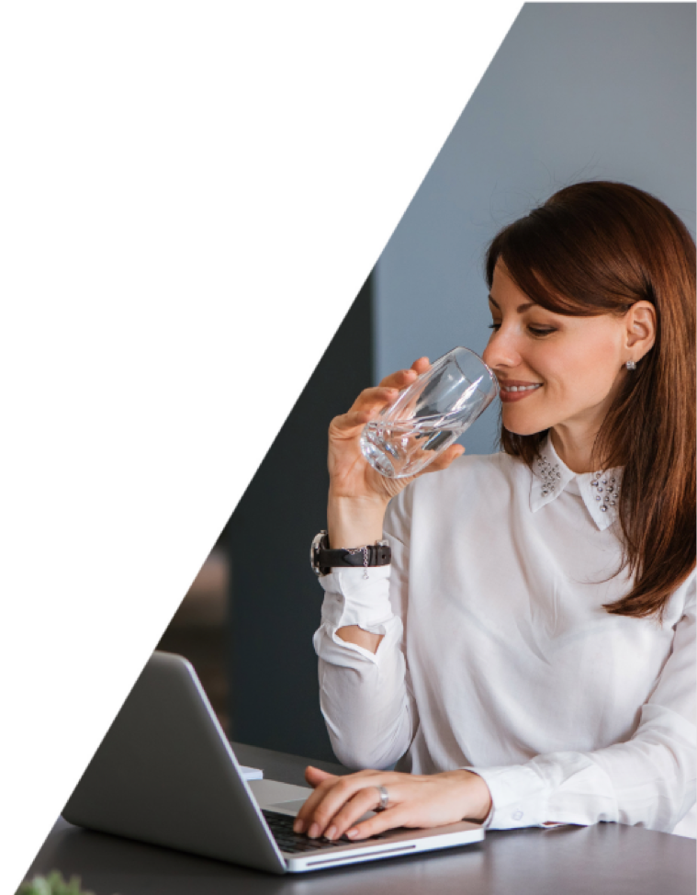
DEVELOPMENT MODEL AND COLLABORATION
METRO C&C: GROW REVENUE BASE VIA PROFESSIONAL SCOS * WITH 11M€ AND ADD 2.2.M€ EXTRA CASH MARGIN
PROPOSED STRATEGY: New At Work Route to Market for Metro B2B
PROPOSAL
Joint collaboration in define and implement “Refreshment At Work “
Set targeted geography and appropriate RtM
Define unique selling proposition (USP)
Activation levers and touch points
Evaluate and measure impact
SCOs’ Customers benefit:
Metro C&C SCOs’ customers will have better services saving time and money USP is covering key value category for professional SCOs’ (NARTD Beverages, Coffee, Confectionary and Stationery) assured by one single supplier
PLAN
Validate landscape & size the opportunity
Segmentation
Define POI and equipment
Service offers
Appropriate RtM
Sales collaboration
Picture of success
EXECUTE
!
Insert comments or additional explanations if required
(*) – Services, Companies and Offices

Slide 16

YOUR FEEDBACK AND PROPOSED NEXT STEPS
<CUSTOMER> FEEDBACK
YOUR FEEDBACK:
NEXT STEPS:
KEY SUCCESS MEASURES:
TIP: Make it an open discussion. Although you already asked for feedback few times its worth reconfirming if there’s anything else
the Customer would like to share.
If you agree on the direction it’s important to:
- discuss key success factors
- align on clear next steps with timelines
- agree how to track and measure the success

Slide 17

Thank You

