Slide 1
v
v
SELLING STORY
HORECA & QSR
v

Slide 2
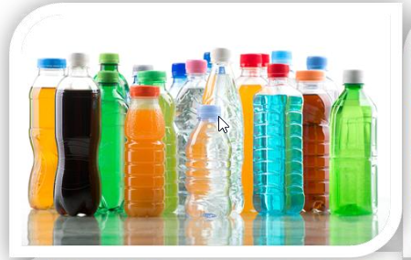
AT WORK OCCASION - FACTSHEETS
SIZE
CONSUMERS
At Work is one of the biggest occasion/drinking moment in terms of expenditure
19,4 BN Euro size of the occasion
13,2 % of all occasion in volume
2,6 BN Euro size of the prize
TCC share within the occasion 11,5%
8 to 10 glasses of fluid every day to be properly hydrated
70% of consumers feel it is very important to stay hydrated
Only 40 % of men and 60 % of women are properly hydrated
Almost 50% of consumers are not currently satisfied with beverage choice in the workplace
Motivation: energize, harmony, unwind
Sub –occasions: 58% while working, 31% while taking a break, 11% while eating
When: 8 AM to 8 PM, 86,1% of occasion value
At Work occasion generates the highest value between 11am & 5pm
L
CATEGORIES
CHANNELS
Coffee is the biggest category – 43,6%
Water - 21,7% ,SSD – 14%, Tea – 7,9%
Juice - 6,2%, Diary & Soy – 4,4%
Energy drinks – 2%, Sport drinks – 0,2%
34% of people are looking for large packs to stay refreshed and hydrated
32% of people prefer smaller bottles and cans while taking a break and eating
80% beverages consumed at work are purchased outside of workplace
Companies: 50 -250; 250+
Blue collar – high SSD share, White collar – high water & coffee share
Channels: Organized trade (C&C&B2B) – 4,1%
On The Go & QSR – 2,5%
HORECA (close to working place) – 3,6%
Workplace channel – 2,7%
RTM: DSD, ISD, Full Service Wending, Rental business
Gatekeepers: Owner, Purchasing, HR
L
Localize content with country figures

Slide 3
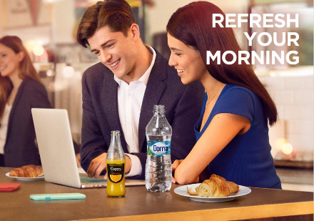
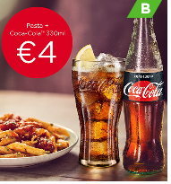
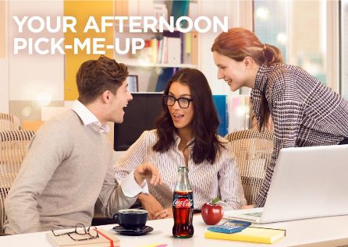
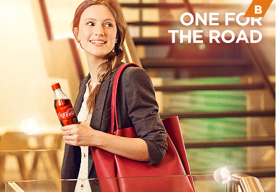
AT WORK ‘HORECA & QSR’ - FACTSHEETS
(outlet in proximity of 1-2 km from work place)
SIZE
CONSUMERS
3,6 % of TTL retail value within At Work drinking moments
25,4 % of retail value At work occasion
2nd channel for purchase within At Work Occasion
xx BN Euro size of the prize
TCC share within the subchannel xx %
39% Early evening consumption (5-8PM)
31,7% Mid morning consumption (8-11AM)
24,5% Afternoon consumption (2-5PM)
L
CATEGORIES
CHANNELS
Coffee
Sparkling
Iced Tea
Water
Juice
80% beverages consumed at work are purchased outside of workplace
8% At work occasion volume both in HORECA
L
Localize content with country figures

Slide 4
AT WORK ‘HORECA & QSR’ - SELLING STORY SUMMARY
(outlet in proximity of 1-2 km from work place)
1. IDENTIFY / SUMMARISE OPPORTUNITY
2. BIG IDEA
At Work is one of the biggest occasion in terms of expenditure
3,6 % of TTL retail value within At Work drinking moments
25,4 % of retail value At work occasion
xx BN Euro size of the price
TCC share within the subchannel xx %
80% of beverages consumed is outside the work place,
8% At work occasion volume consumed at HORECA
Drive transaction growth through JUICES & WATER combing with COFFEE and
COMBO OFFERS for breakfast and lunch, leveraging also food aggregators
ACHIEVE GROWTH:
YOU can capture this opportunity with xxx
increased transactions, €xxx incremental revenue and
€xxx Incremental cash margin, by listing our products and
promo offer to your consumers
3. HOW IT WORKS
4. KEY BENEFITS
Drive availability for juice and water pairing them with coffee
Combo offers for breakfast and lunch drive transaction growth
COMBO MEAL DEAL
MULTI-PURCHASE OFFER
LOYALTY CARD
PORTFOLIO PAIRINGS
COMBO SNACK DEAL
Incremental Transactions and Revenue
Increased Cash Profit-Margin xx %
Increased Transaction xx % , € xx
Estimated Annual Profit Increase: €xx , + xx%
5. CLOSE
Summarise Key Points
Agree listings for new SKUs , agree Juice/Water & Coffee combo offer , COMBO Meal OFFER with date of activation
Listen, Wait & Close!
Compete the Order

Slide 5
v
v
FULL SELLING STORY
HORECA & QSR
v

Slide 6
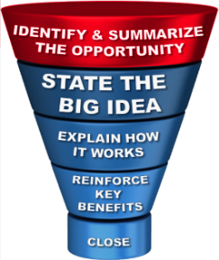
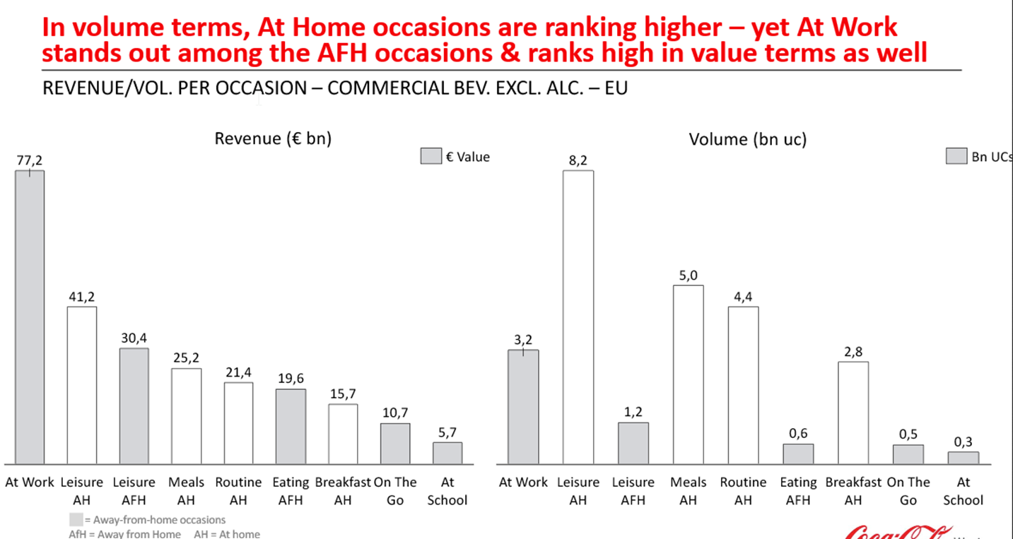
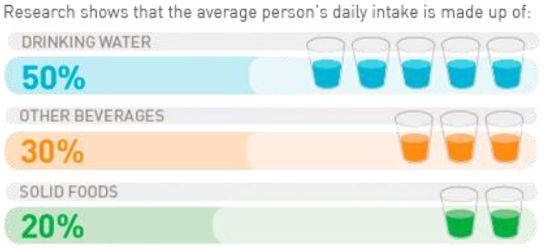
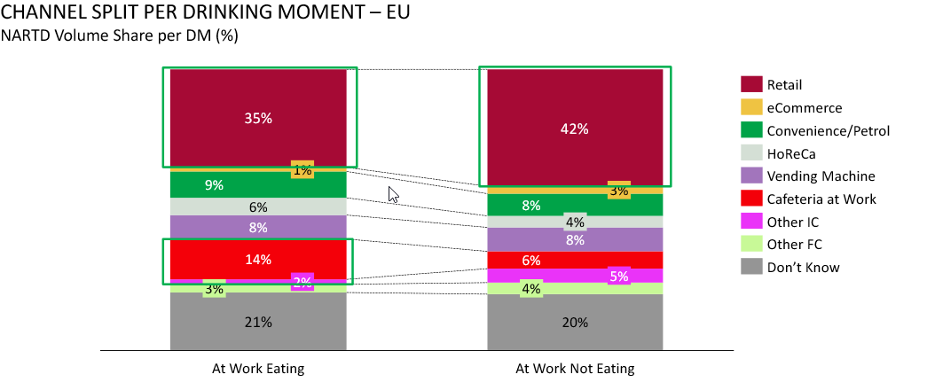
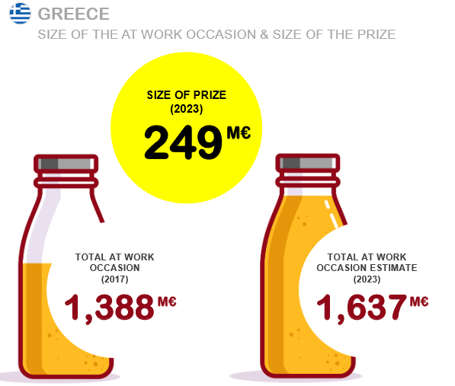
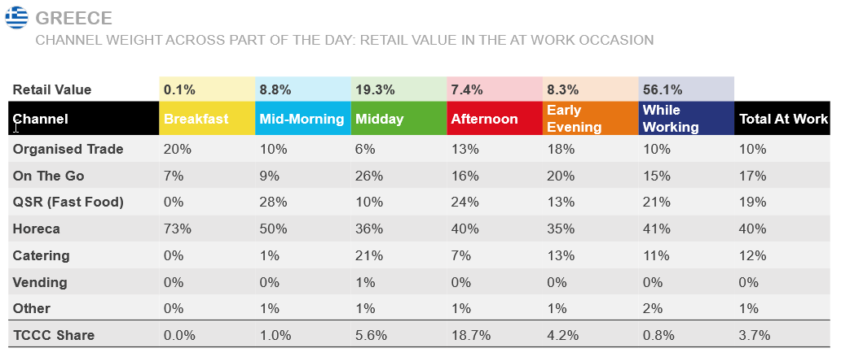
AT WORK OPPORTUNITIES
AT WORK IS THE BIGGEST REVENUE OPPORTUNITY
DEHYDRATION CAN INFLUENCE PHYSICAL & MENTAL PERFORMANCE
L
MOST OF BEVERAGES ARE BOUGHT OUTSIDE THE WORKPLACE
SIZE OF THE PRIZE
L
Localize content with country figures

Slide 7
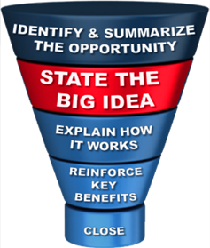
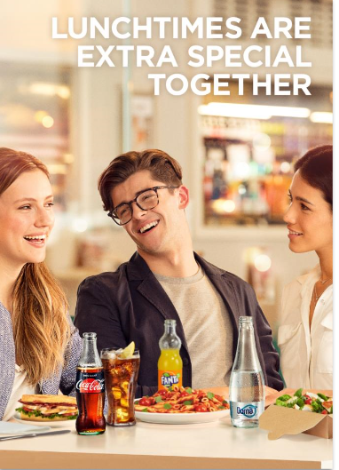
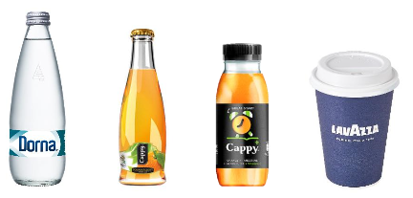
THE BIG IDEA
DRIVE INCIDENCE OF JUICE AND WATER
DRIVE INCIDENCE THROUGH CONVENIENT SOLUTIONS FOR BREAKFAST AND LUNCH
by focusing on product intrinsic or building adjacencies with coffee in
proximity to work place outlets
leveraging also food aggregators
L
L
EXAMPLES
With CAPPY presence in your offer we will drive consumer consumption which will increase your profit for xx% and bring you XX Euro annually
With introducing COMBO MEAL DEAL, we will grow purchase and food & drink association, adding incremental revenue of XX% over the next year which will bring you additional XX Euro
L
Localize content with country SKUs and activation examples

Slide 8
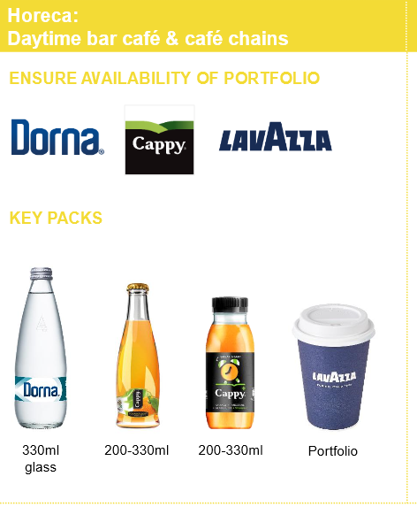
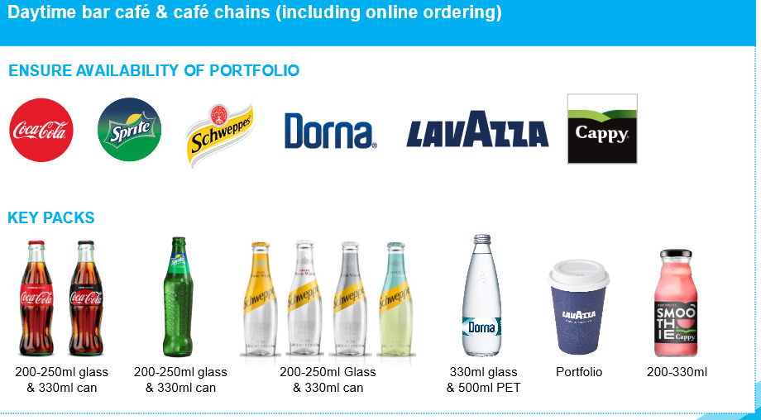
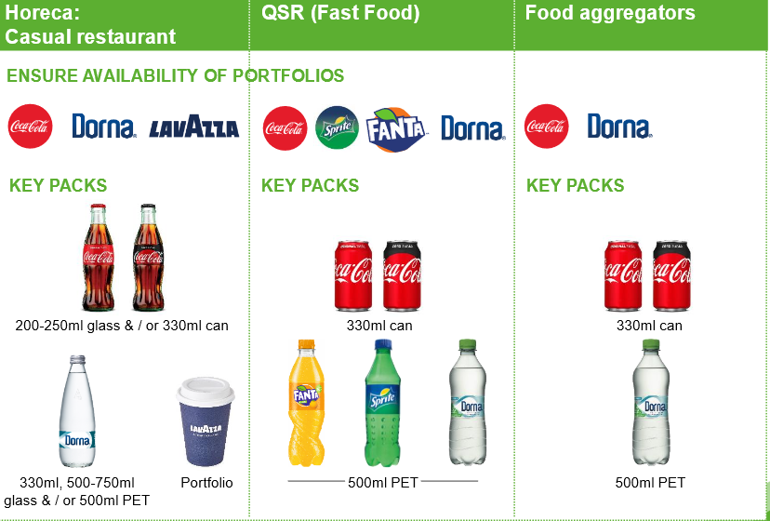
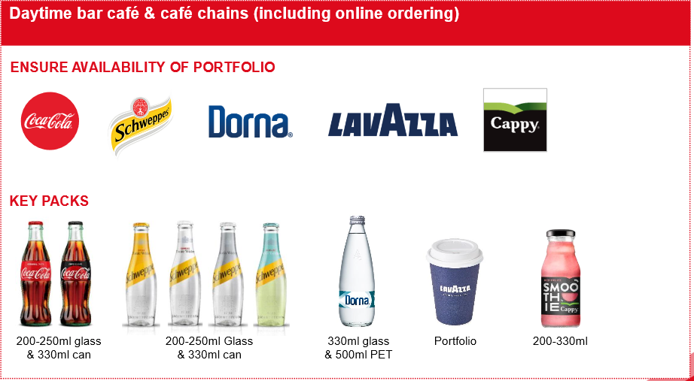
HOW IT WORKS - PORTFOLIO
Start of day
Mid morning brake
L
Lunch
Mid afternoon brake
L
Localize content based on country portfolio

Slide 9
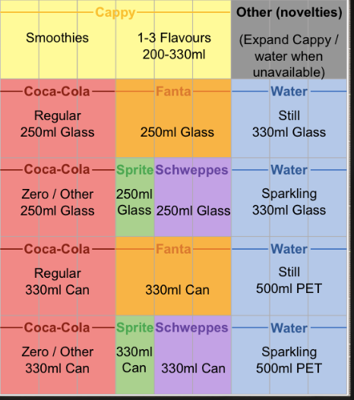
HOW IT WORKS – RIGHT ACTIVATION & EQUIPMENT
Day time bar café coller merch. standard
L
Markets should develop their own merchandising standards based on opportunities in the market and customer specifics, always with the objective to offer enough choice to consumers
L
Localize content based on country portfolio

Slide 10
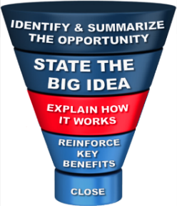
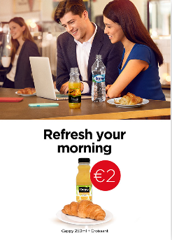
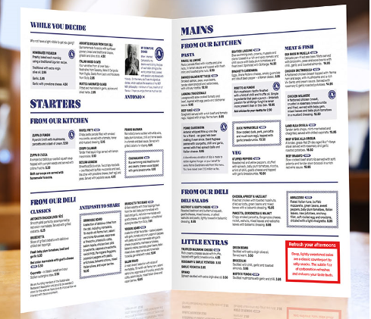
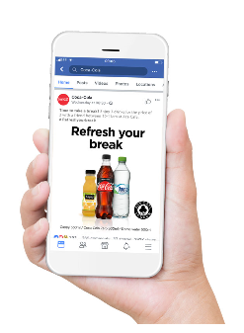
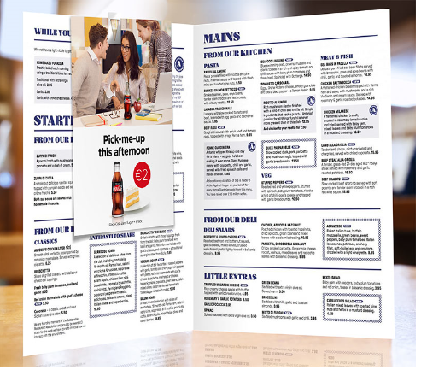
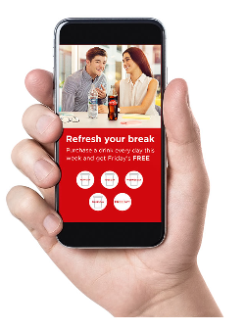
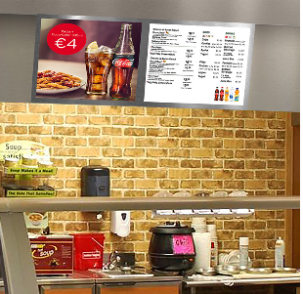
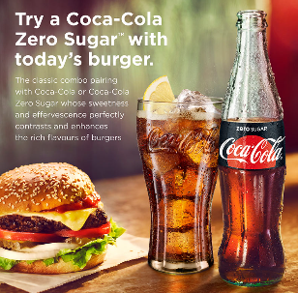
HOW IT WORKS – PROMO OFFERS
Examples throughout the day
COMBO MEAL DEAL Drink with breakfast item for set price to encourage employees to fuel up for the day.
Benefit: Drives association of food and drink
PORTFOLIO PAIRINGS Suggestion of drink based on snack choice (savory vs. sweet) in venue and via menu inserts
Benefit: Drives association of drink with snack
MULTI-PURCHASE OFFER 2 for 1 / 3 for 2 offer on drinks purchased between 10:00-11:00.
Benefit: Drives incidence of priority categories
COMBO SNACK DEAL Snack and drink combo for set price
Benefit: Drives association of drink with snack
LOYALTY CARD (Digital) loyalty card to log purchase of a
drink between 10am-12pm on specific days. If a drink is purchased each day Monday to Thursday, a free drink is given on Friday.
Benefit: Encourages repeat purchase and builds brand loyalty
PORTFOLIO PAIRINGS Suggestion of portfolio drink pairings next to specific lunch items on menu or food types, e.g. Coca-Cola Zero Sugar + burger
Benefit: Convenience drives purchase and food and drink association
COMBO MEAL DEAL Meal and drink for a set price
Benefit: Convenience drives purchase and food and drink association

Slide 11
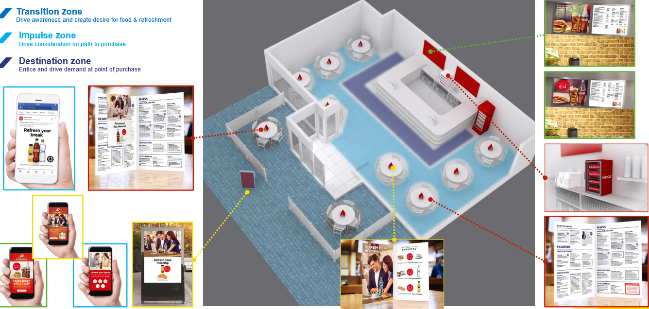
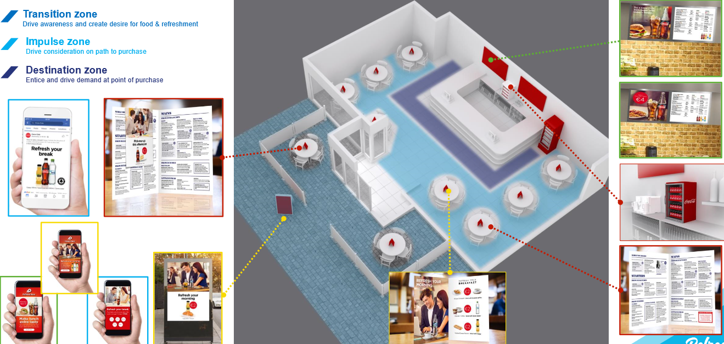
HOW IT WORKS – OPTIMUM PLACEMENT
START OF THE DAY
MID MORNING BRAKE

Slide 12
HOW IT WORKS – OPTIMUM PLACEMENT
LUNCH
MID AFTERNOON BRAKE

Slide 13
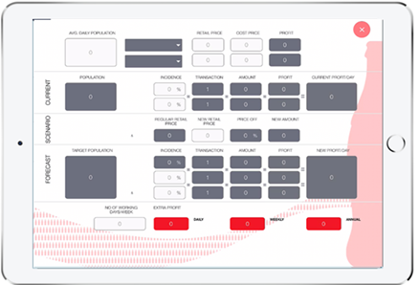
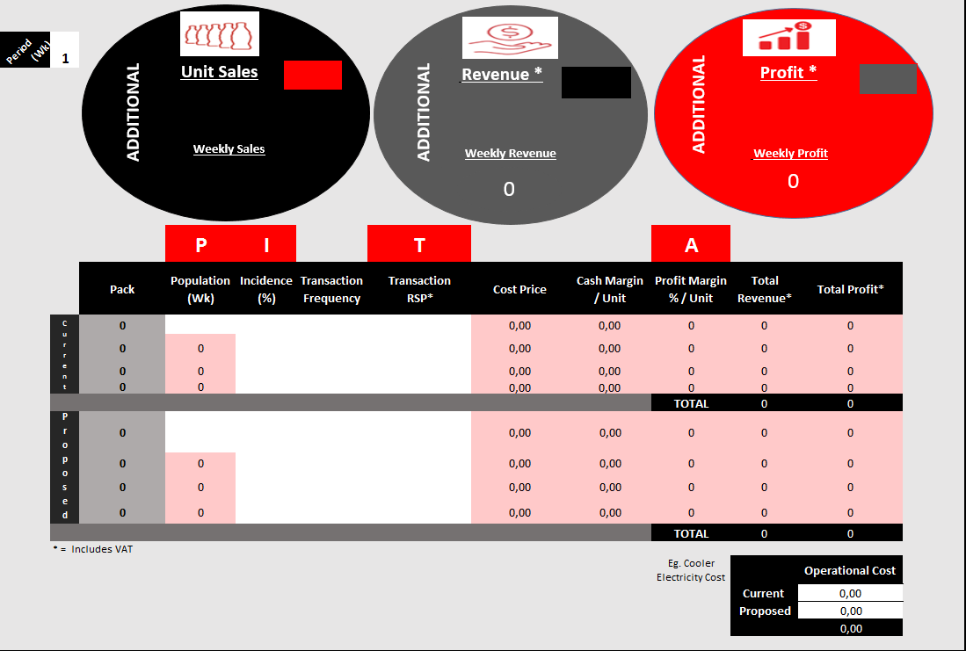
HOW IT WORKS – PROFIT STORY
Leverage profit story tool to show the customer the profit opportunity by: - Assortment listing - Juice & coffee offer - Combo meal deal

Slide 14
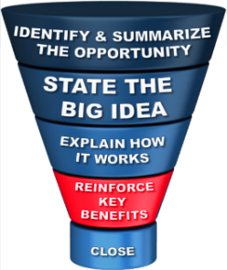
REINFORCE KEY BENEFITS
ASSORTMENT:
Share of profitable categories (SSD, Coffee, Juices) will increase annual profit by XX Euro
Increase transactions by XX%
PROMO OFFERS :
Increase Annual Profits by, potentially XX € , XX%

Slide 15
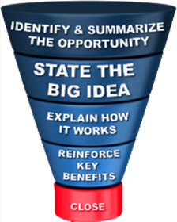
CLOSE THE DEAL
When we will sign the contract
When we will deliver the cooler in the outlet
What/when the order will be place
When we will activate the promo offer

