Slide 1
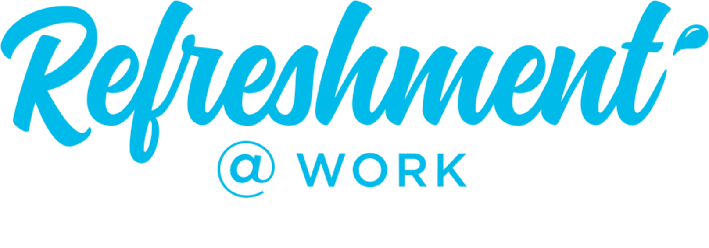
v
v
SELLING STORY
Workplace
v

Slide 2
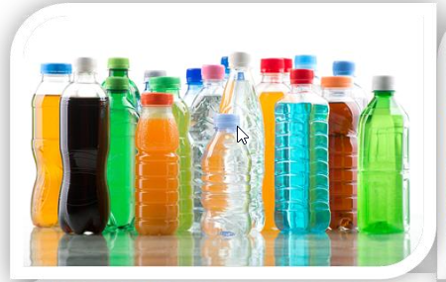
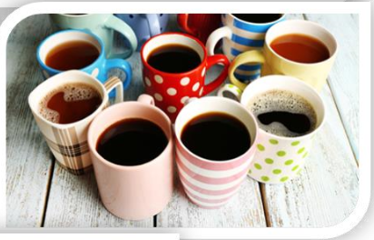
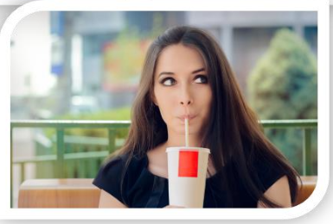
AT WORK DRINKING MOMENT - FACTSHEETS
SIZE
CONSUMERS
At Work is one of the biggest occasion/drinking moment in terms of expenditure
19,4 BN Euro size of the occasion
13,2 % of all occasion in volume
2,6 BN Euro size of the prize
TCC share within the occasion 11,5%
8 to 10 glasses of fluid every day to be properly hydrated
70% of consumers feel it is very important to stay hydrated
Only 40 % of men and 60 % of women are properly hydrated
Almost 50% of consumers are not currently satisfied with beverage choice in the workplace
Motivation: energize, harmony, unwind
Sub –occasions: 58% while working, 31% while taking a break, 11% while eating
When: 8 AM to 8 PM, 86,1% of occasion value
At Work occasion generates the highest value between 11am & 5pm
L
CATEGORIES
CHANNELS
Coffee is the biggest category – 43,6%
Water - 21,7% ,SSD – 14%, Tea – 7,9%
Juice - 6,2%, Diary & Soy – 4,4%
Energy drinks – 2%, Sport drinks – 0,2%
34% of people are looking for large packs to stay refreshed and hydrated
32% of people prefer smaller bottles and cans while taking a break and eating
80% beverages consumed at work are purchased outside of workplace
Companies: 50 -250; 250+
Blue collar – high SSD share, White collar – high water & coffee share
Channels: Organized trade (C&C&B2B) – 4,1%
On The Go & QSR – 2,5%
HORECA (close to working place) – 3,6%
Workplace channel – 2,7%
RTM: DSD, ISD, Full Service Wending, Rental business
Gatekeepers: Owner, Purchasing, HR
L
Localize content with country figures

Slide 3
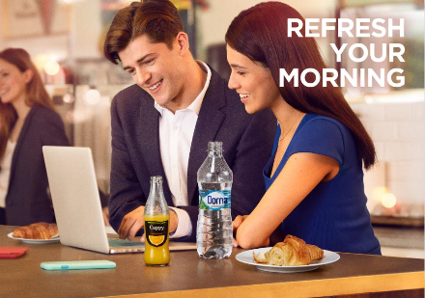
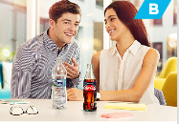
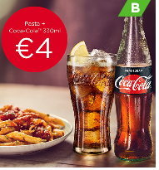
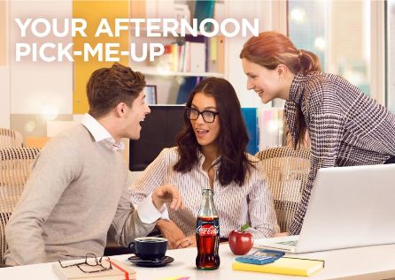
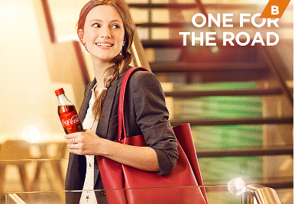
AT WORK ‘WORKPLACE’ - FACTSHEETS
SIZE
CONSUMERS
2,7% of TTL retail value within At Work drinking moments
20,5% of retail value At work occasion
xx BN Euro size of the prize
TCC share within the subchannel xx %
Highest consumption volume during midday (33%)
Most of the volume is consumed while At Work not eating (86%)
Dehydration at work influence decision making and cognitive performance which may contribute to a decline in productivity and could be associated with an work related accidents
Almost 50% of consumers are not currently satisfied with beverage choice in the workplace
L
CATEGORIES
CHANNELS
Tap Water is the no. 1 drink in At Work during midday followed by packaged water & Coffee. Opportunity to grow SSD consumption
Majority Large PETs followed by Small PETs in both
At Work Eating/Not Eating
80% beverages consumed at work are purchased outside of workplace
Companies: 50 -250; 250+
Blue collar – high SSD share, White collar – high water & coffee share
Significant amount of beverages sourced from retail and Cafeteria especially during Work Eating
Cafeteria & vending machines - 22% DM At Work Eating ,
18% DM At Work Not eating
L
Localize content with country figures

Slide 4
AT WORK ‘WORKPLACE’ – SELLING STORY SUMMARY
1. IDENTIFY / SUMMARISE OPPORTUNITY
2. BIG IDEA
At Work is one of the biggest drinking moment in terms of expenditure
2,7% of TTL retail value within At Work drinking moments
20,5% of retail value At work occasion
xx BN Euro size of the prize
TCC share within the subchannel xx %
8 to 10 glasses of fluid are necessary every day
Only 40 % of men and 60 % of women are properly hydrated
Almost 50% of consumers are not currently satisfied with beverage choice in the workplace
Together, we can capture the additional revenue opportunities of “At work” occasion through a joint approach with WINNING PORTFOLIO and
RIGHT ACTIVATION & EQUIPMENT
ACHIEVE GROWTH:
YOU can capture this opportunity with xxx
increased transactions, €xxx incremental revenue and
€xxx Incremental cash margin, by listing our products, equipment and
promo offer to your consumers
3. HOW IT WORKS
4. KEY BENEFITS
Offer the choice and variety with full portfolio through key enabling categories coffee & water
Equipment placement with merchandising principles
Promo offer for end consumers to drive transaction growth
START OF DAY “DRINK DEAL”
MULTI-PURCHASE OFFER
PORTFOLIO PAIRINGS
LUNCH MEAL DEAL
COMBO SNACK DEAL
Increase number of employee who will visit your canteen
Incremental Transactions and Revenue
Increased Cash Profit-Margin xx %
Increased Transaction xx % , € xx
Estimated Annual Profit Increase: €xx , + xx%
Better hydrations drive employees productivity
5. CLOSE
Summarise Key Points
Agree listings , equipment placement with delivery date, promo offer with date of activation Delivery Date
Listen, Wait & Close!
Compete the Order

Slide 5
v
v
FULL SELLING STORY
Workplace
v

Slide 6
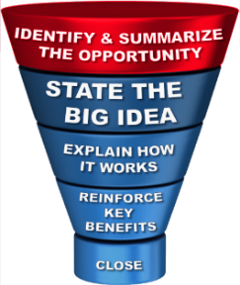
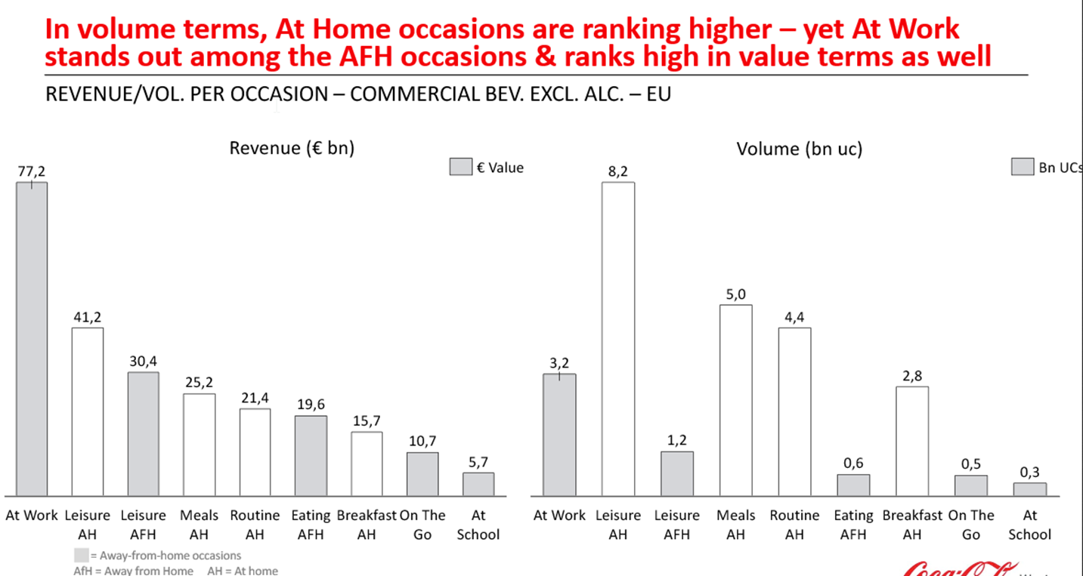
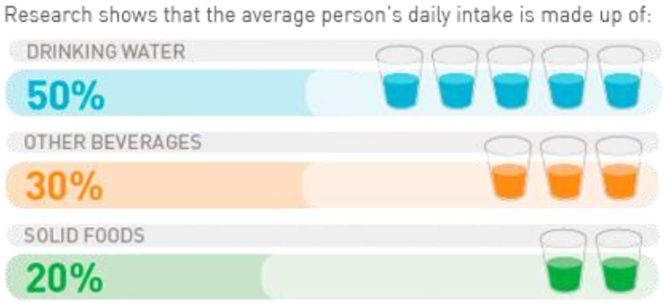
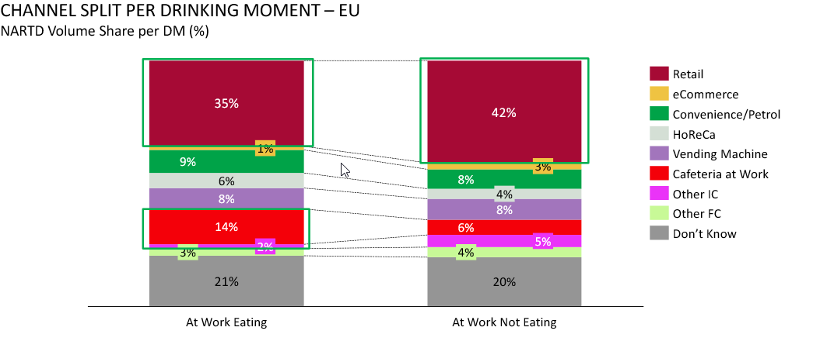
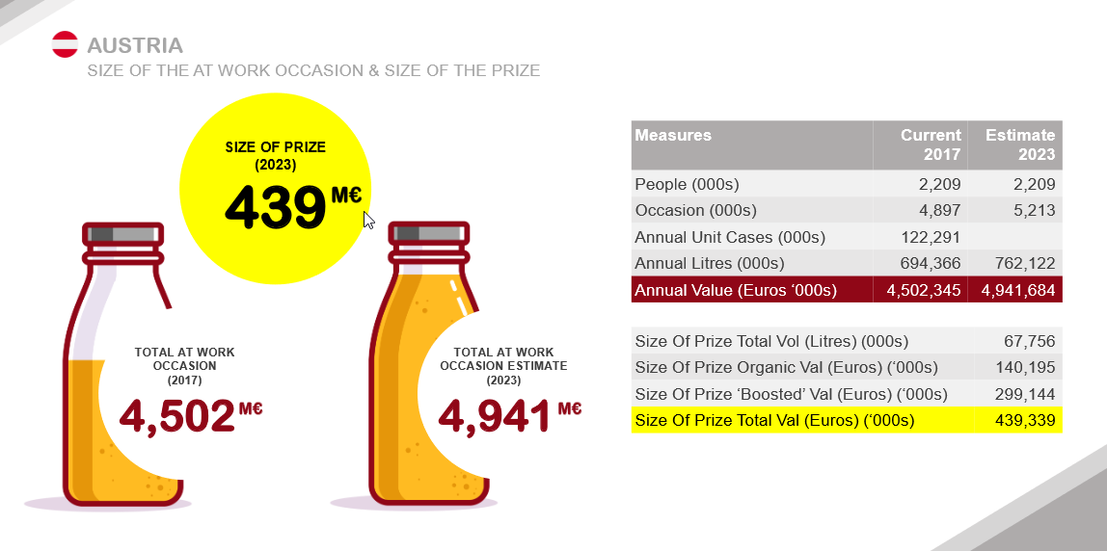
AT WORK OPPORTUNITIES
AT WORK IS THE BIGGEST REVENUE OPPORTUNITY
DEHYDRATION CAN INFLUENCE PHYSICAL & MENTAL PERFORMANCE
L
MOST OF BEVERAGES ARE BOUGHT OUTSIDE THE WORKPLACE
SIZE OF THE PRIZE
L
Localize content with country figures

Slide 7
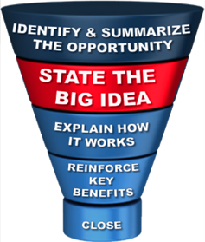
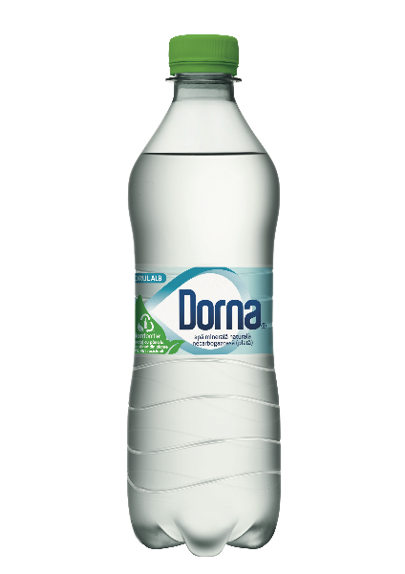
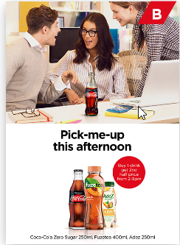
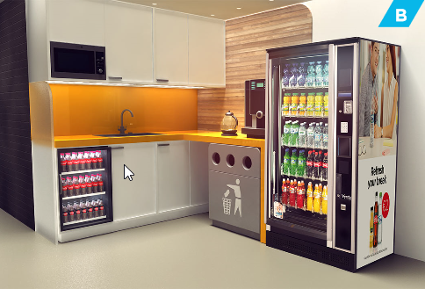
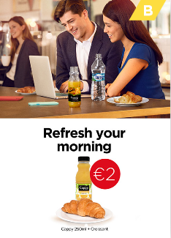
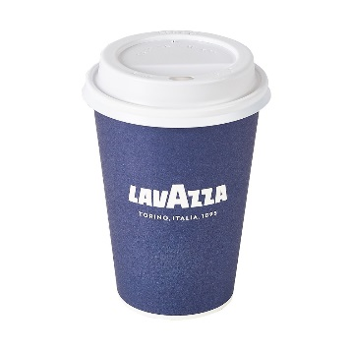
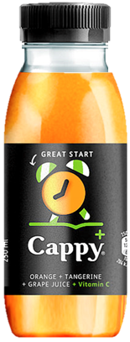
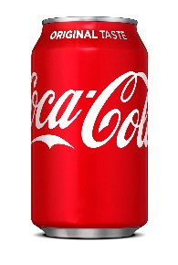
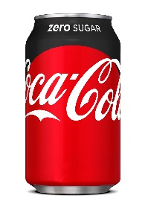
THE BIG IDEA
Together, we can capture the additional revenue opportunities of “At work” occasion through a joint approach:
WINNING PORTFOLIO
RIGHT ACTIVATION & EQUIPMENT
Choice & Availability to drive satisfaction and consumption
Offering to drive incidence of beverages and increase transactions & revenue
L
L
EXAMPLES
With our assortment presence we will drive consumer consumption which will increase your profit for xx% and bring you XX Euro annually
With the installation of our cooler, we will grow your sales adding incremental revenue of XX% over the next year which will bring you additional XX Euro
L
Localize content with country figures

Slide 8
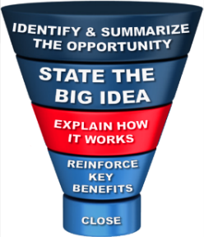
HOW IT WORKS - PORTFOLIO
Right portfolio choice (categories & flavors) will cover different needs throughout the day and will drive traffic, incremental transactions & revenues
Range
White Collar
L
Range
Blue Collar
L
L
Localize content with country figures

Slide 9
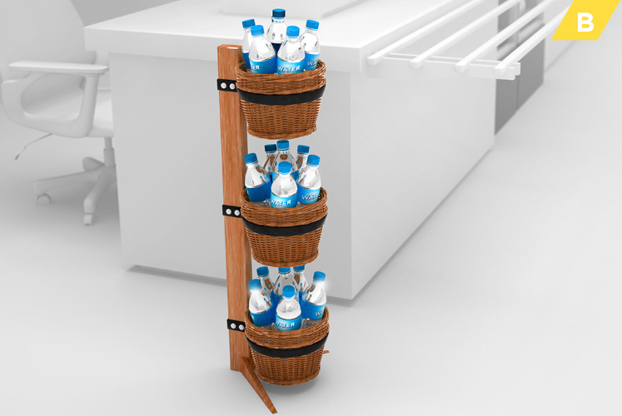
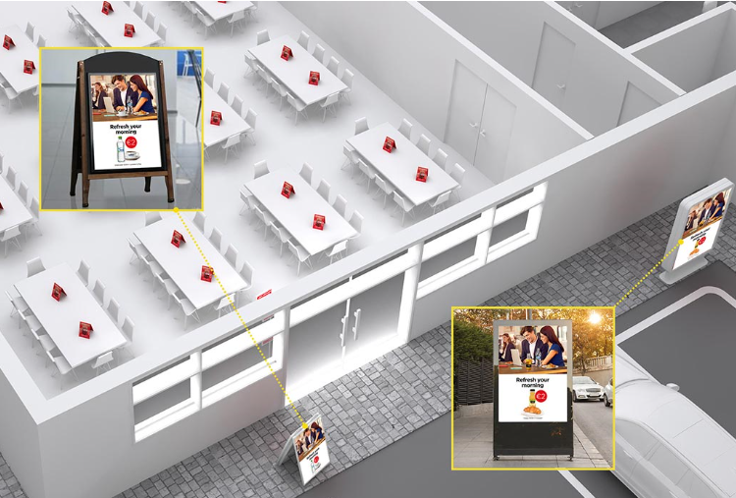
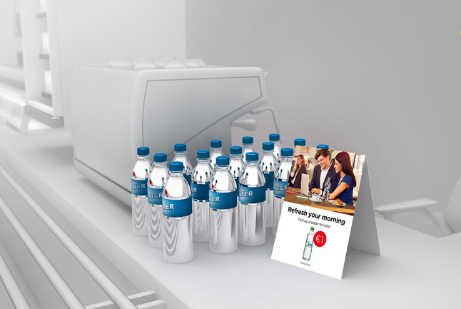
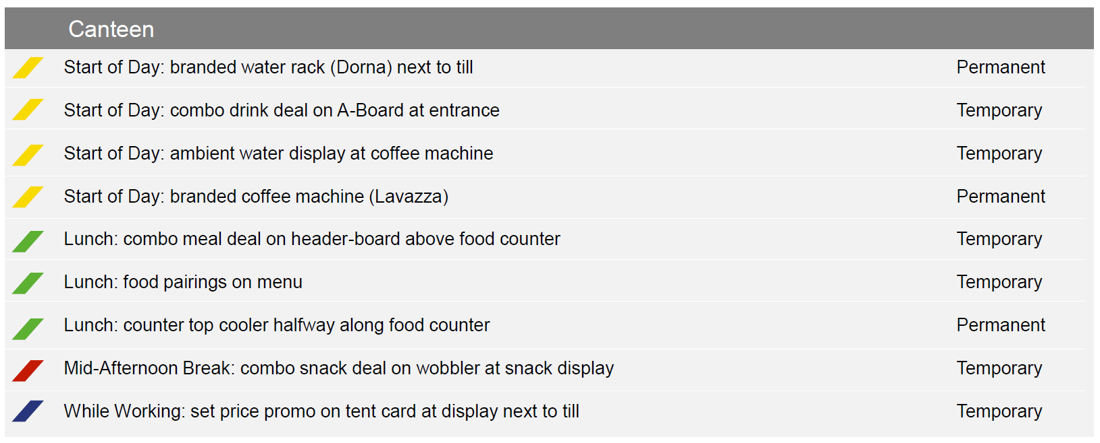
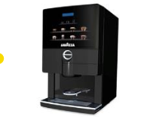
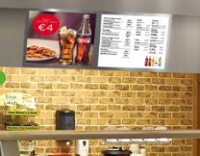
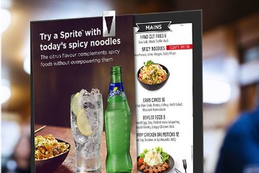
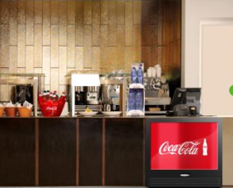
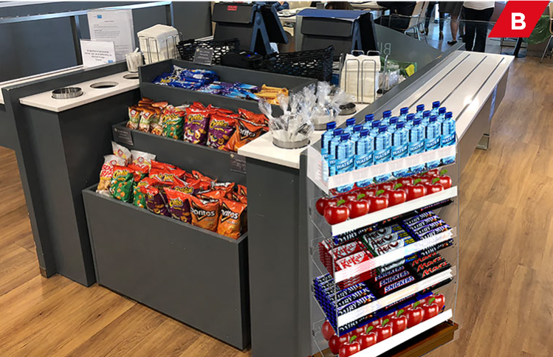
HOW IT WORKS – RIGHT ACTIVATION & EQUIPMENT
Merchandising & Equipment Examples
Canteen Picture of Success - Touchpoints
Branded water rack
next to till
Combo drink deal on
A-board at entrance
Ambient water display
at coffee machine
Branded coffee machine (Lavazza)
Combo meal on header-board above food counter
Food Pairings
on menu
Counter top cooler halfway along food counter
Combo snack deal on wobbler at snack display
Set promo price on tent card at display next to till

Slide 10
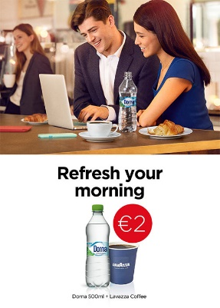
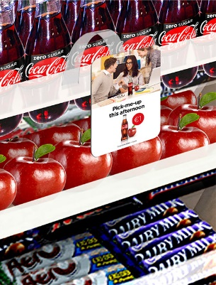
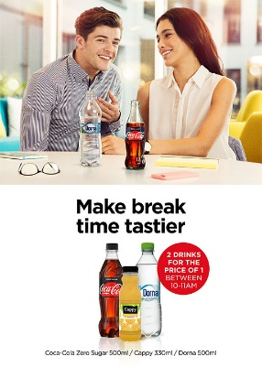
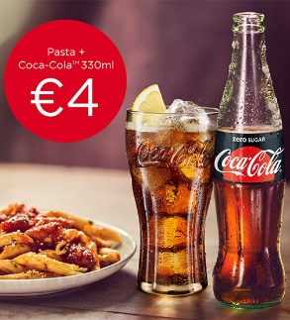
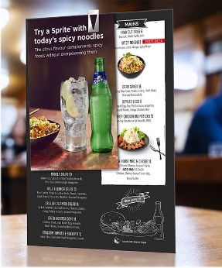
HOW IT WORKS – PROMO OFFERS
Examples throughout the day
START OF DAY “DRINK DEAL” Hot drink (coffee/tea) with chilled drink (juice/water) for set price to encourage 'one for now, one for later’.
Benefit: Greater spend per head.
COMBO SNACK DEAL Snack and drink combo for set price.
Benefit: Convenience and availability drives incidence.
MULTI-PURCHASE OFFER 2 for 1/ 3 for 2 offer on drinks purchased between 10:00-11:00.
Benefit: Increase frequency of consumption.
LUNCH MEAL DEAL Drink with lunch dish for set price.
Benefit: Convenience drives
purchase and food & drink association.
PORTFOLIO PAIRINGS Suggestion of portfolio drink pairings next to specific lunch items on menu.
Benefit: Drive association of food and drink.

Slide 11
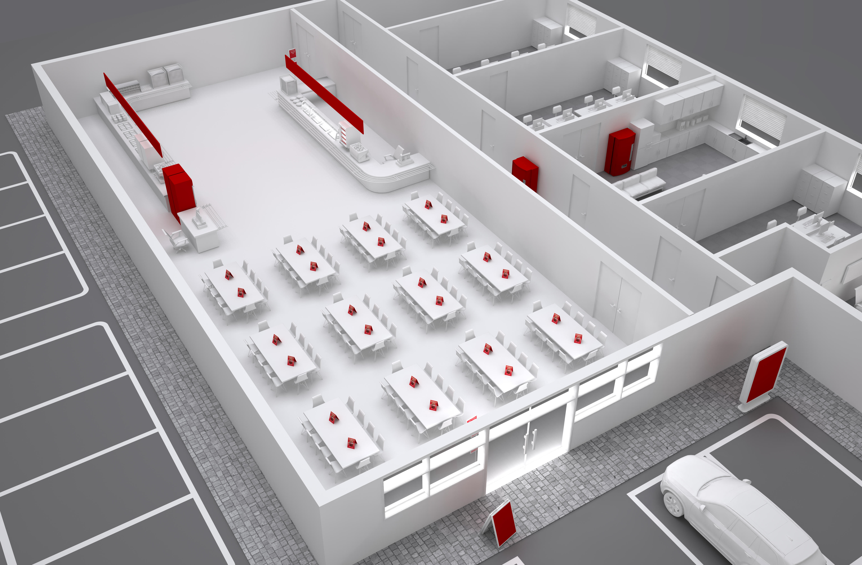
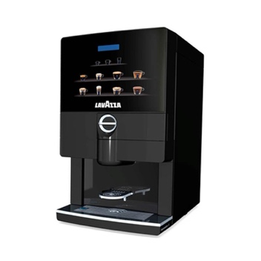
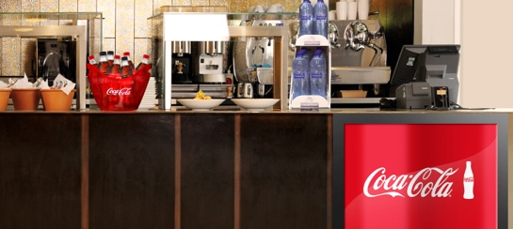
HOW IT WORKS – OPTIMUM PLACEMENT

Slide 12
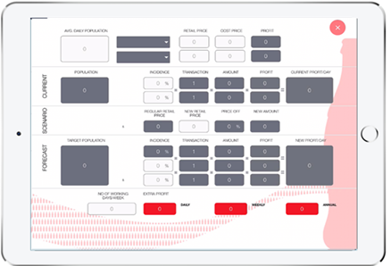
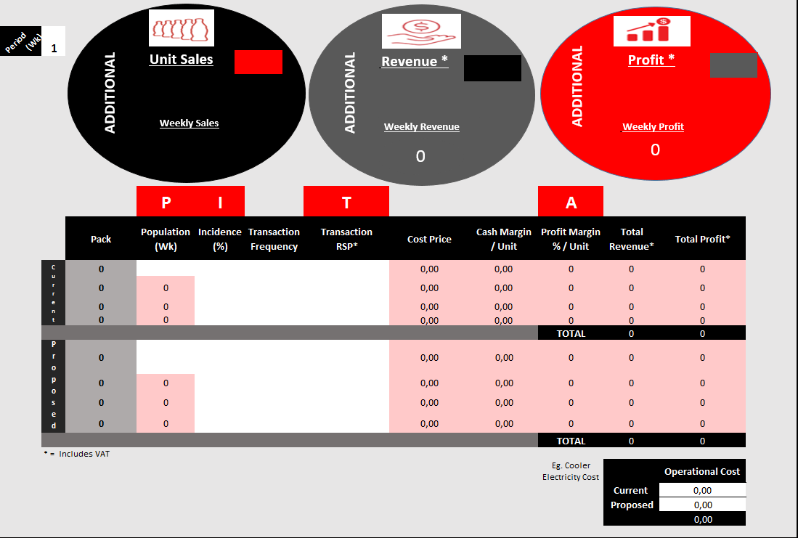
HOW IT WORKS – PROFIT STORY
Leverage profit story tool to show the customer the profit opportunity by: - Assortment listing - Equipment placement - Consumer promotion

Slide 13
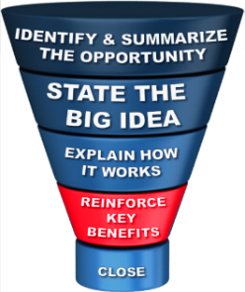
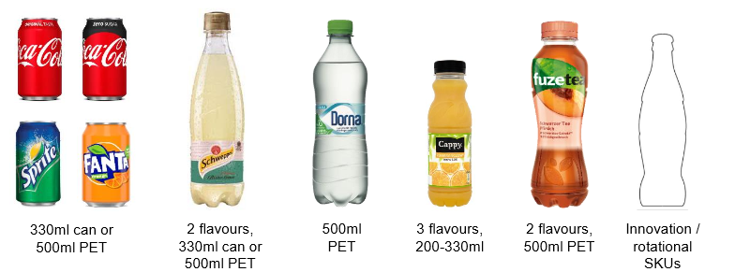
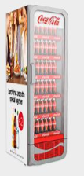
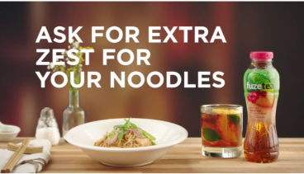
REINFORCE KEY BENEFITS
ASSORTMENT:
Share of profitable categories (SSD, Coffee, Juices) will increase annual profit by XX Euro
Increase transactions by XX%
COOLER PLACEMENT:
First placed door: + XX % (+xxx Eur)
Additional cooler door bring sales incremental of x % to x %
PROMO OFFERS :
Increase Annual Profits by, potentially XX € , XX%

Slide 14
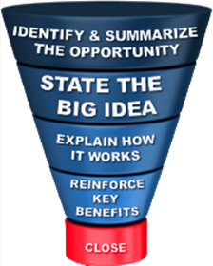
CLOSE THE DEAL
When we will sign the contract
When we will deliver the cooler in the outlet
What/when the order will be place
When we will activate the promo offer

