Slide 1
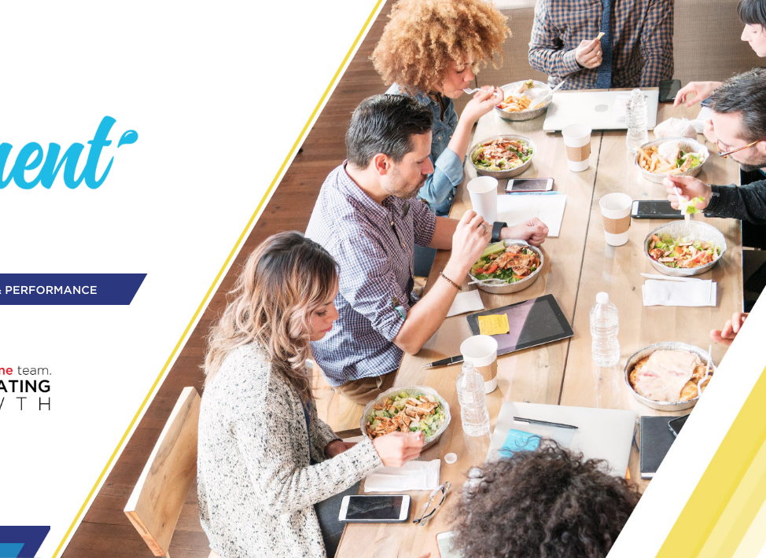



v
v
CUSTOMER SELL IN
Canteen Providers
v
Insert Customer’s logo

Slide 2
CUSTOMER SELL IN – CANTEEN PROVIDERS
TIPS BEFORE YOU START!
1
Foster Customer and our logo:
In opening page and across template
Put customer logo first
2
Be simple and concise:
In this deck you will find many examples for inspiration purpose. Each and every selling story is unique, focus on your objective, and based on that, craft the story.
3
Open with clear agenda:
How to unlock the potential?
Let’s bring it to life together – proposal for Customer XYZ
4
Follow up!:
Once activated, track results, present the findings
Remind the Customer - build your future stories on successful practices from the past

Slide 3
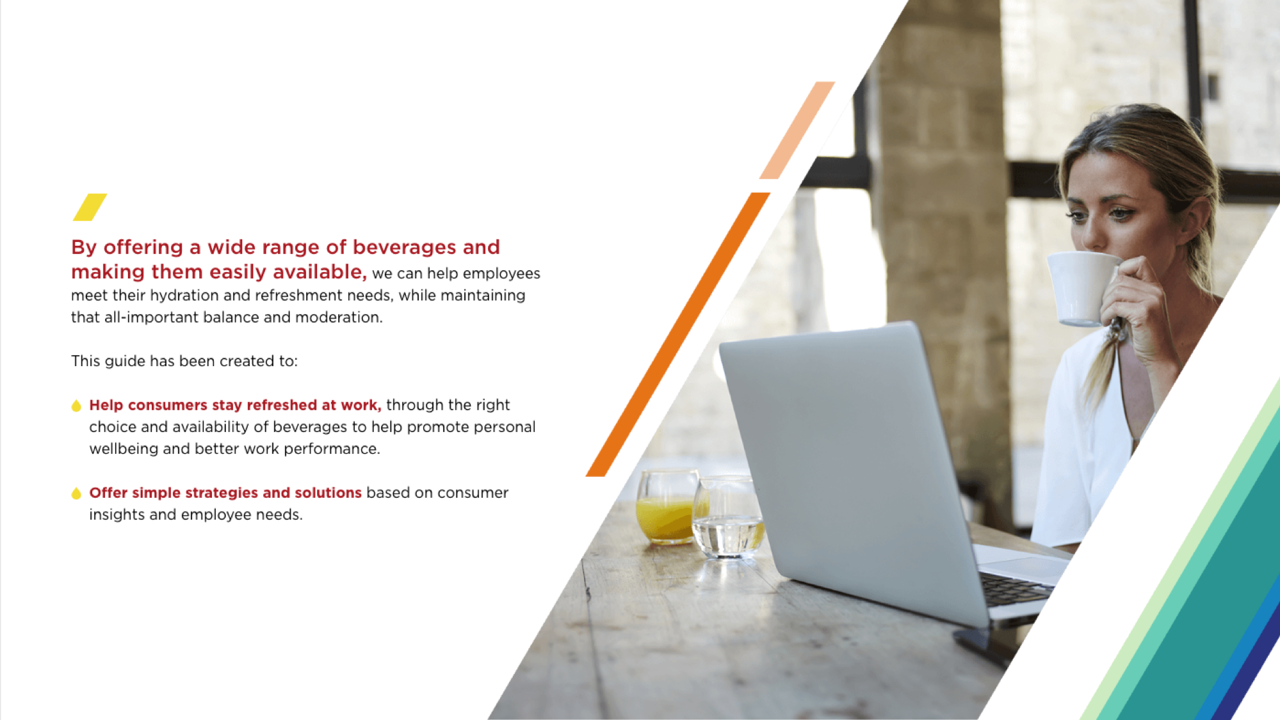
“AT WORK” IS OUR 2ND LARGEST OUT OF HOME DRINKING MOMENT IN VALUE
Value Share AH Occasions
Volume Share AH Occasions
19%
Value Share OOH Occasions
Volume Share OOH Occasions
17%
15%
15%
13%
13%
12%
10%
10%
9%
7%
7%
6%
6%
6%
5%
4%
3%
4%
3%
2%
2%
3%
3%
1%
2%
1%
1%
At School
On the Go
Physical Activity AFH
Socializing at Home
Snack time
Breakfast
Routine Habits at Home
My Moment at Home
Hanging Out
Screen Time
Eating Out
At Work
Meals at Home
Drinking Out
Drinking Moments in Value – Central Eastern Europe (CEE)
AH: At Home
OOH: Out of Home

Slide 4

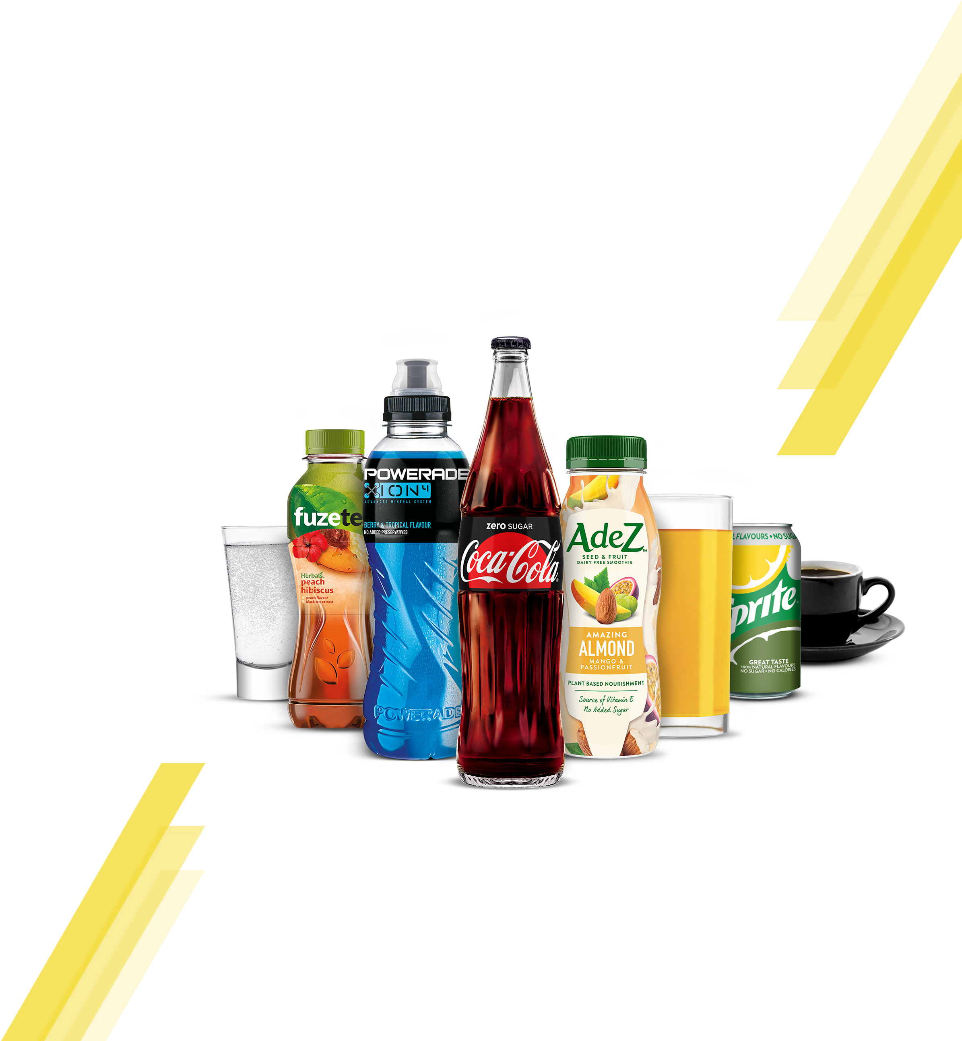
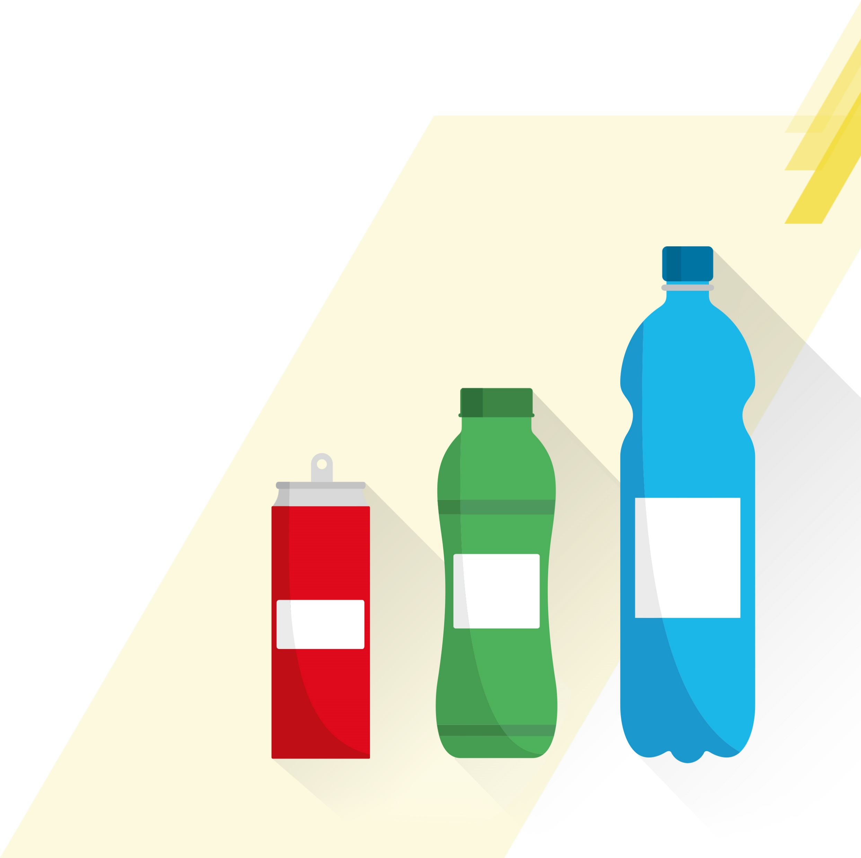
STAYING HYDRATED AT WORK IS VITAL TO OUR WELLBEING AND ABILITY TO PERFORM TASKS SAFELY AND EFFICIENTLY. ITS ESSENTIAL TO OFFER A BALANCED RANGE OF DRINKS IN THE RIGHT OPTIONS TO MEET EMPLOYEE NEEDS
We need 8 to 10
glasses of fluid
every day to be
properly hydrated
70% of consumers feel it
is very important to stay hydrated during the day
at the workplace
‘At work drinkers’ are
looking for increased
variety within
the category
60% of employees are currently not satisfied
with their beverage offer
@ Work
If water is the only option available, consumers
can get bored and not
drink enough
Choice & availability
can drive satisfaction
& consumption
Soft drinks at 10%
daily consumption
although only
available In
50% sites
Consumers stress
the importance of
health-conscious,
natural, sugar-free
and organic drinks
that are rich in vitamins
and energy

Slide 5
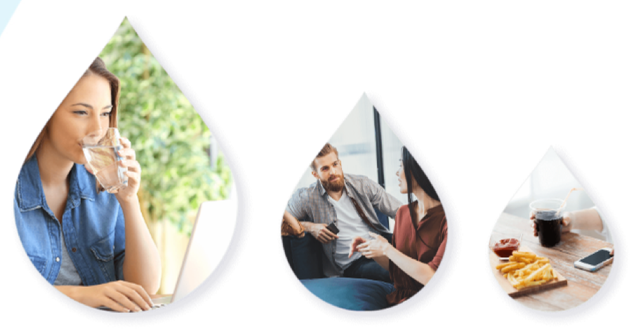
CONSUMERS OFTEN HAVE VERY DIFFERENT NEEDS FROM BEVERAGES ACROSS ‘AT WORK’ SUB‑OCCASIONS AND IT IS IMPORTANT TO OFFER A BROAD RANGE OF CATEGORIES AND PACKS TO FULLY SATISFY THEIR NEEDS
Focus on ‘while working’ & ‘while taking a break’ that account for 89% of consumption, rather than just on ‘while eating’
The more choice of beverages and the more they are easily available, then the higher the consumption
8AM TO 8PM DRINKING MOMENT
Coffee
43.6%
Opportunity
SSDs
Tea
Juices
Plant Based Dairies
Energy
Water
21.7%
SSDs
14%
WHILE
WORKING
WHILE TAKING
A BREAK
WHILE
EATING
58%
31%
11%
Opportunity

Slide 6





ALTHOUGH PEOPLE DO DRINK WHEN AT WORK, ONLY 1 OUT OF 5 BEVERAGES ARE BOUGHT ON PREMISE, AS EMPLOYEES ARE NOT HAPPY WITH THE BEVERAGE CHOICE
IN THE WORKPLACE
ALMOST
1/2
80%
Beverages consumed
at work are purchased outside of the workplace
Of consumers are not currently satisfied with
the beverage choice in
the workplace.
Beverage Purchase
Country Weight
Organised Trade
KIOKS
& Petrol
QSR
(Fast Food)
HORECA
Workplace
Total
100.0%
31.4%
9.7%
8.8%
25.4%
20.5%

Slide 7
BY ADDING ONE MORE DRINK PER WEEK WE HAVE AN OPPORTUNITY TO CAPTURE €25MN REVENUE
EXAMPLE FOR SWISS MARKET
EXAMPLE FOR SWISS MARKET
SIZE OF THE AT WORK OCCASION & SIZE OF THE PRIZE
SIZE OF THE AT WORK OCCASION & SIZE OF THE PRIZE
€340 MN
€25 MN
16.2%
Value of DM
Size of prize
(2023)
TCCC category
value share
NOTE
NOTE
VALUE OF DM IS ACTUALIZED 2017
AND SIZE OF THE PRIZE AS PER CATEGORY VISION CALCULATION TO YEAR 2023
VALUE OF DM IS ACTUALIZED 2017
AND SIZE OF THE PRIZE AS PER CATEGORY VISION CALCULATION TO YEAR 2023
Source: CBL, IE, Unmet Beverage Needs At Work research
Note to markets: Insert local data to calculate size of prize

Slide 8
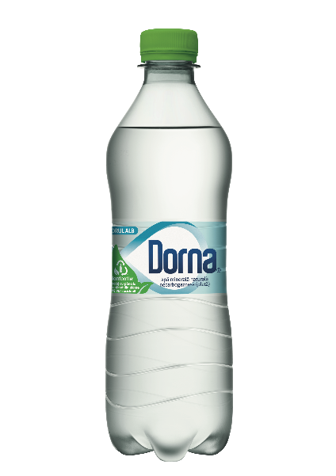
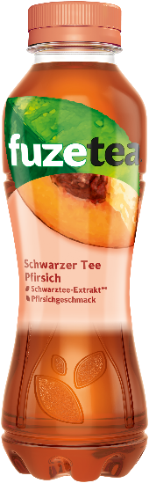
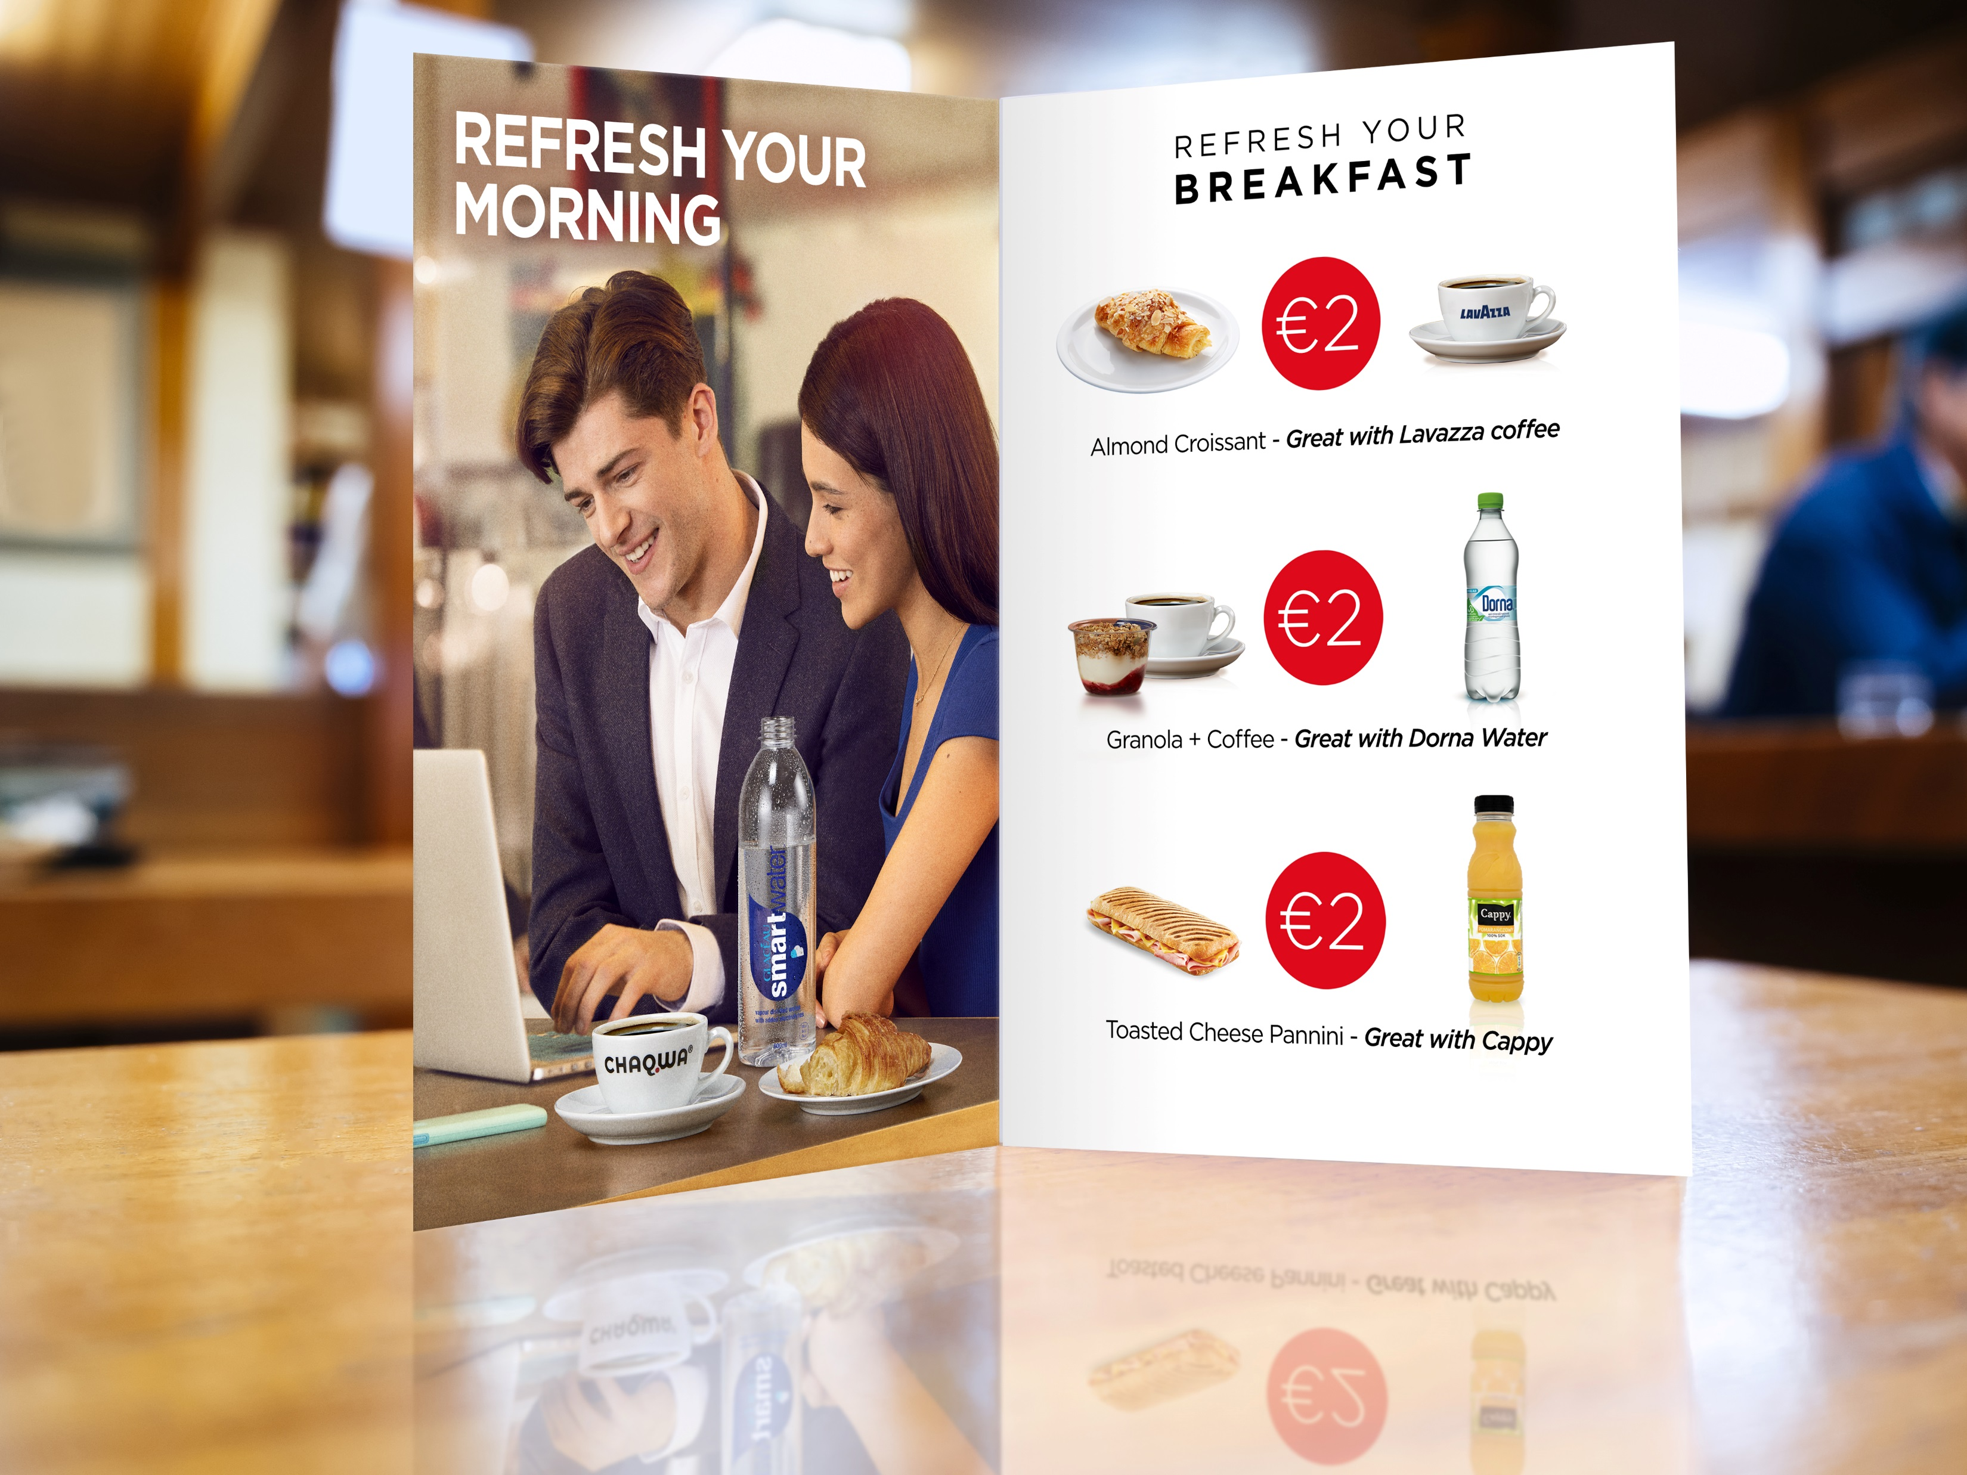
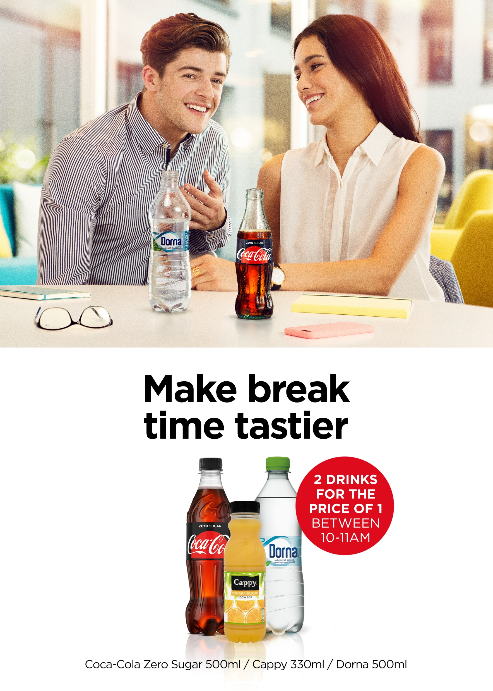
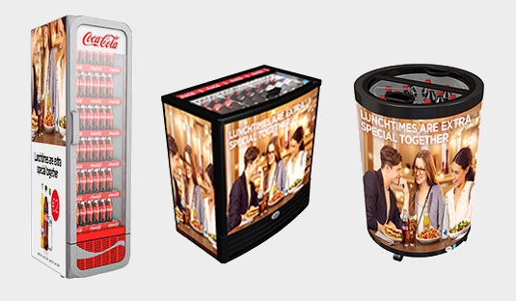
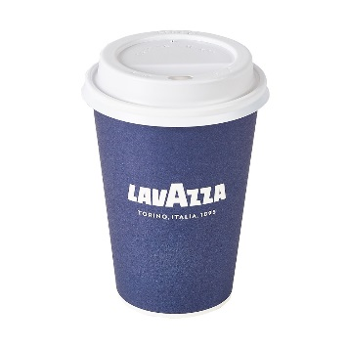
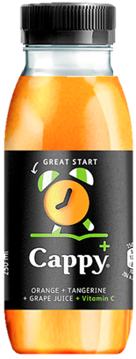
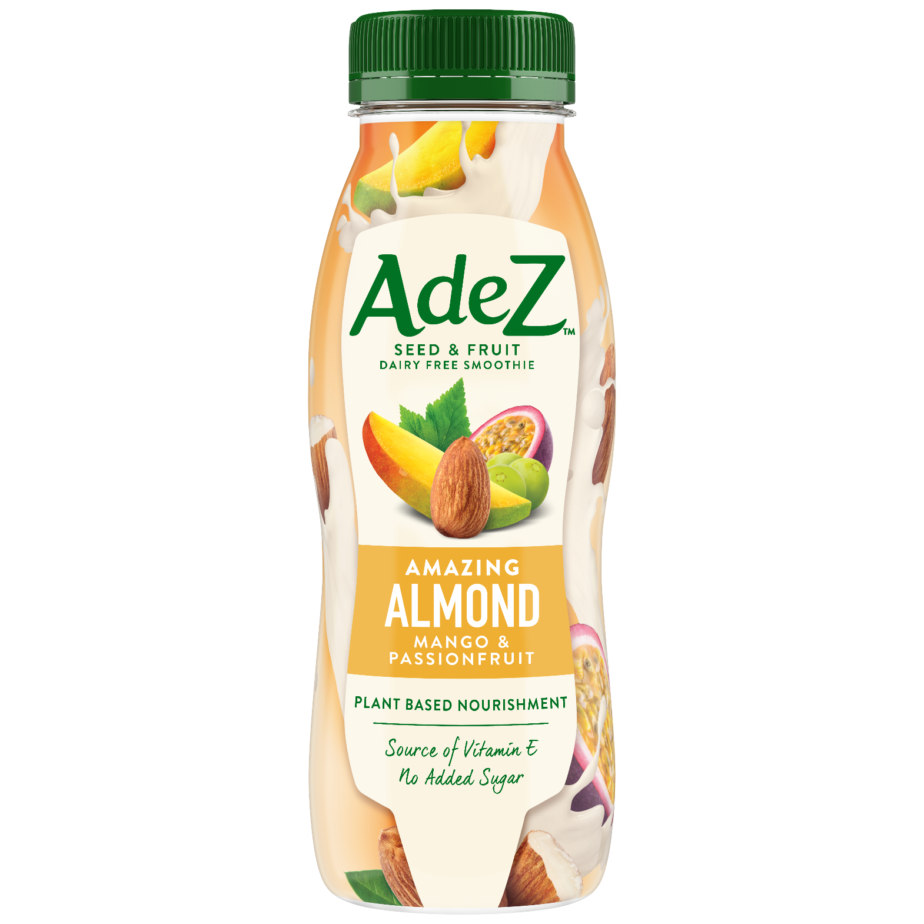
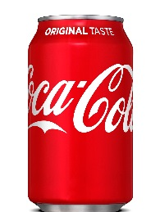

TOGETHER, WE CAN CAPTURE THE ADDITIONAL REVENUE OPPORTUNITY FROM THE ‘AT WORK’ OCCASION THROUGH A JOINT STRATEGIC APPROACH
1
2
WINNING
PORTFOLIO
Choice & availability to drive satisfaction and consumption
RIGHT ACTIVATION
& EQUIPMENT
Offering to drive incidence
of beverages and increase transactions & revenue
Note to markets: Insert local data to calculate size of prize

Slide 9
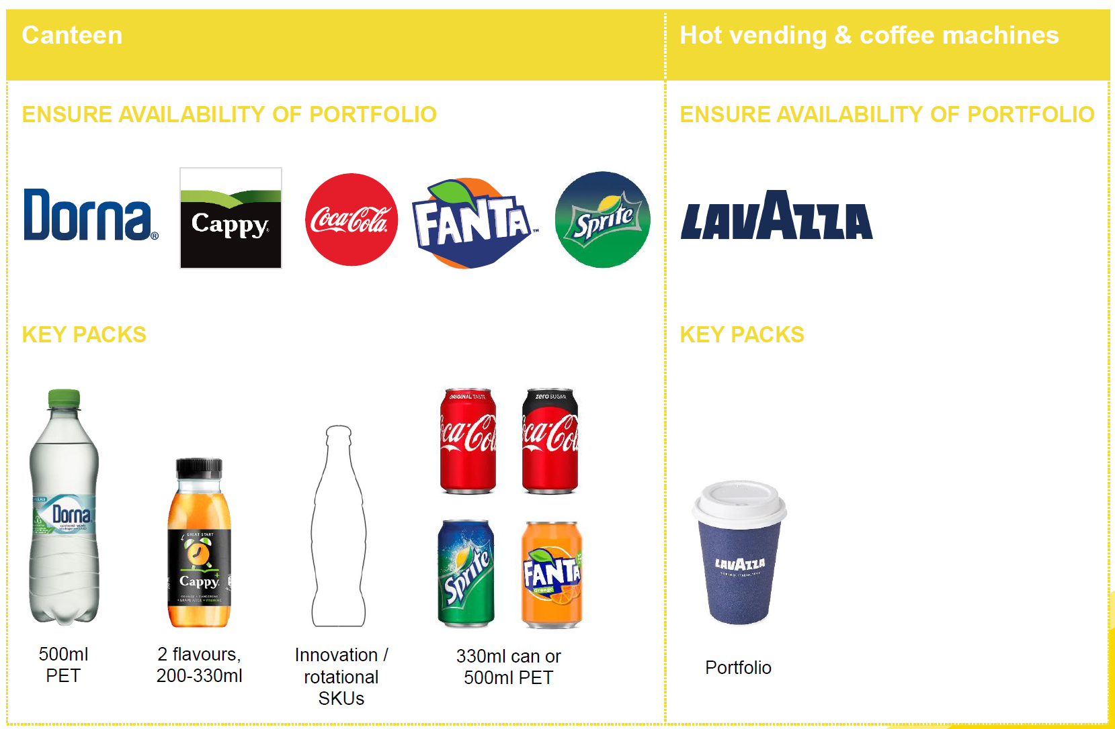
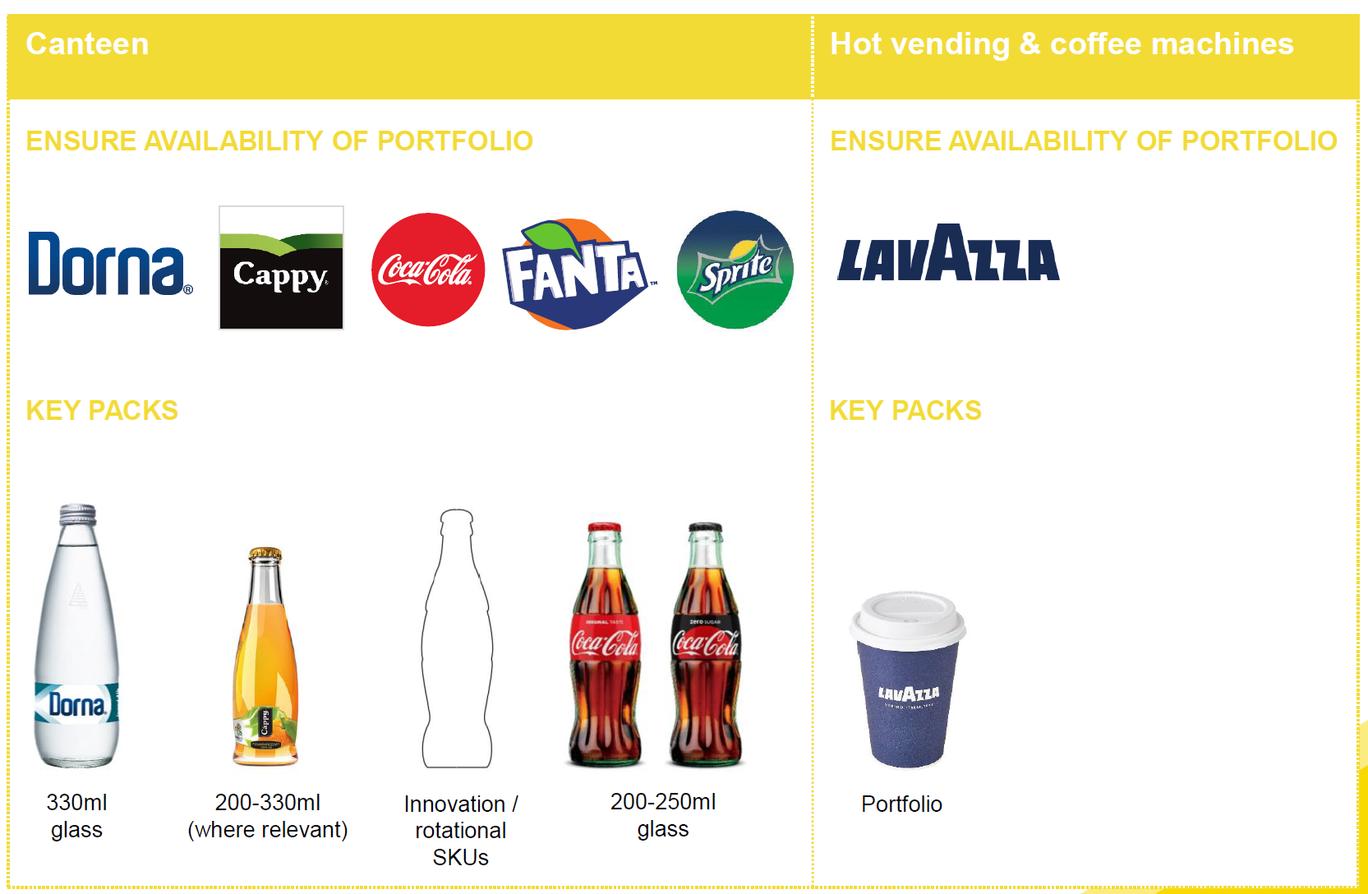
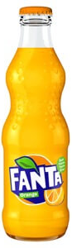
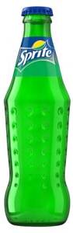
1
WINNING
PORTFOLIO
RIGHT PORTFOLIO CHOICE (CATEGORIES & FLAVORS) WILL COVER DIFFERENT NEEDS THROUGHOUT THE DAY AND WILL DRIVE TRAFFIC, INCREMENTAL TRANSACTIONS & REVENUE
ENABLING CATEGORIES
RANGE
WHITE COLLAR
COFFEE
WATER
Portfolio
330ml glass
200-300ml (where relevant)
Innovation / rotational SKUs
200-250ml glass
ENABLING CATEGORIES
COFFEE
RANGE
BLUE COLLAR
WATER
Portfolio
500ml PET
2 flavors, 200-330ml
Innovation / rotational SKUs
330ml can or 500ml PET
Note to markets: Replace with country specific product & pack portfolio

Slide 10
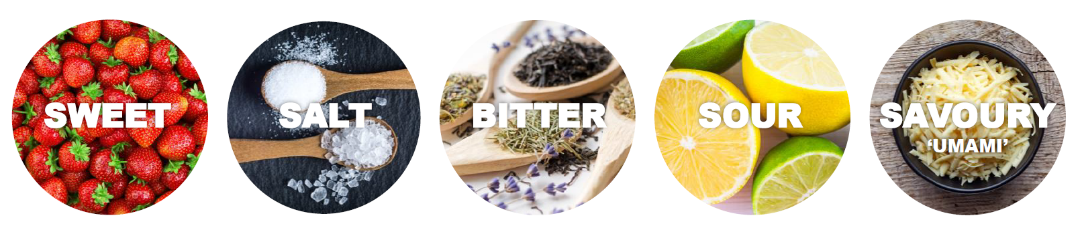
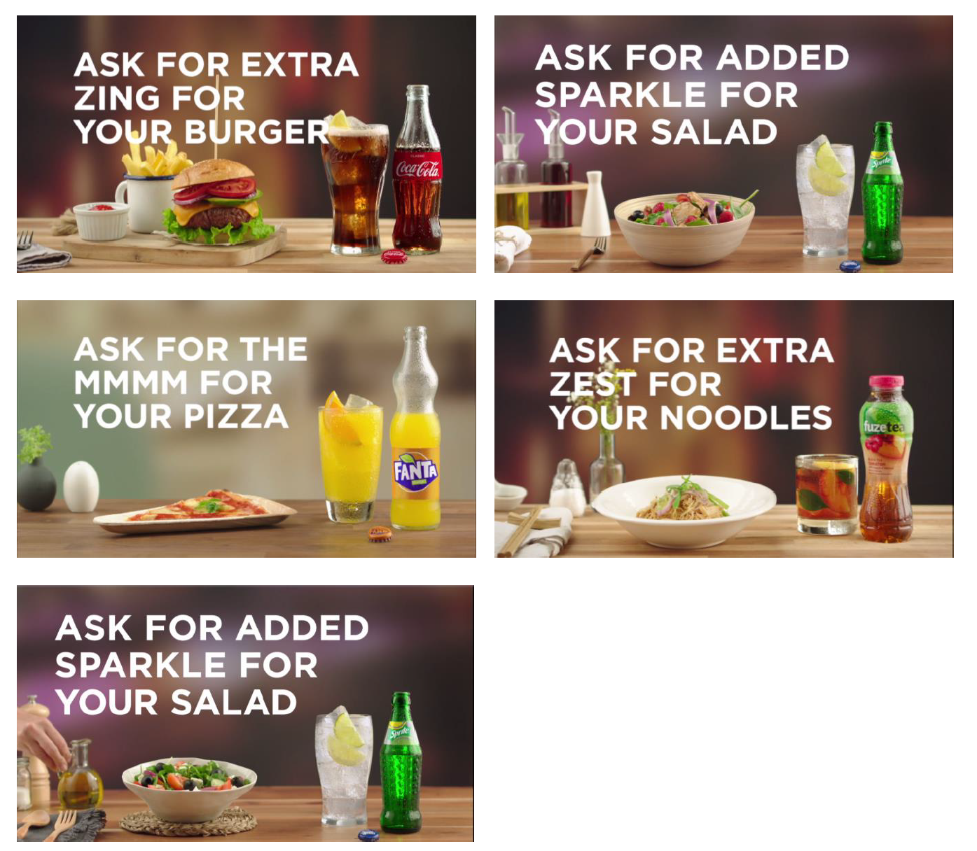
1
WINNING
PORTFOLIO
PAIRING BEVERAGES WITH FOOD WILL HELP INCREASE EMPLOYEE SATISFACTION, BEVERAGE INCIDENCE AND REVENUE, WHILST DELIVERING AN ENHANCED MEAL EXPERIENCE
Sensory receptors in our mouth detect five basic tastes:
In biting and chewing our food, we experience texture, freshness and pungency. However, on average only 20% of our experience is derived from taste and touch with as much as 80% of what we experience as taste driven by the aromas we detect through our sense of smell.
The right food and beverage combinations can enhance the experience by either mirroring similar flavour characteristics or contrasting flavours to bring out the best in both.
The right beverages should be displayed WITH FOOD and when food is served (Examples).
EXAMPLES OF FOOD PAIRING:

Slide 11
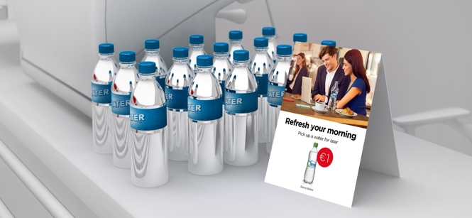
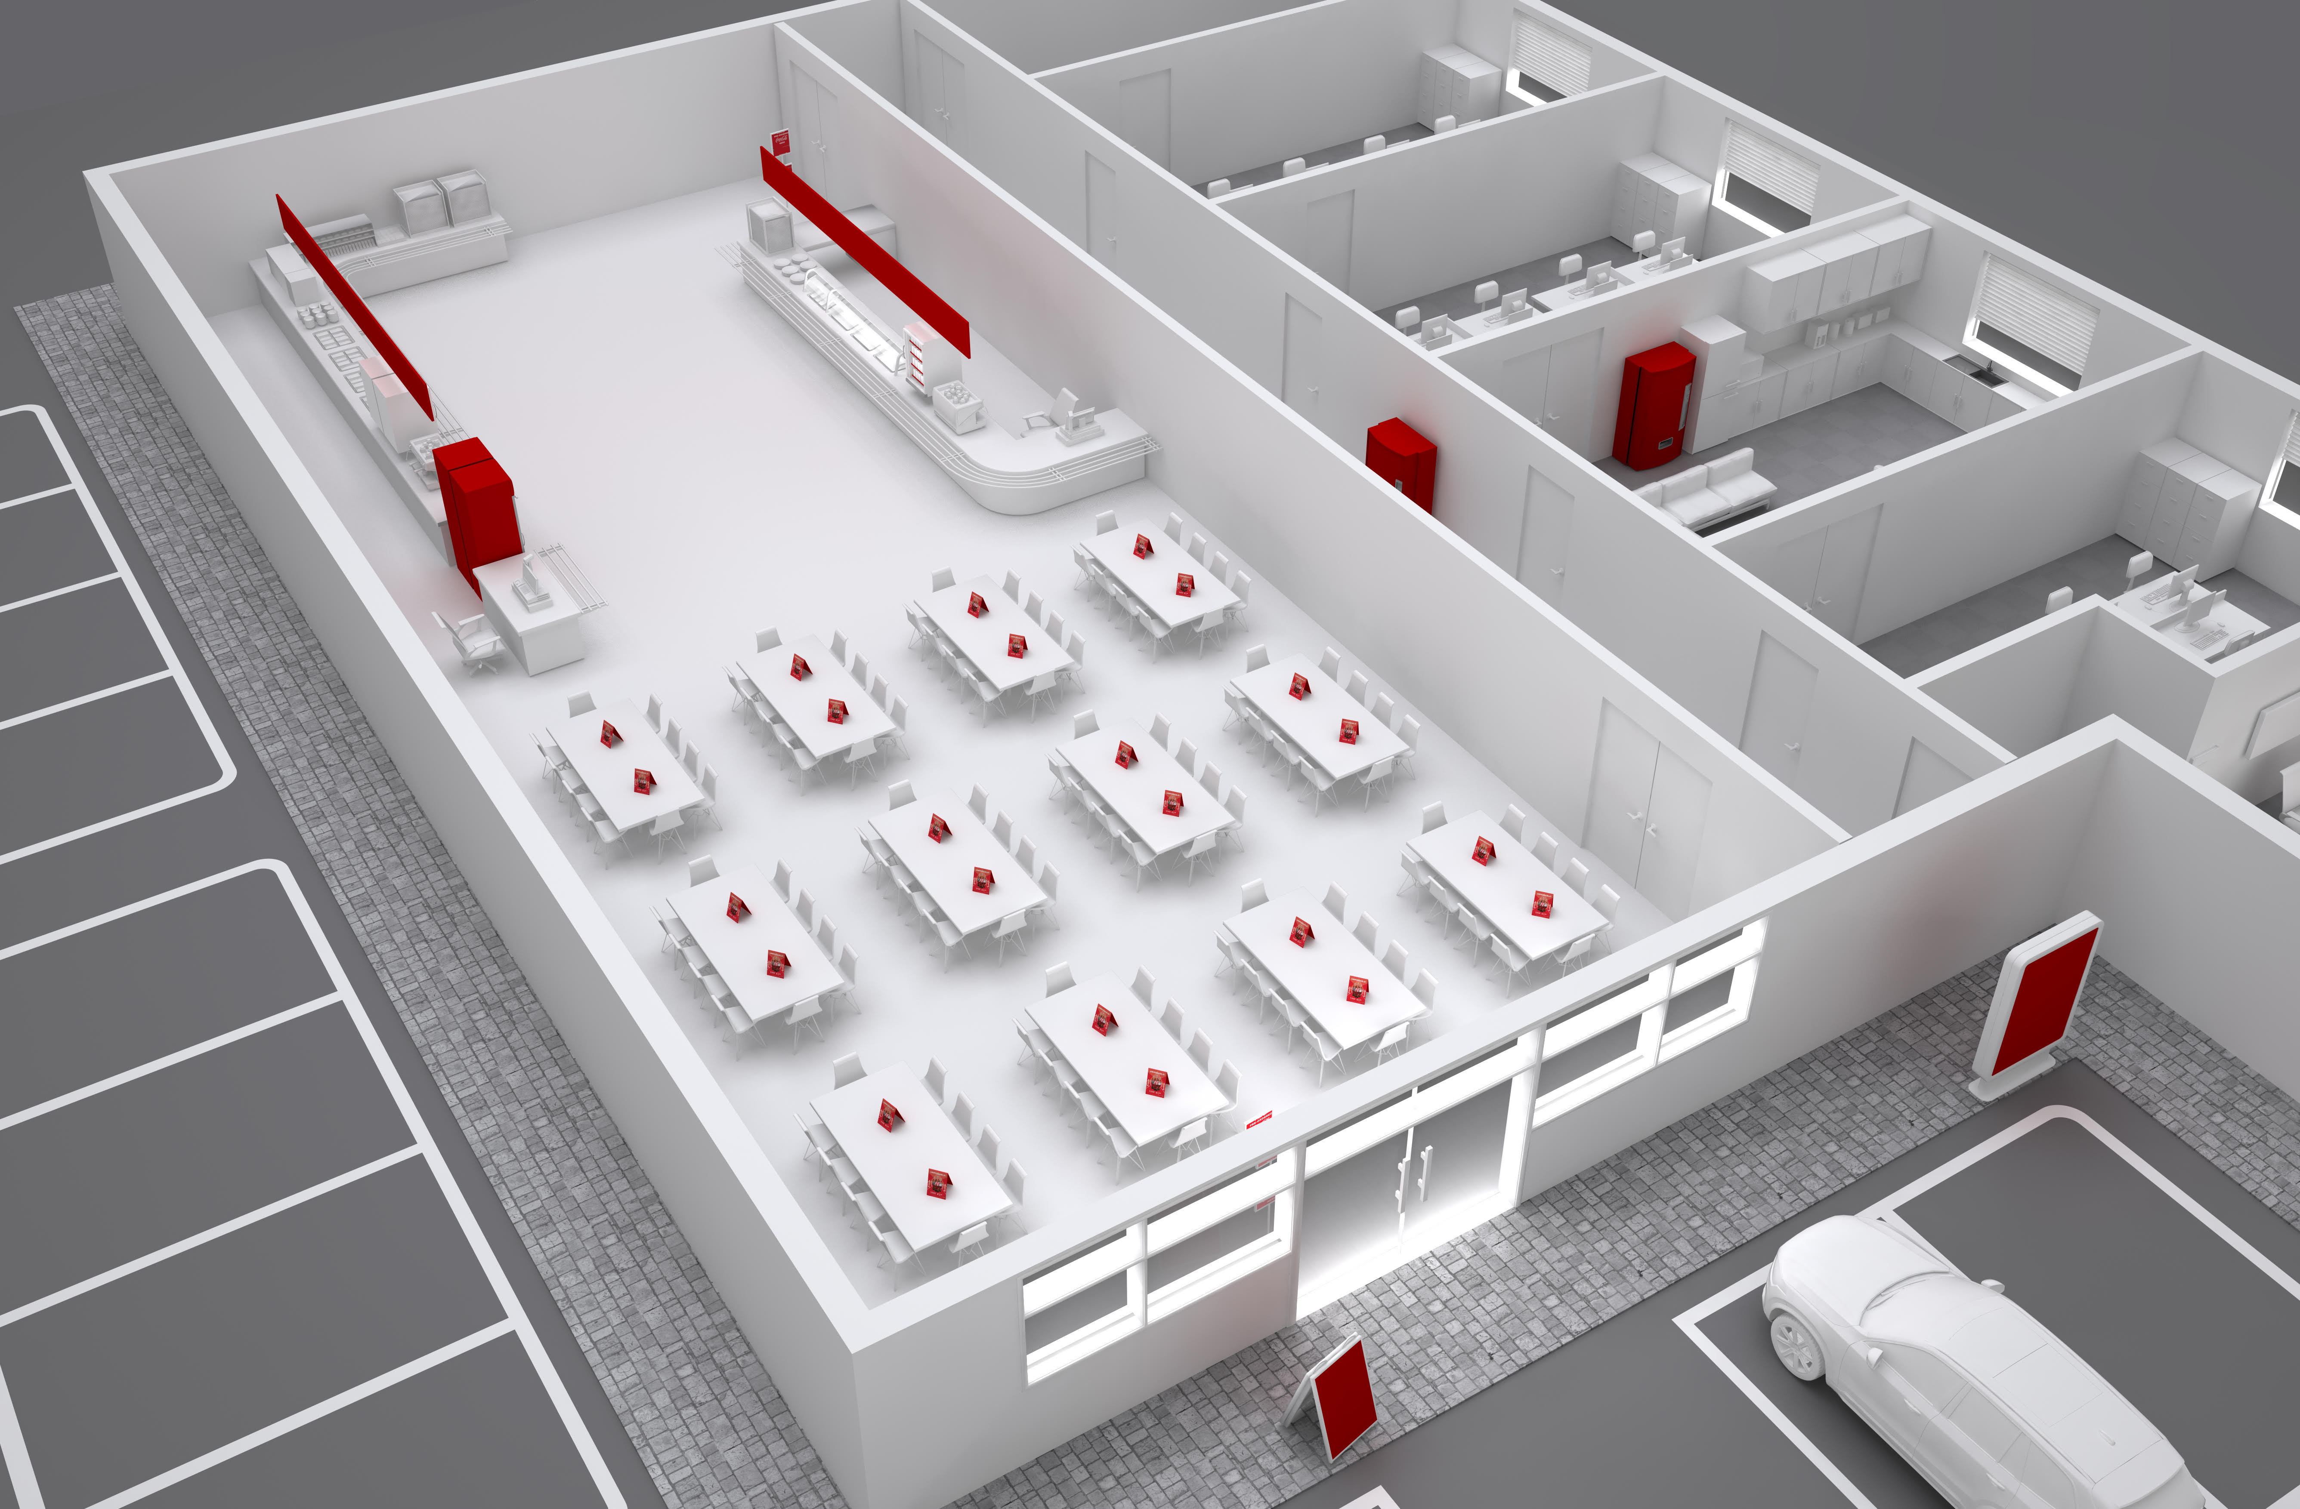
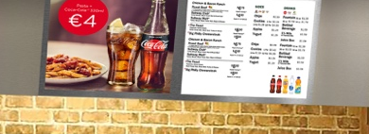
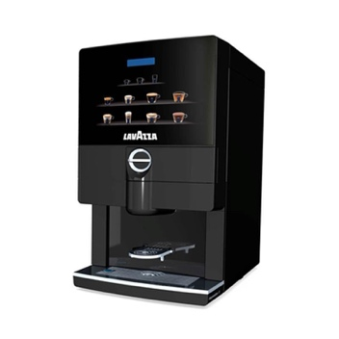
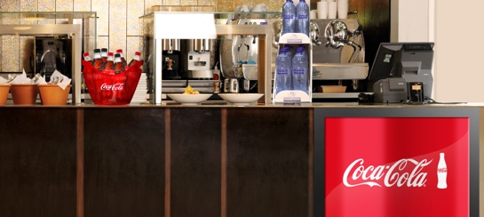
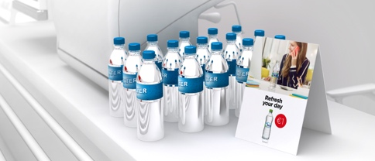
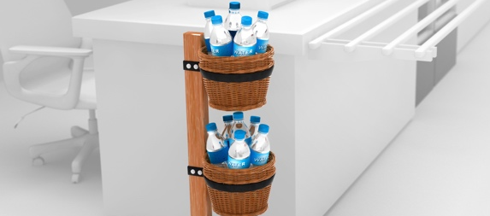
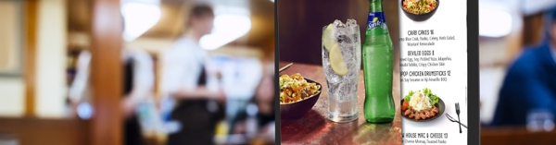
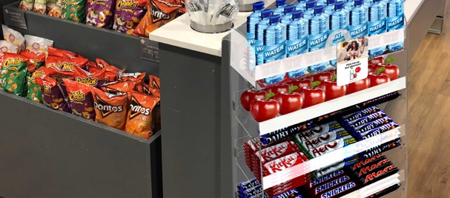
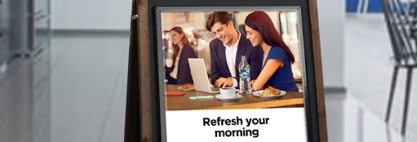
2
RIGHT
ACTIVATION
EQUIPMENT
THE RIGHT ACTIVATION THROUGHOUT THE DAY TARGETING ALL SUB-OCCASIONS WILL DRIVE INCIDENCE OF BEVERAGES, FREQUENCY OF PURCHASE, TRANSACTIONS AND REVENUE
Note to markets: Replace pictures with real merchandising & equipment solutions available in your market

Slide 12
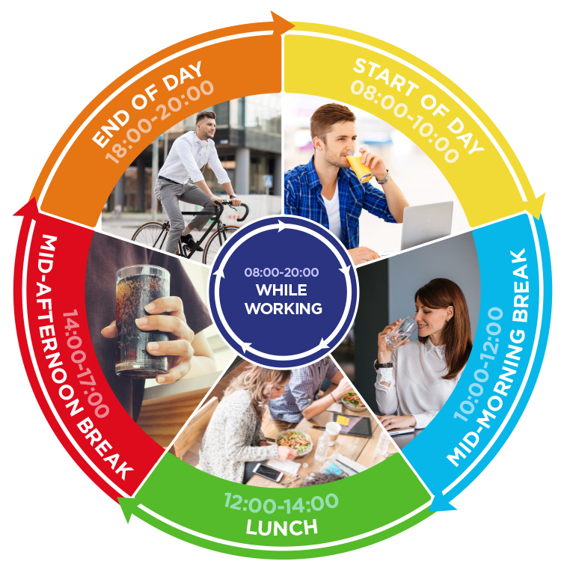
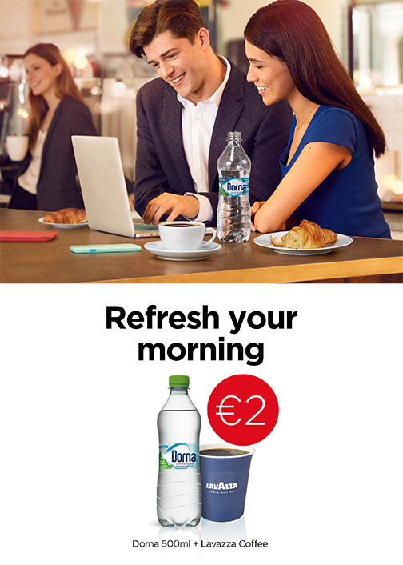
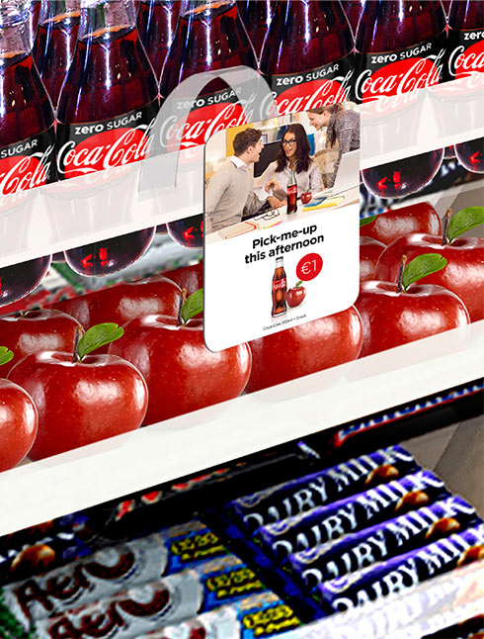

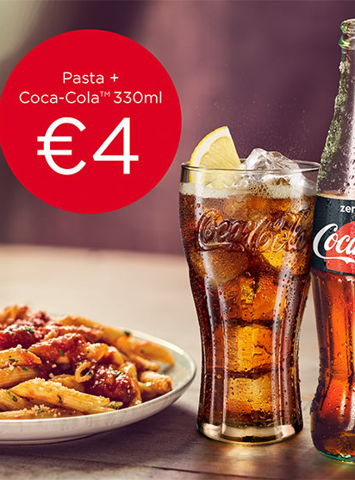
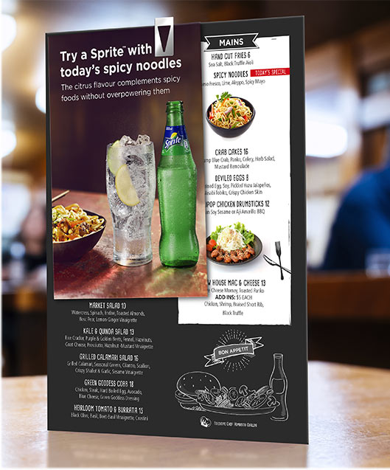
2
RIGHT
ACTIVATION
EQUIPMENT
THE RIGHT ACTIVATION THROUGHOUT THE DAY TARGETING ALL SUB-OCCASIONS WILL DRIVE INCIDENCE OF BEVERAGES, FREQUENCY OF PURCHASE, TRANSACTIONS AND REVENUE
PROMOTIONAL OFFER EXAMPLE THROUGHOUT THE DAY
START OF DAY “DRINK DEAL”
Hot drink (coffee/tea) with chilled drink (juice/water) for set price to encourage ‘1 for now, 1 for later’.
Benefit: Greater spend per head.
COMBO SNACK DEAL
Snack and drink combo for set price.
Benefit: Convenience and availability drives incidence.
MULTI-PURCHASE OFFER
2 for 1/ 3 for 2 offer on drinks purchased between 10:00-11:00.
Benefit: Increase frequency
of consumption.
LUNCH MEAL DEAL
Drink with lunch dish for set price.
Benefit: Convenience drives
purchase and food & drink association.
PORTFOLIO PAIRINGS
Suggestion of portfolio drink pairings next to specific lunch items on menu.
Benefit: Drive association of
food and drink.
Note to markets: Replace with country specific promotional mechanisms

Slide 13
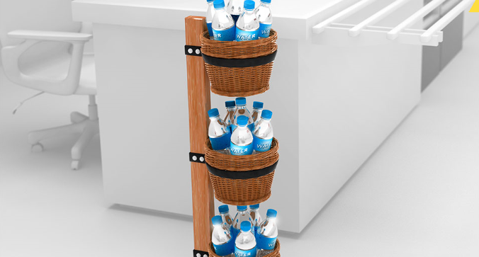
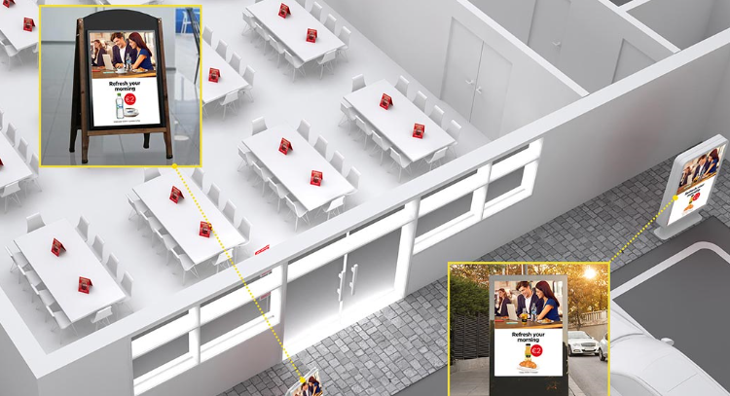
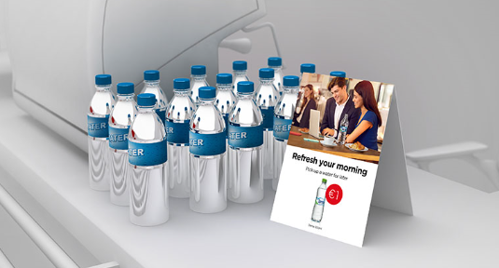
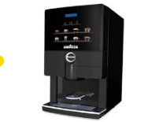
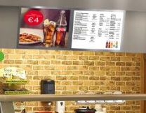
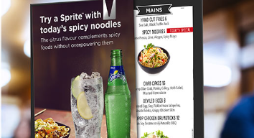
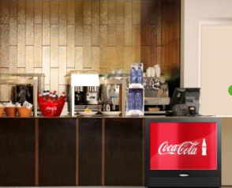
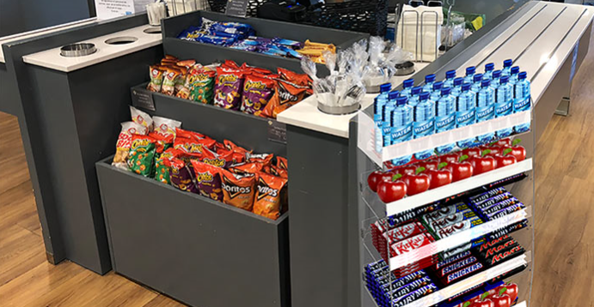
2
RIGHT
ACTIVATION
EQUIPMENT
THE RIGHT ACTIVATION THROUGHOUT THE DAY TARGETING ALL SUB-OCCASIONS WILL DRIVE INCIDENCE OF BEVERAGES, FREQUENCY OF PURCHASE, TRANSACTIONS AND REVENUE
MERCHANDISING AND EQUIPMENT SOLUTIONS
Branded water rack
next to till
Combo drink deal on
A-board at entrance
Ambient water display
at coffee machine
CANTEEN PICTURE OF SUCCESS - TOUCHPOINTS
Canteen
Start of Day: branded water rack (Dorna) next to till | Permanent
Start of Day: combo drink deal on A-Board at entrance | Temporary
Start of Day: ambient water display at coffee machine | Temporary
Start of Day: branded coffee machine (Lavazza) | Permanent
Lunch: combo meal deal on header-board above food counter | Temporary
Lunch: food pairings on menu | Temporary
Lunch: counter top cooler halfway along food counter | Permanent
Mid-Afternoon Break: combo snack deal on wobbler at snack display | Temporary
While Working: set price promo on tent card at display next to till | Temporary
Branded coffee machine (Lavazza)
Combo meal on header-board above food counter
Food Pairings
on menu
Counter top cooler halfway along food counter
Combo snack deal on wobbler at snack display
Set promo price on tent card at display next to till
Note to markets: Replace pictures with relevant merchandising solutions

Slide 14








TOGETHER, WE CAN CAPTURE A BIG REVENUE OPPORTUNITY IN ‘AT WORK’
25Mio EUR
Drive transactions
and revenue
through:
1. Winning portfolio of brands & packs
2. Right activation throughout the day targeting all at work sub-occasions
Increase traffic
of canteens and cafes at the workplace by providing an enhanced meal/snack experience
Offer choice
through a broad range of categories and packs to fully satisfy different needs throughout the day
Staying hydrated at
work is vital
to our wellbeing and our
ability to perform tasks safely and efficiently
At Work is
The 2nd biggest
OOH occasion
in value
Note to markets: Insert local data to calculate size of prize

Slide 15

NEXT STEPS
<CUSTOMER> FEEDBACK
YOUR FEEDBACK:
NEXT STEPS:
KEY SUCCESS MEASURES:
TIP: Make it an open discussion. Although you already asked for feedback few times its worth reconfirming if there’s anything else
the Customer would like to share.
If you agree on the direction it’s important to:
- discuss key success factors
- align on clear next steps with timelines
- agree how to track and measure the success

Slide 16

Thank You

