Slide 1

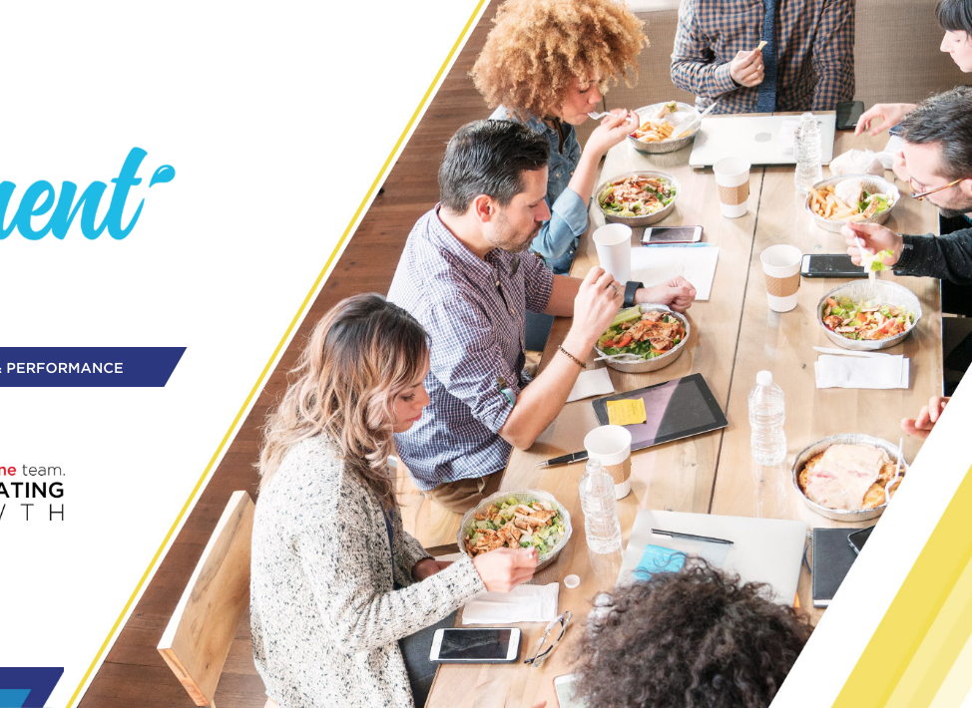



v
v
CUSTOMER SELL IN
KA Super / Hypers
v
Insert Customer’s logo

Slide 2
CUSTOMER SELL-IN – KA HYPER/SUPER
TIPS BEFORE YOU START!
1
Foster Customer and our logo:
In opening page and across template
Put customer logo first
2
Be simple and concise:
In this deck you will find many examples for inspiration purpose. Each and every selling story is unique, focus on your objective, and based on that, craft the story.
3
Open with clear agenda:
How to unlock the potential?
Let’s bring it to life together – proposal for Customer XYZ
4
Follow up!:
Once activated, track results, present the findings
Remind the Customer - build your future stories on successful practices from the past

Slide 3
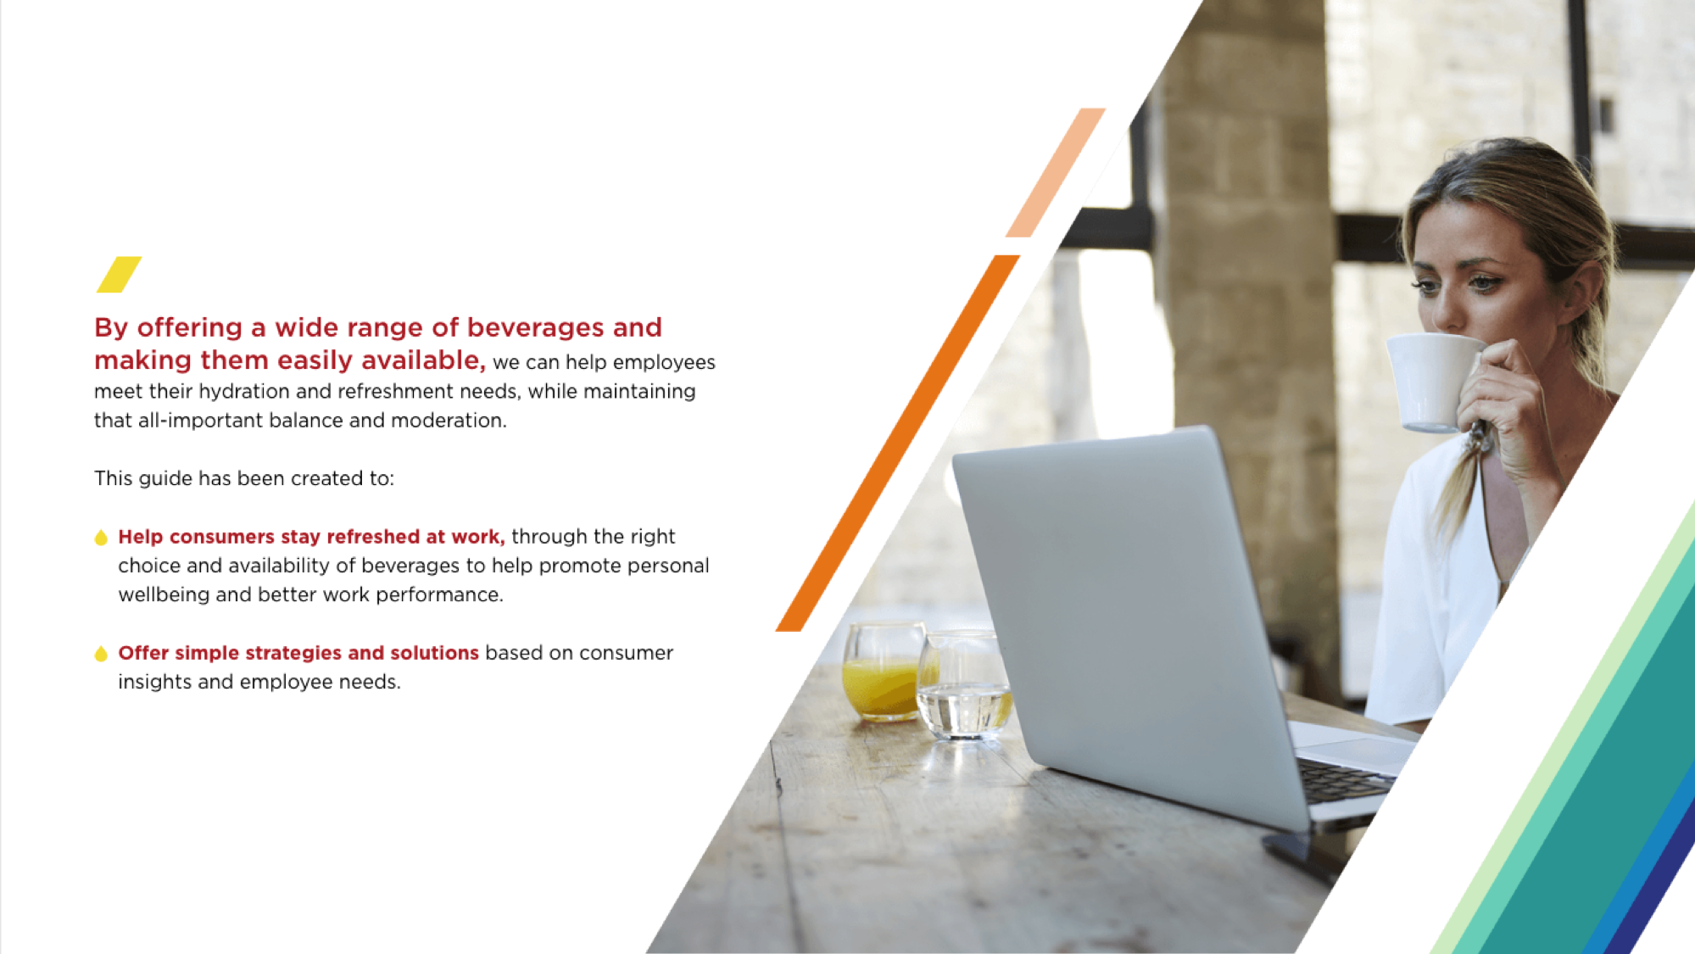
‘AT WORK’ IS OUR 2ND LARGEST OUT OF HOME DRINKING MOMENT IN VALUE
Value Share AH Occasions
Volume Share AH Occasions
19%
Value Share OOH Occasions
Volume Share OOH Occasions
17%
15%
15%
13%
13%
12%
10%
10%
9%
7%
7%
6%
6%
6%
5%
4%
3%
4%
3%
2%
2%
3%
3%
3%
1%
2%
1%
At School
On the Go
Physical Activity AFH
Socializing at Home
Snack time
Breakfast
Routine Habits at Home
My Moment at Home
Hanging Out
Screen Time
Eating Out
At Work
Meals at Home
Drinking Out
Drinking Moments in Value – Central Eastern Europe (CEE)
AH: At Home
OOH: Out of Home

Slide 4

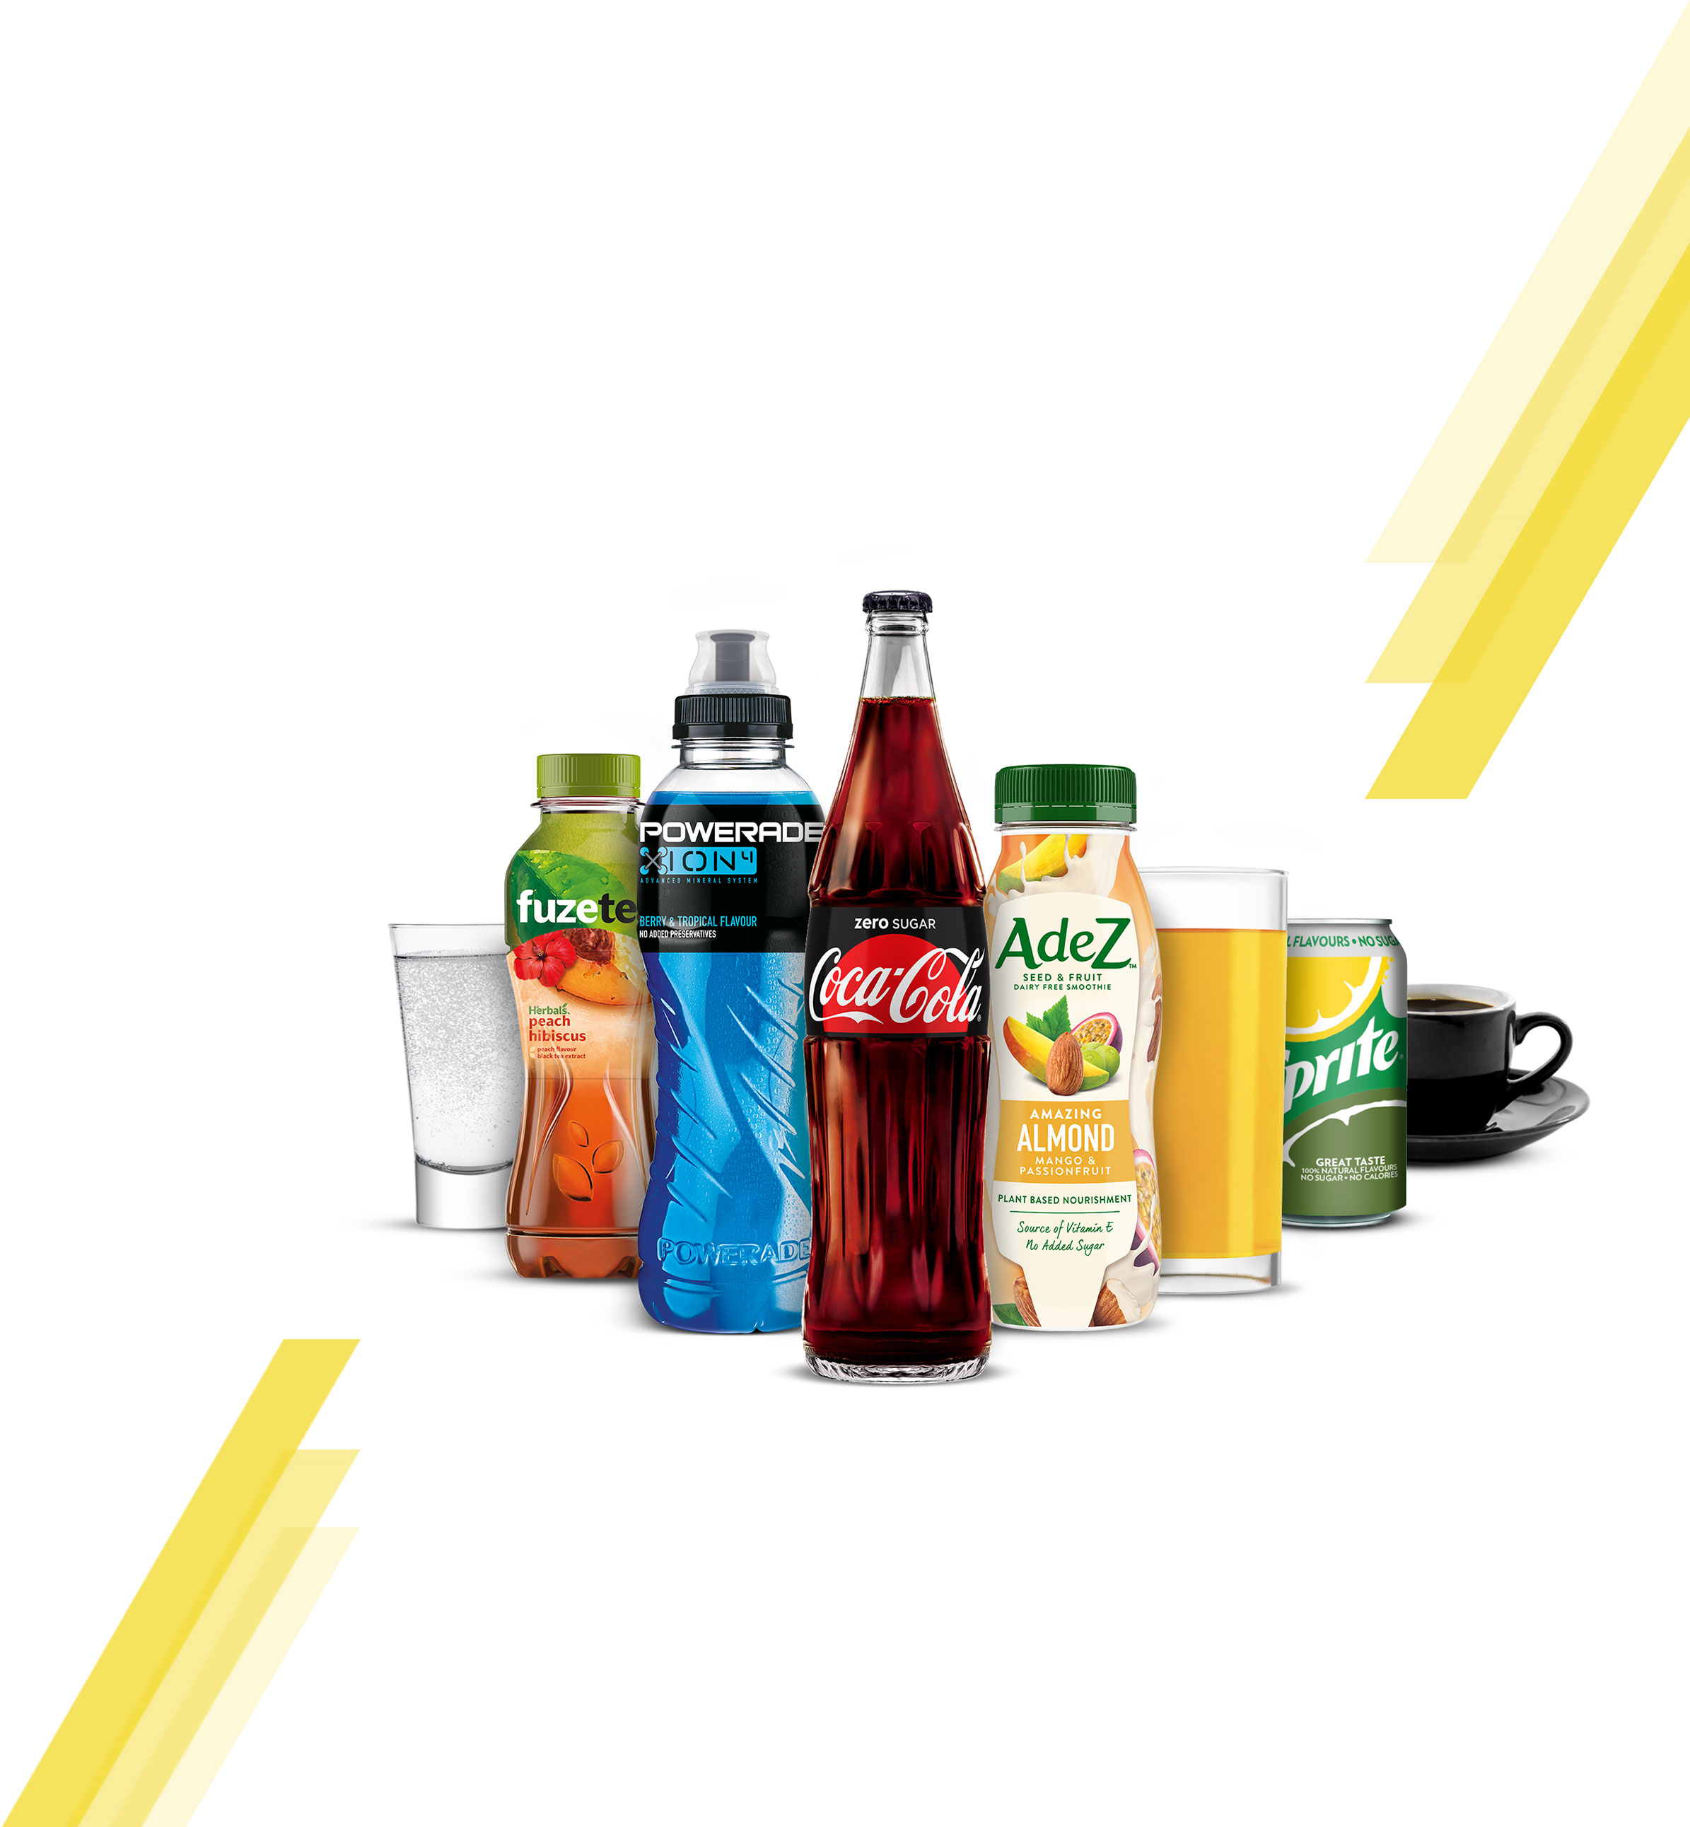
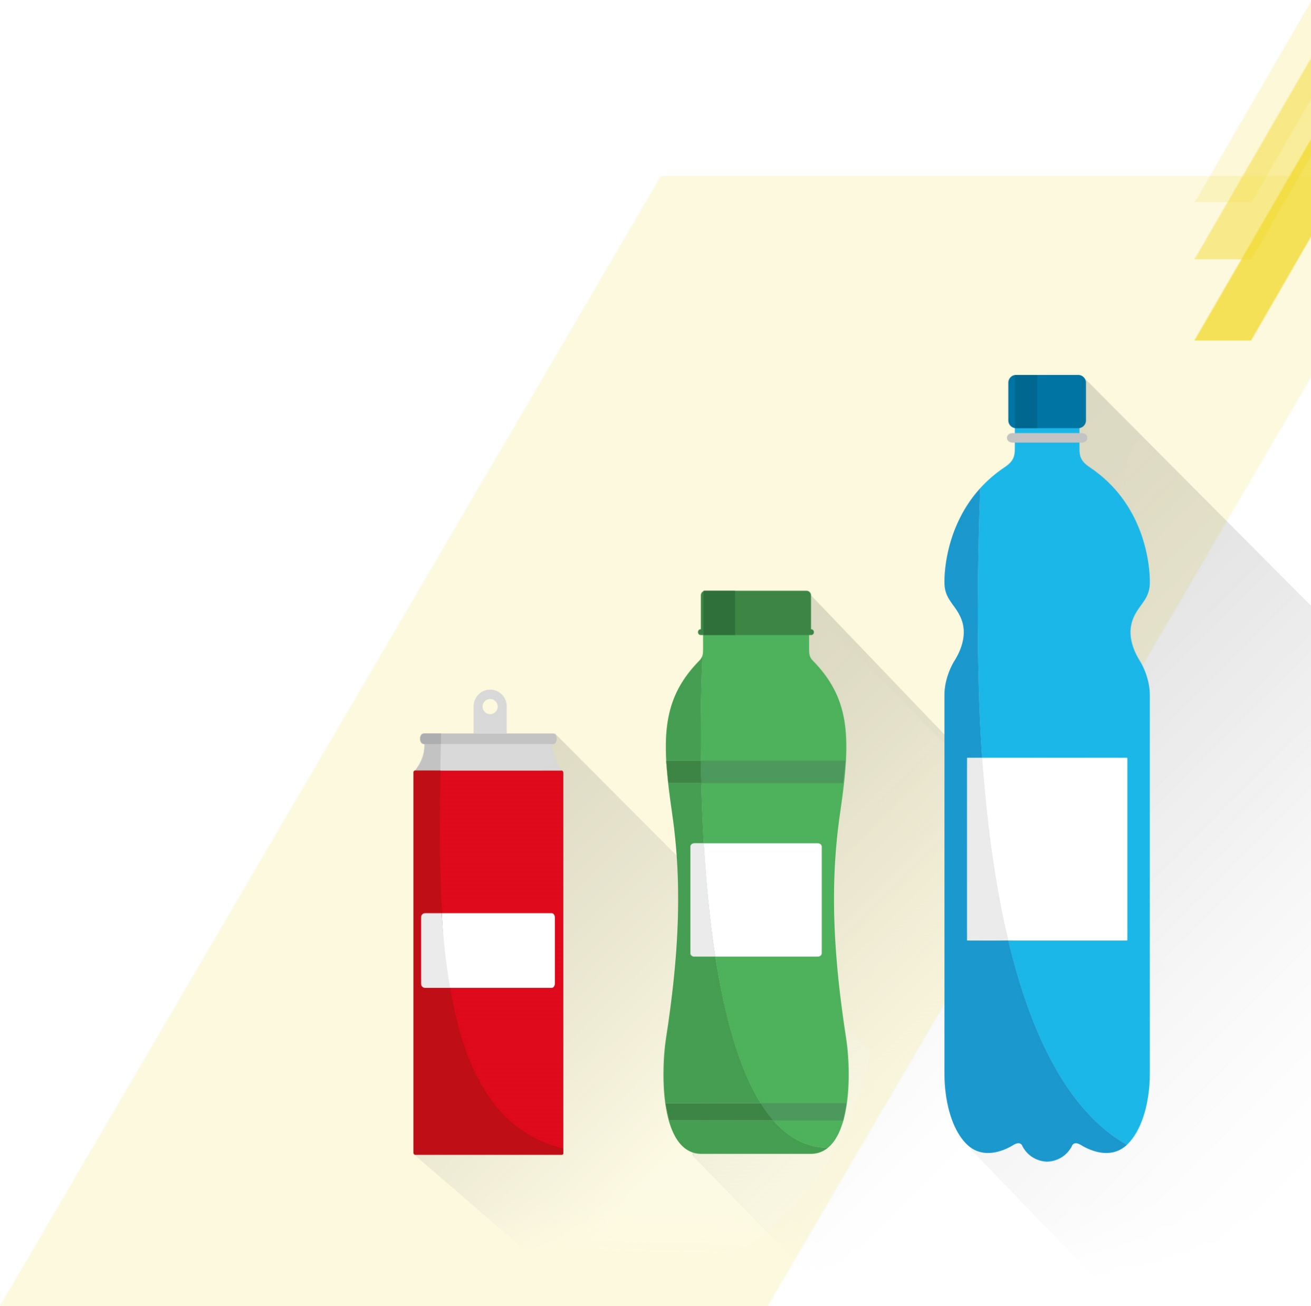
STAYING HYDRATED AT WORK IS VITAL TO OUR WELLBEING AND OUR ABILITY TO PERFORM TASKS SAFELY AND EFFICIENTLY. ITS ESSENTIAL TO OFFER A BALANCED RANGE OF DRINKS IN THE RIGHT OPTIONS TO MEET EMPLOYEE NEEDS
We need 8 to 10
glasses of fluid
every day to be
properly hydrated
70% of consumers feel it
is very important to stay hydrated during the day
at the workplace
‘At work drinkers’ are
looking for increased
variety within
the category
60% of employees are currently not satisfied
with their beverage offer
@ Work
If water is the only option available, consumers
can get bored and not
drink enough
Choice & availability
can drive satisfaction
& consumption
Soft drinks at 10%
daily consumption
although only
available In
50% sites
Consumers stress
the importance of
health-conscious,
natural, sugar-free
and organic drinks
that are rich in vitamins
and energy

Slide 5
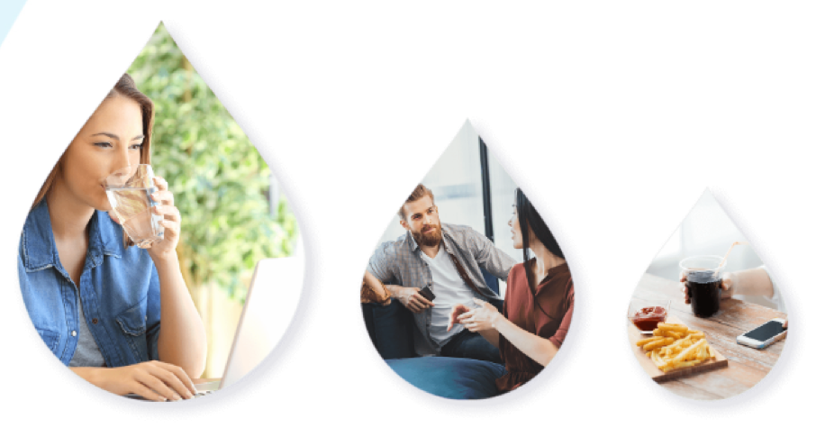
CONSUMERS OFTEN HAVE VERY DIFFERENT NEEDS FROM BEVERAGES ACROSS ‘AT WORK’ SUB‑OCCASIONS AND IT IS IMPORTANT TO OFFER A BROAD RANGE OF CATEGORIES AND PACKS TO FULLY SATISFY THEIR NEEDS
Drive incidence of SSDs and Juice among adults with ready take away meal solutions
The more choice of beverages and the more they are easily available, then the higher the consumption
8AM TO 8PM DRINKING MOMENT
Coffee
43.6%
Opportunity
SSDs
Tea
Juices
Plant Based Dairies
Energy
Water
21.7%
SSDs
14%
WHILE
WORKING
WHILE TAKING
A BREAK
WHILE
EATING
58%
31%
11%

Slide 6

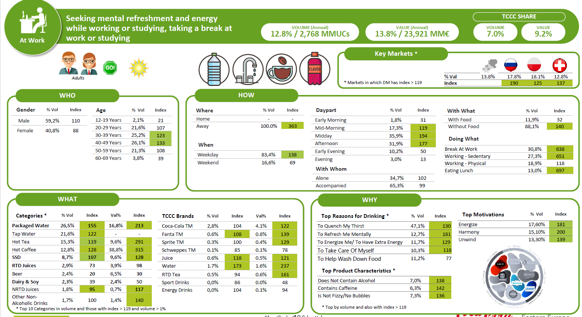
OUR RESEARCH PROVIDES A DETAILED PROFILE OF CONSUMERS AND IDENTIFIES HOW AND WHEN THEY DRINK DURING THE DAY
Seeking mental refreshment and energy while working or studying, taking a break at work or studying
VOLUME (Annual)
12.8% / 2,768 MMUCs
VALUE (Annual)
13.8% / 23,921 MM€
TCCC SHARE
VOLUME
7.0%
VALUE
9.2%
Key Markets*
CONSUMER TRENDS
% Val | 13.8% | 17.8% | 18.1% | 12.8%
Index |  | 190 | 125 | 137
WHO
Age | % Vol | Index
12-19 Years | 2,1% | 21
20-29 Years | 21,6% | 107
30-39 Years | 25,2% | 123
40-49 Years | 26,1% | 133
50-59 Years | 21,3% | 108
60-69 Years | 3,8% | 39
HOW
Where | % Vol | Index
Home | - | -
Away | 100,0% | 363
With What | % Vol | Index
With Food | 11,9% | 32
Without Food | 88,1% | 140
Daypart | % Vol | Index
Early Morning | 1,8% | 31
Mid-Morning | 17,3% | 119
Midday | 35,9% | 194
Afternoon | 31,9% | 177
Early Evening | 10,2% | 50
Evening | 3,0% | 13
When | % Vol | Index
Weekday | 83,4% | 138
Weekend | 16,6% | 69
Doing What | % Vol | Index
Break At Work | 30,8% | 638
Working - Sedentary | 27,3% | 651
Working - Physical | 18,9% | 118
Eating Lunch | 13,0% | 697
Gender | % Vol | Index
Male | 59,2% | 110
Female | 40,8% | 88
With Whom | % Vol | Index
Alone | 34,7% | 102
Accompanied | 65,3% | 99
WHAT
Categories* | %Vol | Index | Val% | Index
Packaged Water | 25,6% | 155 | 16,8% | 213
Tap Water | 21,6% | 122 | - | -
Hot Tea | 15,3% | 119 | 9,6% | 291
Hot Coffee | 12,8% | 128 | 38,8% | 315
SSD | 8,7% | 107 | 9,6% | 128
RTD Juices | 2,9% | 73 | 3,9% | 98
Beer | 2,4% | 20 | 6,5% | 30
Dairy & Soy | 2,3% | 39 | 2,4% | 50
NRTD Juices | 1,8% | 95 | 0,7% | 117
Other Non-Alchoholic Drinks | 1,7% | 100 | 1,4% | 140
TCCC Brands | %Vol | Index | Val% | Index
Coca-Cola TM | 2,8% | 104 | 4,1% | 122
Fanta TM | 0,6% | 108 | 0,8% | 139
Sprite TM | 0,3% | 100 | 0,4% | 129
Schweppes TM | 0,1% | 85 | 0,1% | 78
Juice | 0,6% | 118 | 0,5% | 121
Water | 1,7% | 173 | 1,6% | 237
RTTD Tea | 0,5% | 94 | 0,6% | 161
Sport Drinks | 0,0% | 86 | 0,0% | 48
Energy Drinks | 0,0% | 104 | 0,1% | 94
WHY
Top Motivations | % Vol | Index
Energize | 17,60% | 181
Harmony | 15,10% | 200
Unwind | 13,30% | 139
Top Reasons for Drinking* | % Vol | Index
To Quench My Thirst | 47,1% | 130
To Refresh Me Mentally | 12,7% | 181
To Energize Me / To Have Extra Energy | 11,7% | 129
To Take Care Of Myself | 10,3% | 118
To Help Wash Down Food | 11,2% | 77
Top Product Characteristics* | % Vol | Index
Does Not Contain Alcohol | 7,0% | 138
Contains Caffeine | 6,3% | 142
Is Not Fizzy / No Bubbles | 7,3% | 136
*Top 10 categories in volume and those with index >119 and volume >1%
*Top by volume and also with index >119

Slide 7





ALTHOUGH PEOPLE DO DRINK WHEN AT WORK, 80% OF BEVERAGES ARE BOUGHT OFF PREMISE, WITH 31% BOUGHT FROM ORGANIZE TRADE.
ALMOST
1/2
80%
Beverages consumed
at work are purchased outside of the workplace
Of consumers are not currently satisfied with
the beverage choice in
the workplace.
Beverage Purchase
Country Weight
Organised Trade
KIOKS
& Petrol
QSR
(Fast Food)
HORECA
Workplace
Total
100.0%
31.4%
9.7%
8.8%
25.4%
20.5%

Slide 8
WE HAVE AN OPPORTUNITY TO CAPTURE 3.5MN€ REVENUE BY INCREASING NARTD BEVERAGE BASKET INCIDENCE BY 1%
!
Numbers need to be adapted to specific market
Data : At Work market size, At Work population, Customer share in OT market. Customer Basket size and penetration, CCH share in retailer business Customer PITA data
€280 MN
€3.5 MN
12.7%
Value of DM
Size of prize
TCCC category
value share
NOTE
VALUE OF DM IS ACTUALIZED 2017
AND SIZE OF THE PRIZE AS PER CATEGORY VISION CALCULATION TO YEAR 2023
VALUE OF DM IS ACTUALIZED 2017
AND SIZE OF THE PRIZE AS PER CATEGORY VISION CALCULATION TO YEAR 2023
Source: CBL, IE, Unmet Beverage Needs At Work research
Note to markets: Insert local data to calculate size of prize

Slide 9
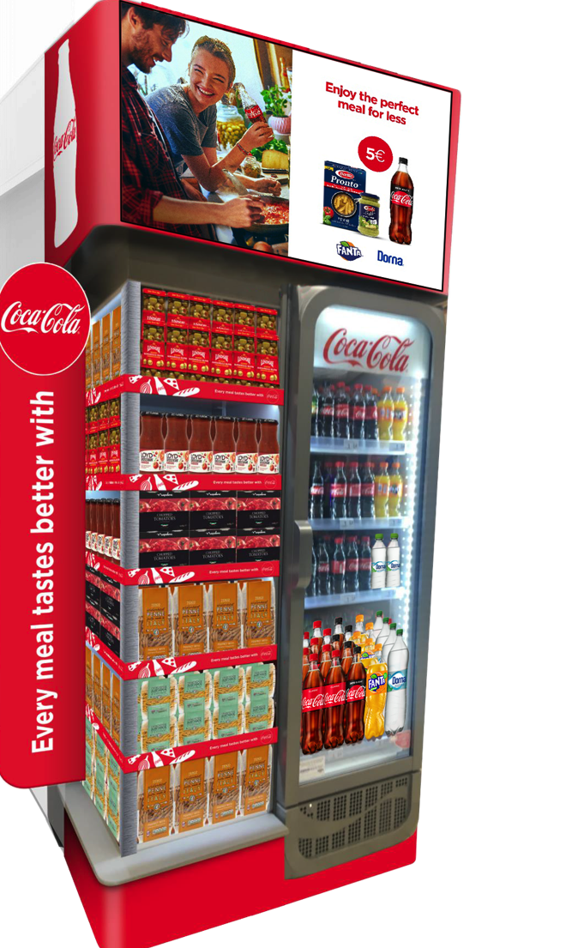
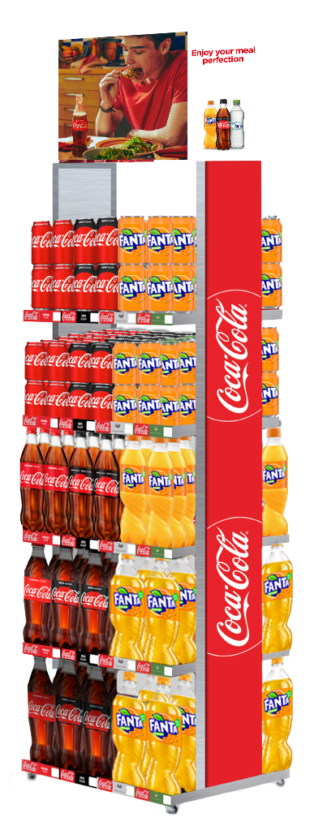
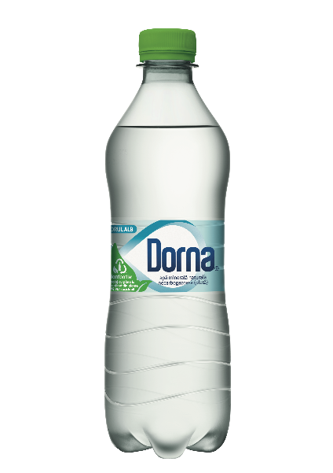
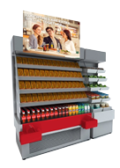
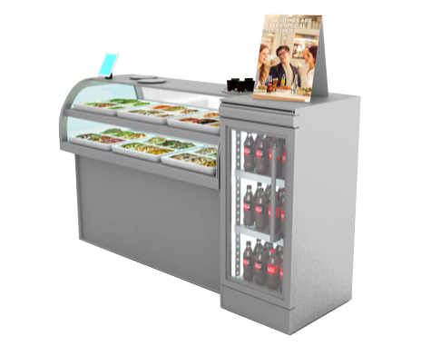
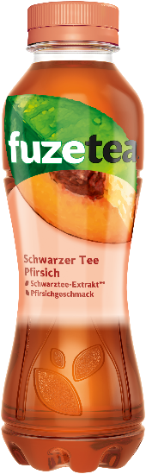
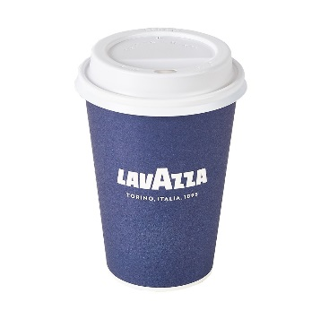
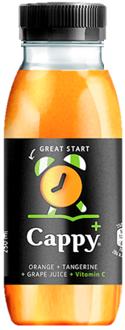
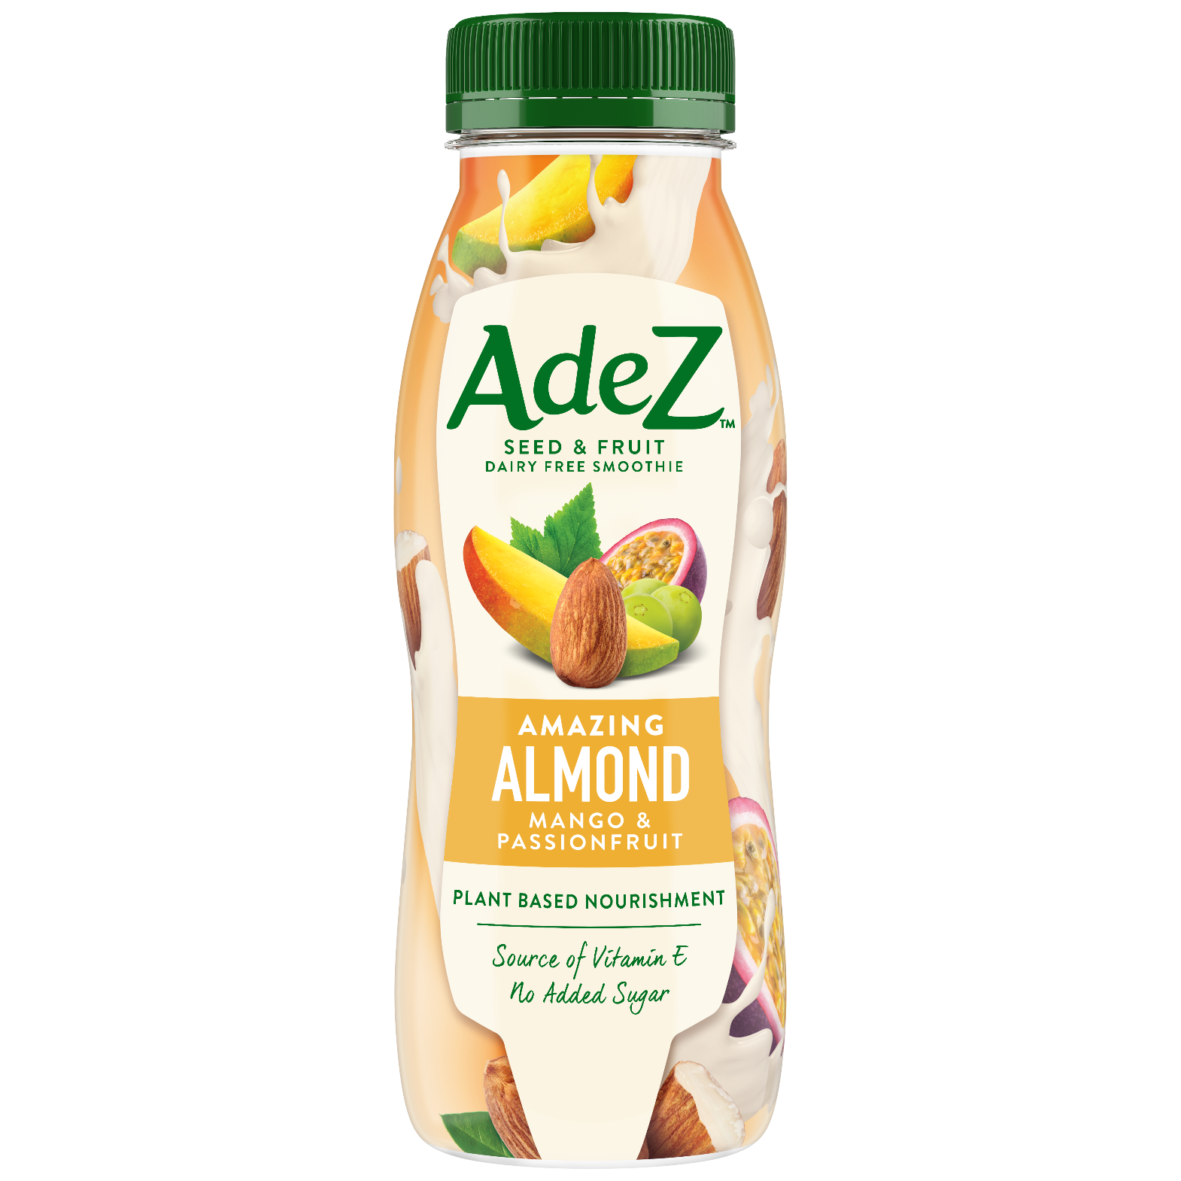
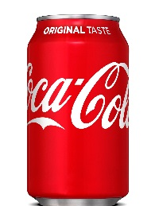
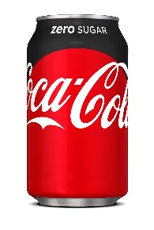
TOGETHER, WE CAN CAPTURE THE ADDITIONAL REVENUE OPPORTUNITY FOR THE ‘AT WORK’ OCCASION THROUGH A JOINT STRATEGIC APPROACH
1
2
WINNING
PORTFOLIO
Choice & availability to drive satisfaction and consumption
RIGHT ACTIVATION
& EQUIPMENT
Offering to drive incidence
of beverages and increase transactions & revenue
Note to markets: Insert local data to calculate size of prize

Slide 10
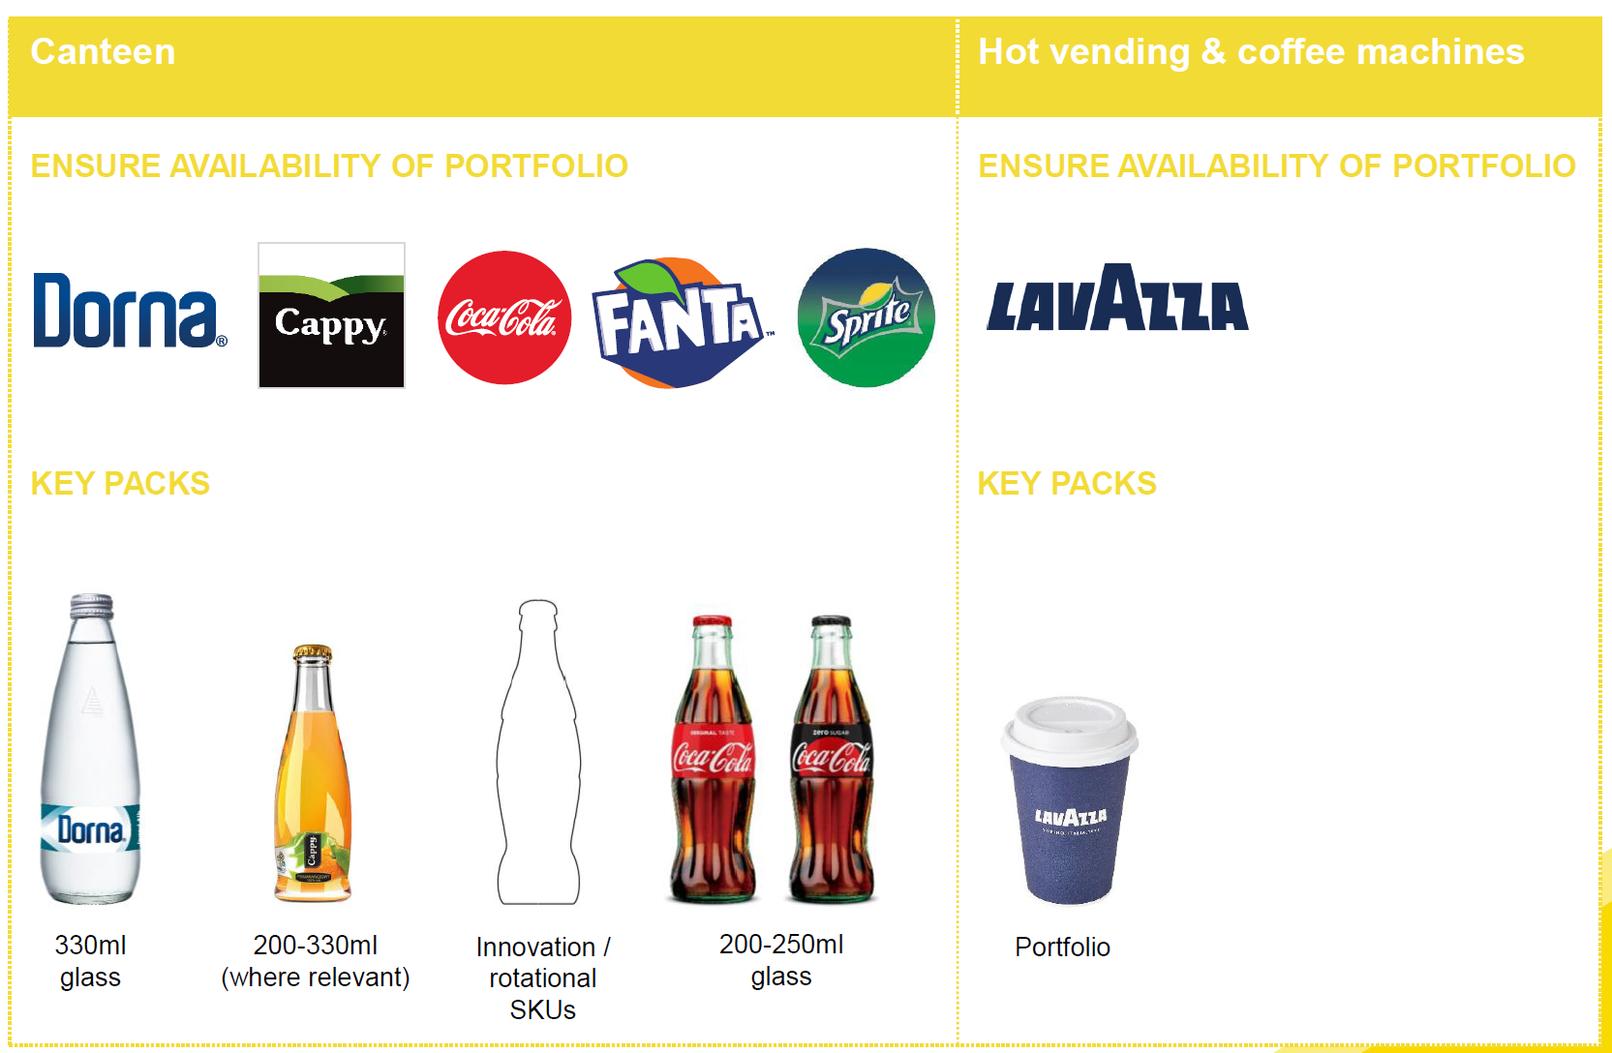
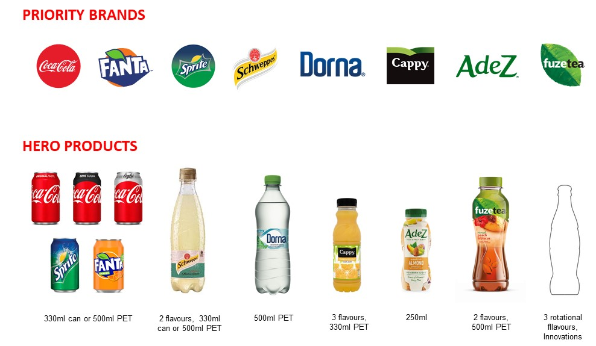
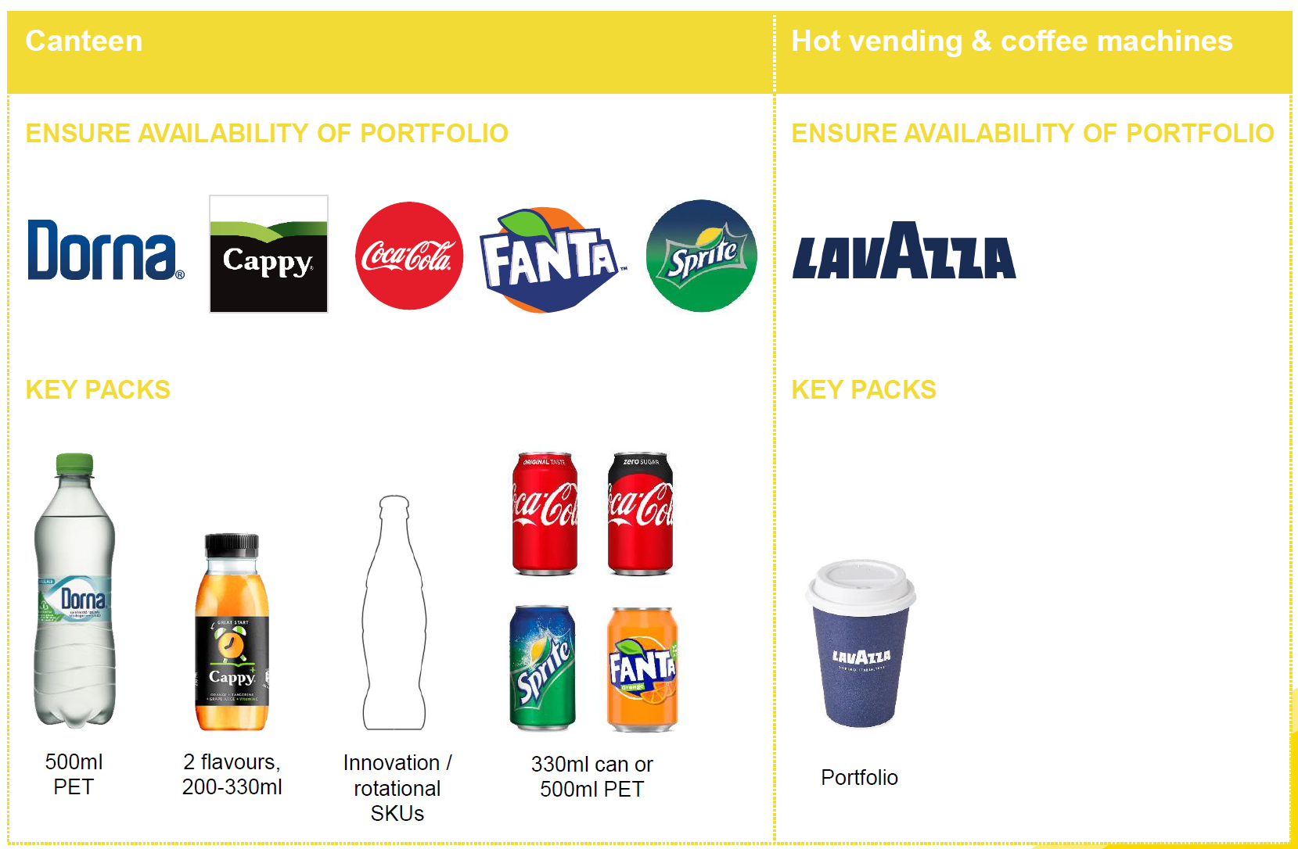
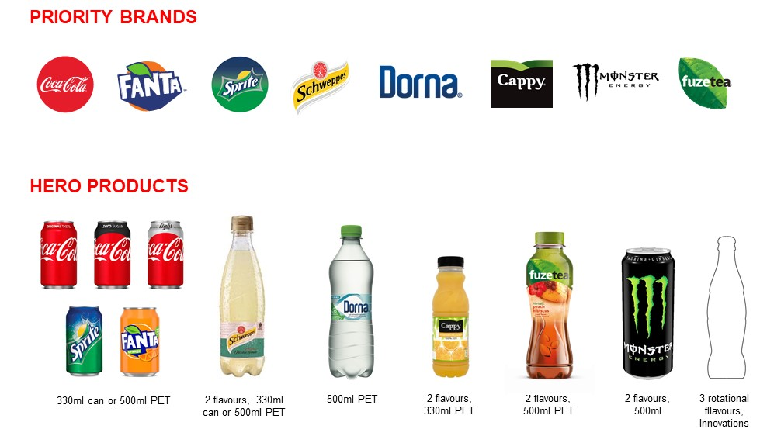
1
WINNING
PORTFOLIO
WE CAN OFFER A BALANCED RANGE OF DRINKS AND PACK SIZES TO MEET CONSUMER REFRESHMENT NEEDS
ENABLING CATEGORIES
RANGE
WHITE COLLAR
COFFEE
WATER
3 rotational flavors, innovations
330ml can or 500ml PET
2 flavors, 330ml can or 550ml PET
550ml PET
3 flavors 330ml PET
250ml
2 flavors 500ml PET
ENABLING CATEGORIES
COFFEE
RANGE
BLUE COLLAR
WATER
3 rotational flavors, innovations
330ml can or 500ml PET
2 flavors, 330ml can or 550ml PET
550ml PET
3 flavors 330ml PET
500ml
2 flavors 500ml PET
Drive availability for Refreshment in At Work for full portfolio through key enabling categories Water and Coffee
Drive incidence for all categories
(except coffee) through relevant solutions
and adjacency throughout the shopping trip
Leverage OT channel to drive consumer recruitment and loyalty for At Work channels and occasions) for NARTD beverages
Note to markets: Replace with country specific product & pack portfolio

Slide 11
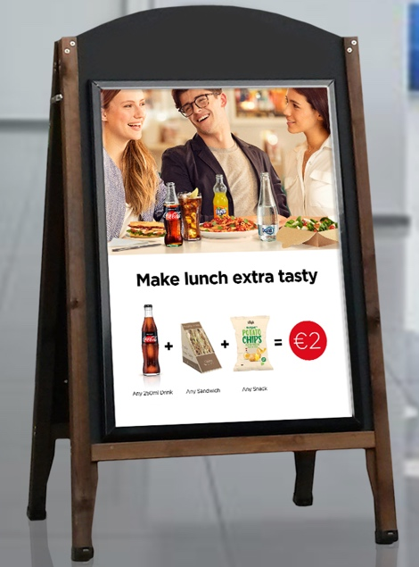
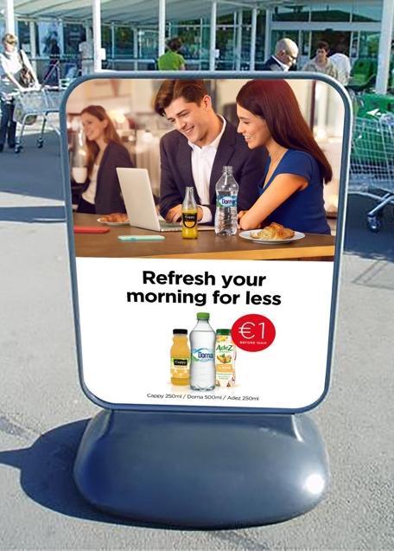
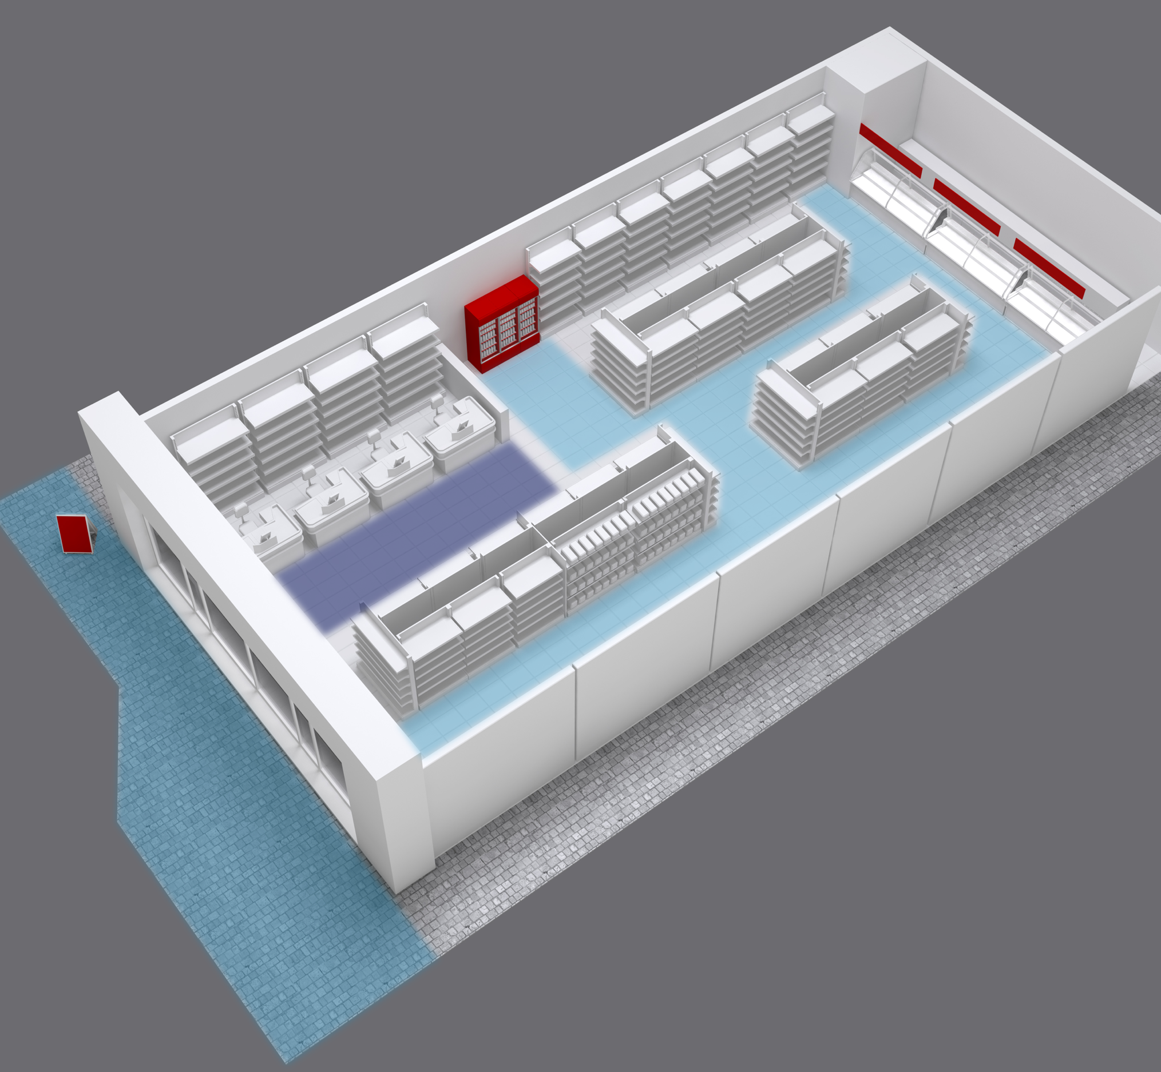
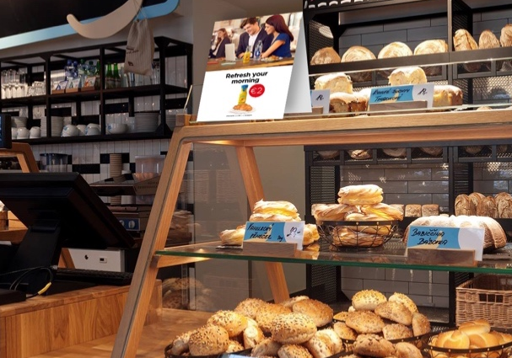
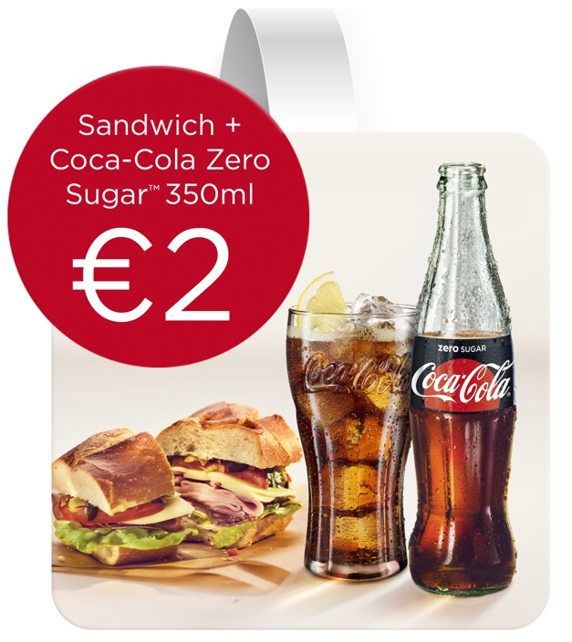
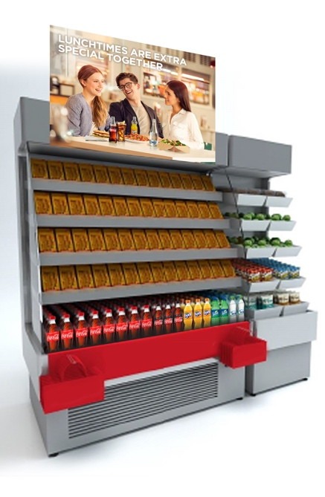
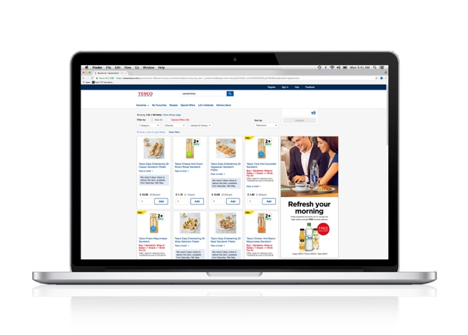
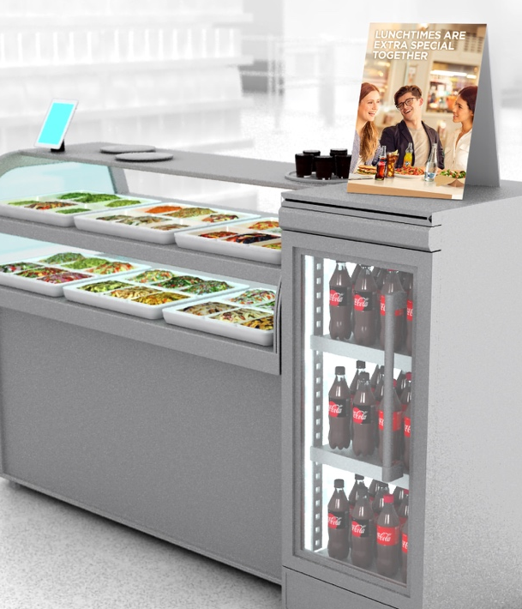
2
RIGHT
ACTIVATION
EQUIPMENT
THE RIGHT ACTIVATION THROUGHOUT THE DAY TARGETING ALL SUB-OCCASIONS WILL DRIVE INCIDENCE OF BEVERAGES, FREQUENCY OF PURCHASE, TRANSACTIONS AND REVENUE
Transition zone
Drive awareness and create desire for food & refreshment
Impulse zone
Drive consideration on path to purchase
Destination zone
Entice and drive demand at point of purchase
Note to markets: Replace pictures with real merchandising & equipment solutions available in your market

Slide 12
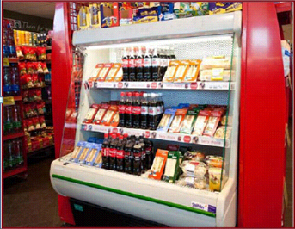
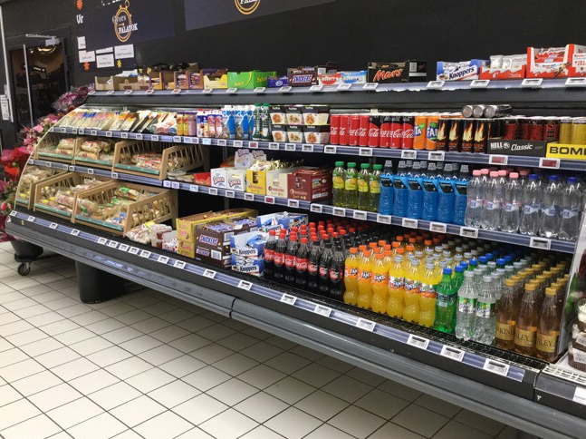
2
RIGHT
ACTIVATION
EQUIPMENT
OFFER CHILLED AVAILABILITY OF ‘READY TO EAT’ MEALS
WITH BEVERAGES FOR AN ‘AT WORK’ QUICK MISSION
LUNCH SOLUTION
What it is:
Pairing chilled CCH NARTD Bev. and ready to eat food with side items to create convenient one stop shop solution
How it works:
Works best when visible from store entrance bringing the offer where quick mission shoppers are. Enables quick decisions to this time-poor shopper with pre-selected product offer. Supports sales and rotation for high-margin but short shelf live ready to eat food.
Note: consumption of ready-to-eat food has quadrupled over the past 25 years.
Sandwiches & beverages
Reference to coolers activation – insert your proposal

Slide 13
2
RIGHT
ACTIVATION
EQUIPMENT
BELOW ARE OTHER GOOD PRACTICES EXAMPLES, WHICH OFFER SHOPPERTRAITMENT AND RETAILER LOYALTY
Beverage shelf and display
Integrated cooler in beverage shelf
+12%
+10%
Demonstrate occasion
Secondary display and positioning
+26%
+18%
+11%
Note to markets: Replace pictures with relevant merchandising solutions

Slide 14







TOGETHER, WE CAN CAPTURE A BIG REVENUE OPPORTUNITY IN ‘AT WORK’
3.5Mio EUR
80%
Drive transactions
and revenue
through:
1. Winning portfolio of brands & packs
2. Right activation throughout the day targeting all at work sub-occasions
Offer choice
through a broad range of categories and packs to fully satisfy different needs throughout the day
Organize trade key source of supply for
At Work
beverages consumed during working time is bought off premise
Staying hydrated at
work is vital
to our wellbeing and our
ability to perform tasks safely and efficiently
At Work is
The 2nd biggest
OOH occasion
in value
Note to markets: Insert local data to calculate size of prize

Slide 15

NEXT STEPS
<CUSTOMER> FEEDBACK
YOUR FEEDBACK:
NEXT STEPS:
KEY SUCCESS MEASURES:
TIP: Make it an open discussion. Although you already asked for feedback few times its worth reconfirming if there’s anything else
the Customer would like to share.
If you agree on the direction it’s important to:
- discuss key success factors
- align on clear next steps with timelines
- agree how to track and measure the success

Slide 16

Thank You

