Slide 1
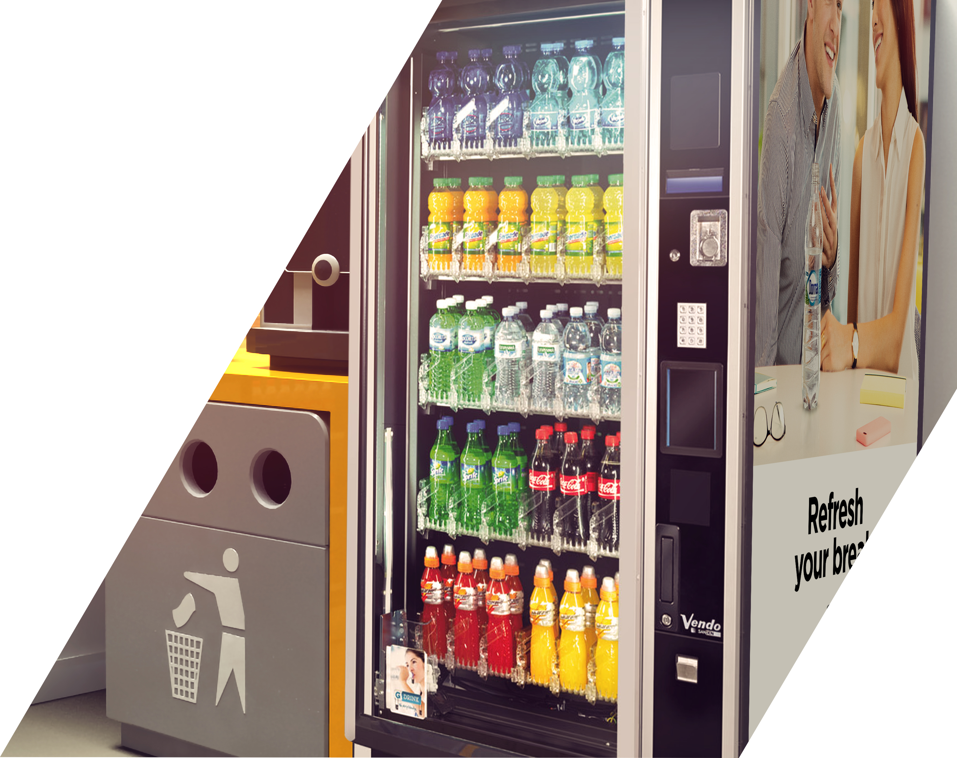


v
v
CUSTOMER SELL IN
Vending Operators
v
Insert Customer’s logo

Slide 2
CUSTOMER SELL IN – VENDING OPERATORS
TIPS BEFORE YOU START!
1
Foster Customer and our logo:
In opening page and across template
Put customer logo first
2
Be simple and concise:
In this deck you will find many examples for inspiration purpose. Each and every selling story is unique, focus on your objective, and based on that, craft the story.
3
Open with clear agenda:
How to unlock the potential?
Let’s bring it to life together – proposal for Customer XYZ
4
Follow up!:
Once activated, track results, present the findings
Remind the Customer - build your future stories on successful practices from the past

Slide 3
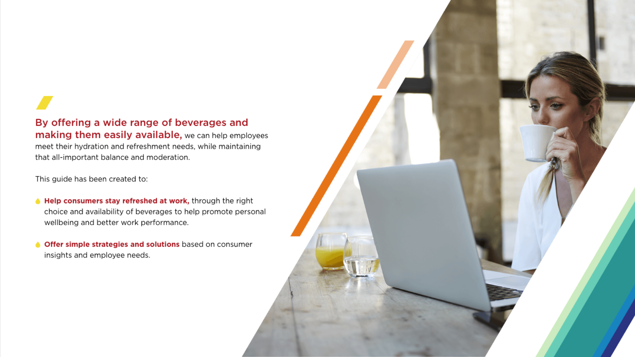
‘AT WORK’ IS OUR 2ND LARGEST OUT OF HOME DRINKING MOMENT IN VALUE
Value Share AH Occasions
Volume Share AH Occasions
19%
Value Share OOH Occasions
Volume Share OOH Occasions
17%
15%
15%
13%
13%
12%
10%
10%
9%
7%
7%
6%
6%
6%
5%
4%
3%
4%
3%
2%
2%
3%
3%
3%
1%
2%
1%
At School
On the Go
Physical Activity AFH
Socializing at Home
Snack time
Breakfast
Routine Habits at Home
My Moment at Home
Hanging Out
Screen Time
Eating Out
At Work
Meals at Home
Drinking Out
Drinking Moments in Value – Central Eastern Europe (CEE)
AH: At Home
OOH: Out of Home

Slide 4

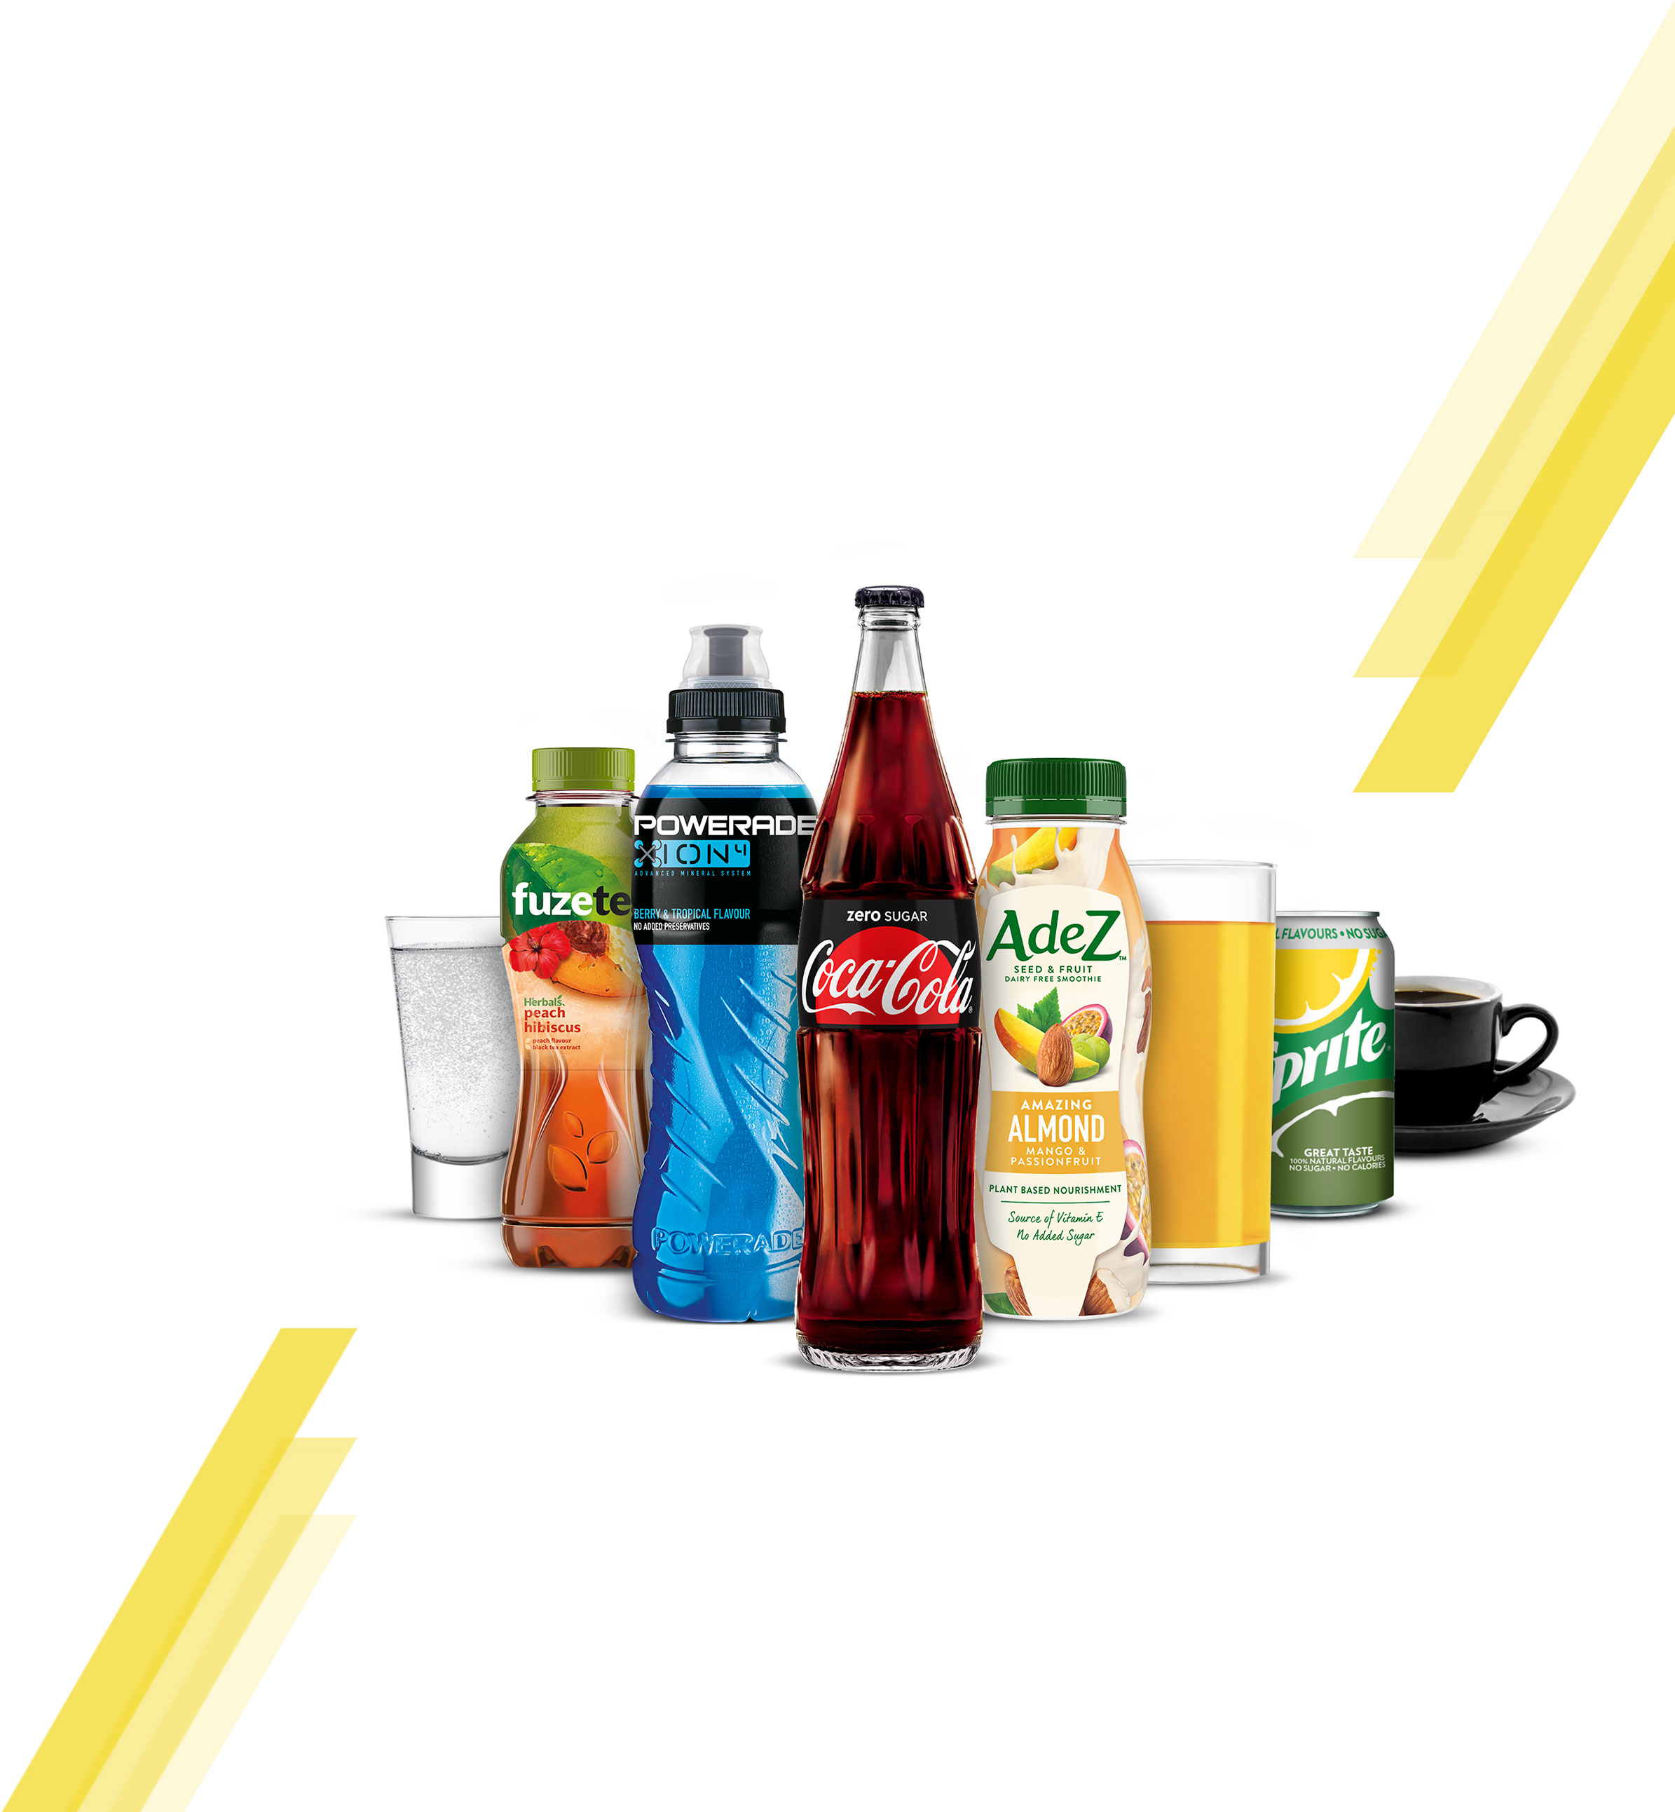
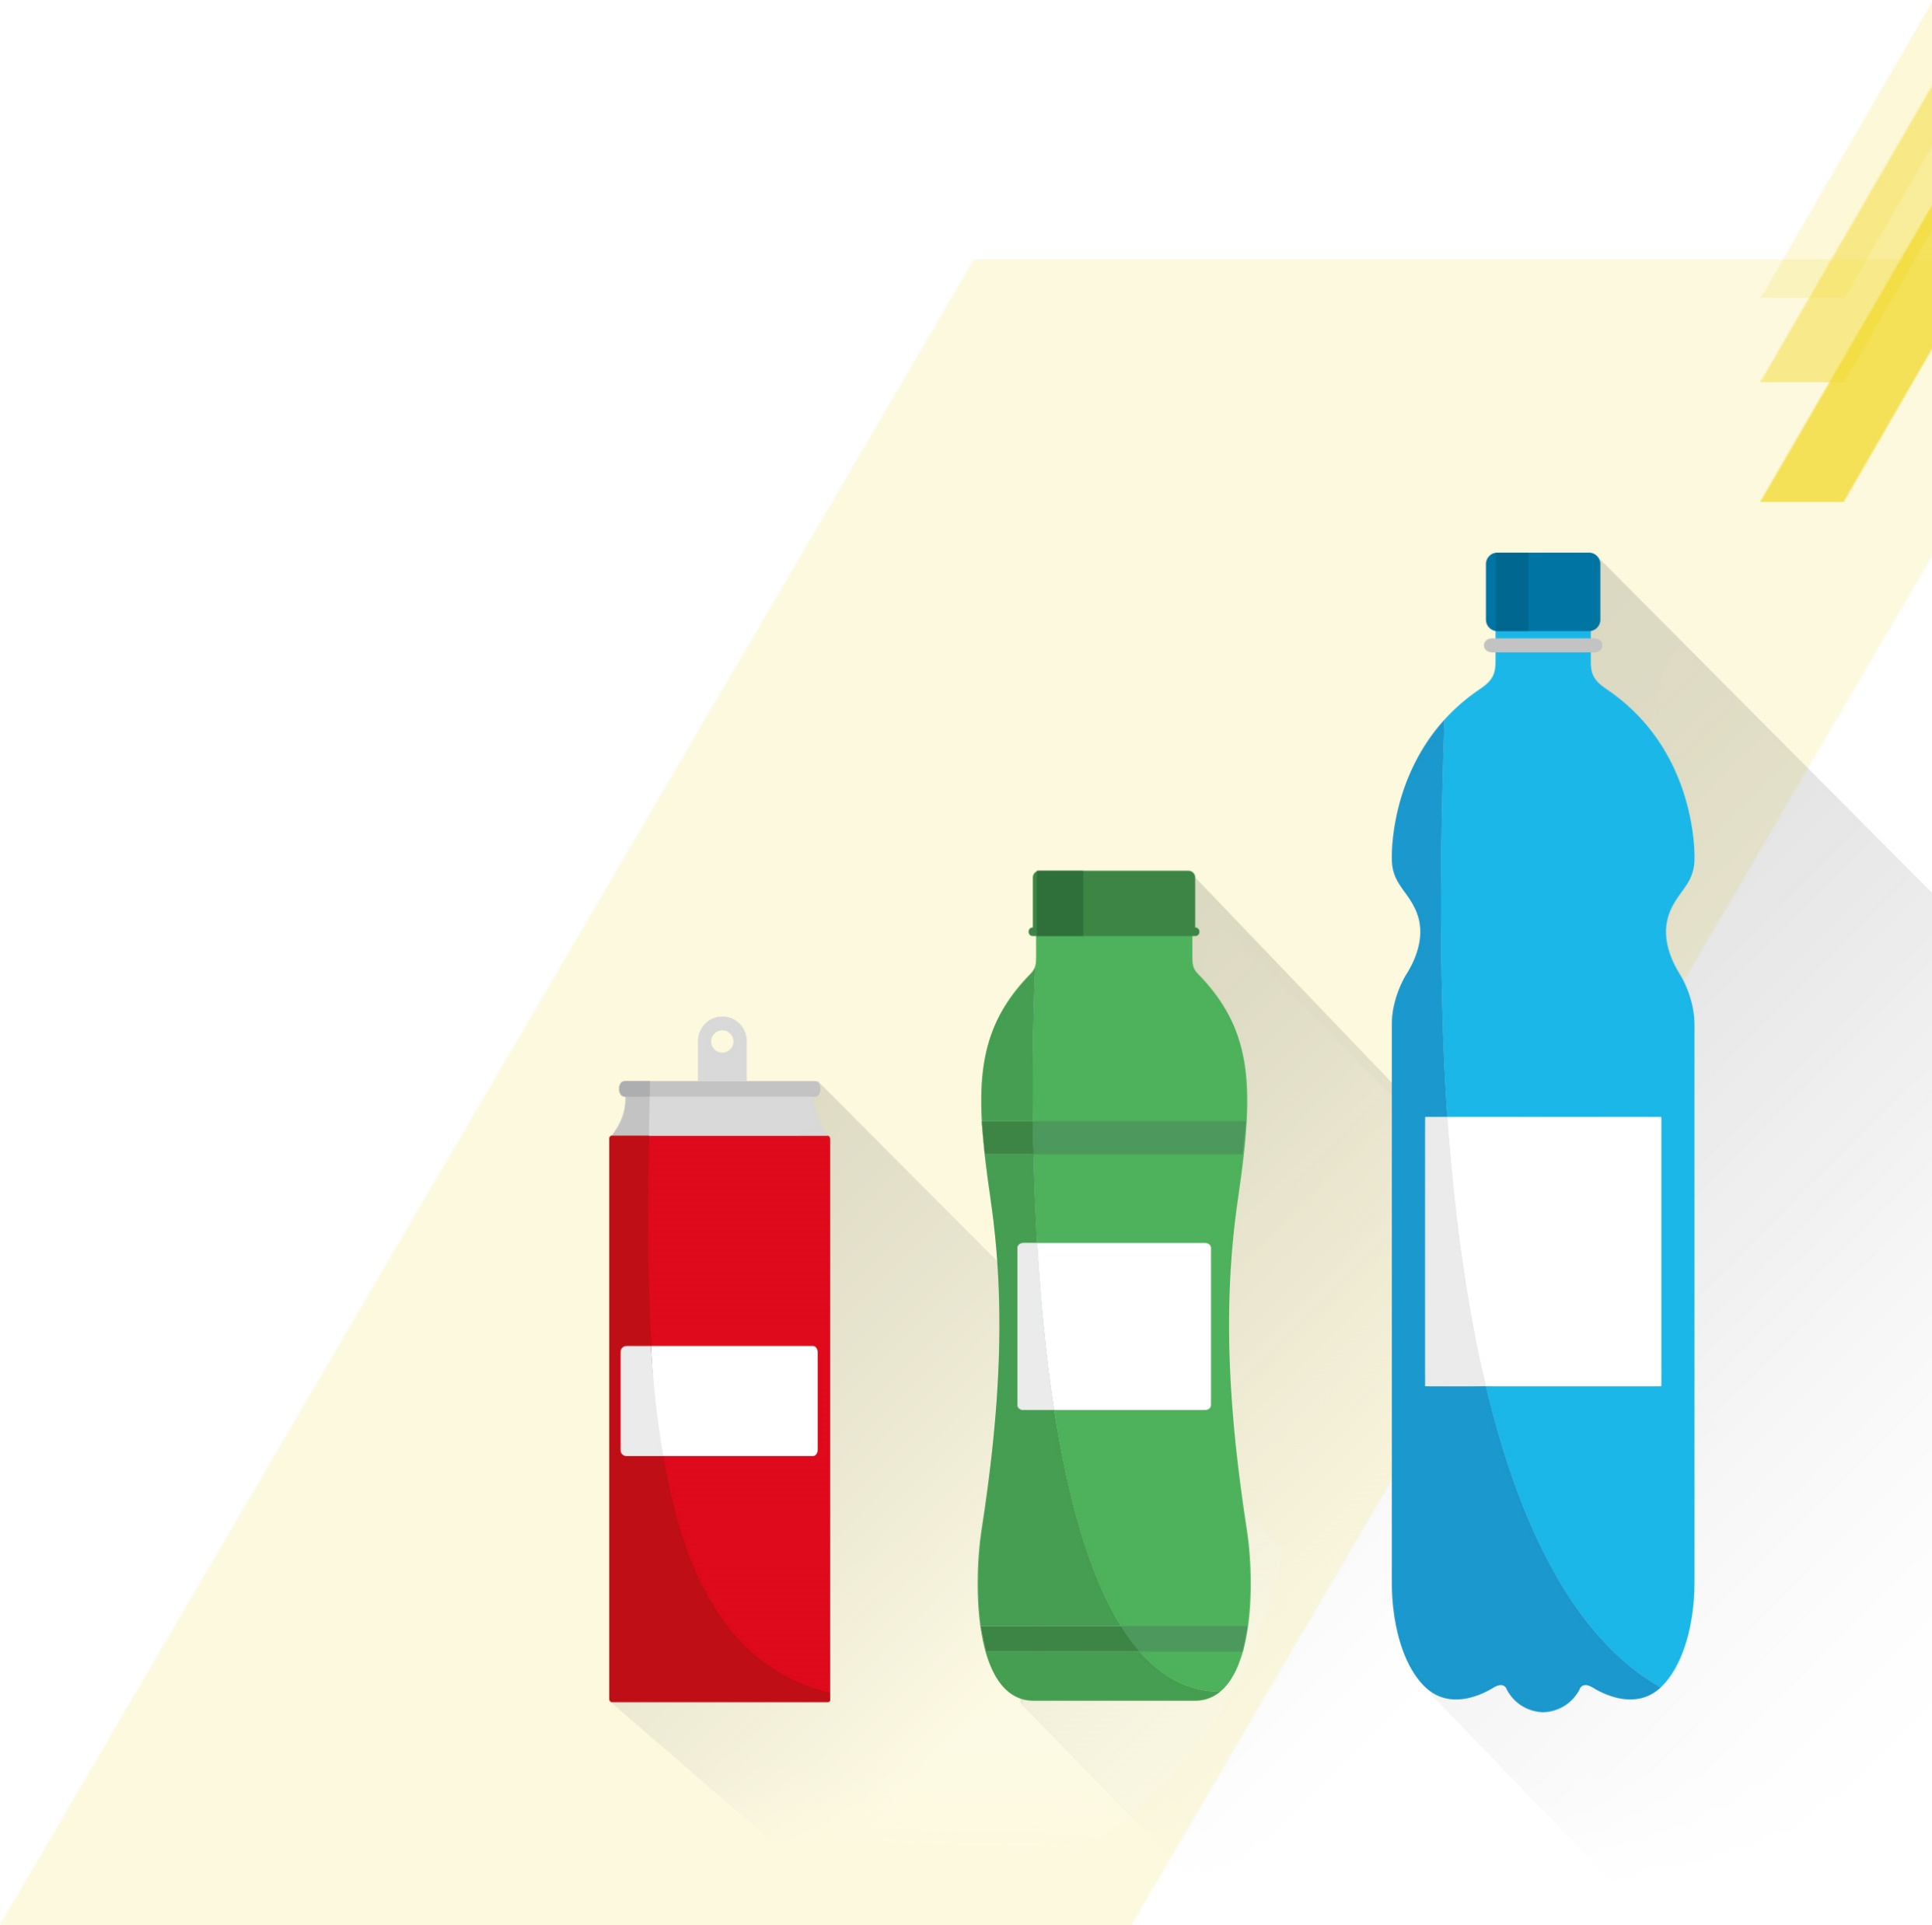
STAYING HYDRATED AT WORK IS VITAL TO OUR WELLBEING AND OUR ABILITY TO PERFORM TASKS SAFELY AND EFFICIENTLY. ITS ESSENTIAL TO OFFER A BALANCED RANGE OF DRINKS IN THE RIGHT OPTIONS TO MEET EMPLOYEE NEEDS
We need 8 to 10
glasses of fluid
every day to be
properly hydrated
70% of consumers feel it
is very important to stay hydrated during the day
at the workplace
‘At work drinkers’ are
looking for increased
variety within
the category
60% of employees are currently not satisfied
with their beverage offer
@ Work
If water is the only option available, consumers
can get bored and not
drink enough
Choice & availability
can drive satisfaction
& consumption
Soft drinks at 10%
daily consumption
although only
available In
50% sites
Consumers stress
the importance of
health-conscious,
natural, sugar-free
and organic drinks
that are rich in vitamins
and energy

Slide 5
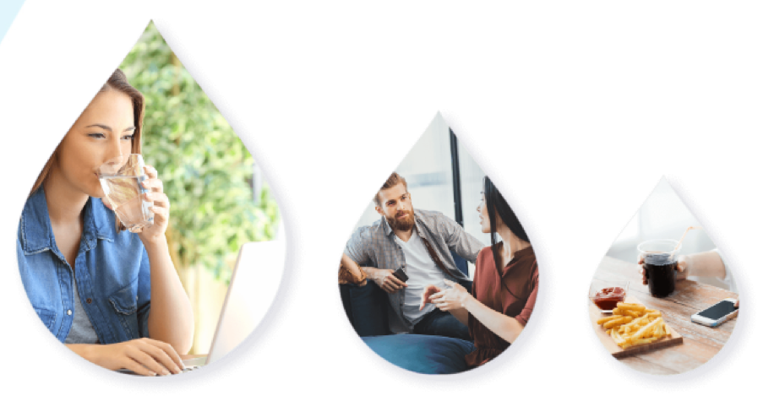
CONSUMERS OFTEN HAVE VERY DIFFERENT NEEDS FROM BEVERAGES ACROSS ‘AT WORK’ SUB‑OCCASIONS AND IT IS IMPORTANT TO OFFER A BROAD RANGE OF CATEGORIES AND PACKS TO FULLY SATISFY THEIR NEEDS
Focus on ‘while working’ & ‘while taking a break’ that account for 89% of consumption
The more choice of beverages and the more they are easily available, then the higher the consumption
8AM TO 8PM DRINKING MOMENT
Coffee
43.6%
Opportunity
SSDs
Tea
Juices
Plant Based Dairies
Energy
Water
21.7%
SSDs
14%
WHILE
WORKING
WHILE TAKING
A BREAK
WHILE
EATING
58%
31%
11%
Opportunity

Slide 6





ALTHOUGH PEOPLE DO DRINK WHEN AT WORK, ONLY 1 OUT OF 5 BEVERAGES ARE BOUGHT ON PREMISE, AS EMPLOYEES ARE NOT HAPPY WITH THE BEVERAGE CHOICE
IN THE WORKPLACE
ALMOST
1/2
80%
Beverages consumed
at work are purchased outside of the workplace
Of consumers are not currently satisfied with
the beverage choice in
the workplace.
Beverage Purchase
Country Weight
Organised Trade
KIOKS
& Petrol
QSR
(Fast Food)
HORECA
Workplace
Total
100.0%
31.4%
9.7%
8.8%
25.4%
20.5%

Slide 7
BY ADDING ONE MORE DRINK PER WEEK WE HAVE AN OPPORTUNITY TO CAPTURE 30MN€ REVENUE
EXAMPLE FOR SWISS MARKET
SIZE OF THE AT WORK OCCASION & SIZE OF THE PRIZE
€410 MN
€30 MN
24.4%
Value of DM
Size of prize
TCCC category
value share
NOTE
VALUE OF DM IS ACTUALIZED 2017
AND SIZE OF THE PRIZE AS PER CATEGORY VISION CALCULATION TO YEAR 2023
Source: CBL, IE, Unmet Beverage Needs At Work research
Note to markets: Insert local data to calculate size of prize

Slide 8
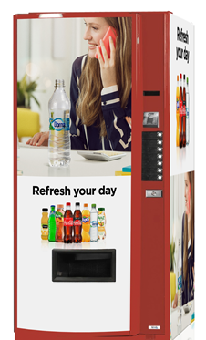
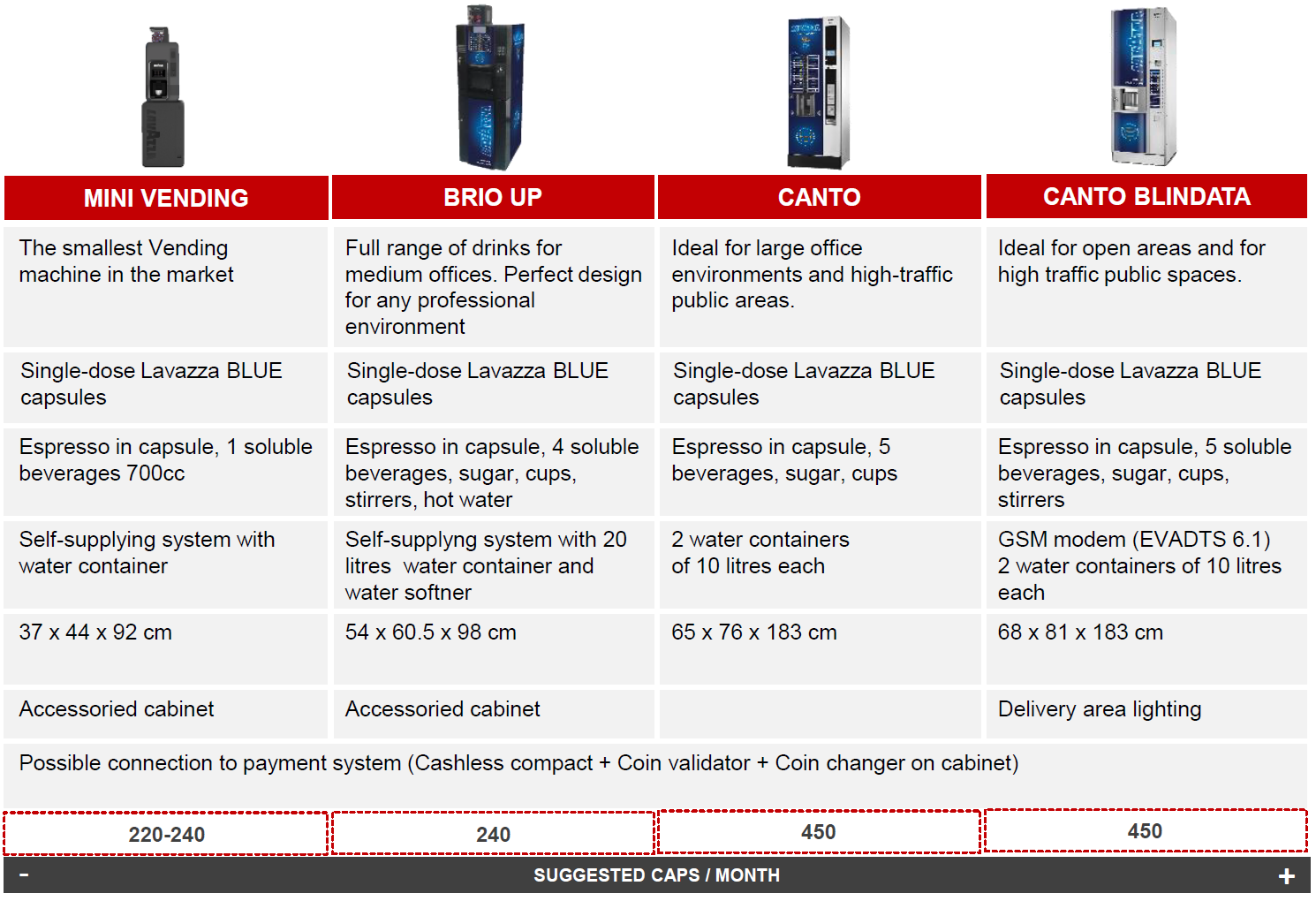
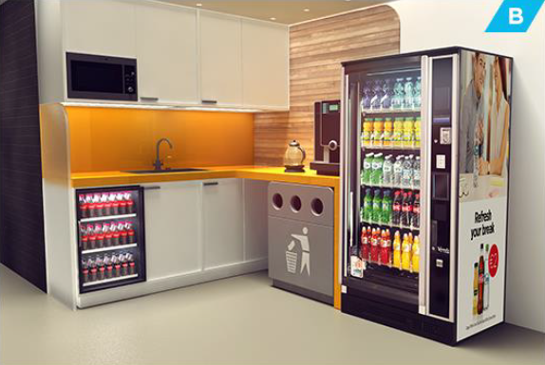
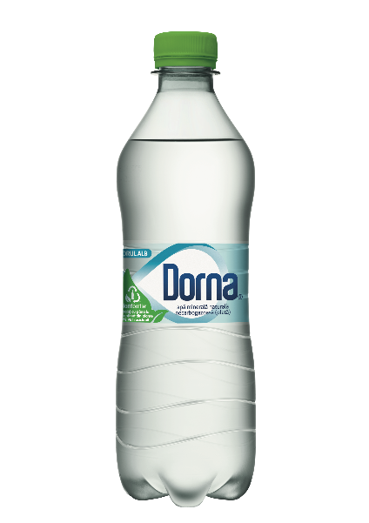
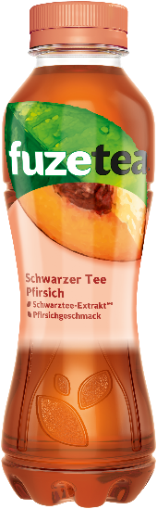
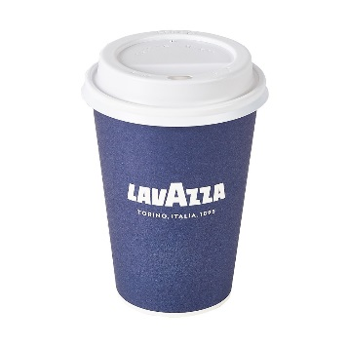
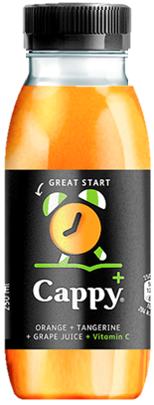
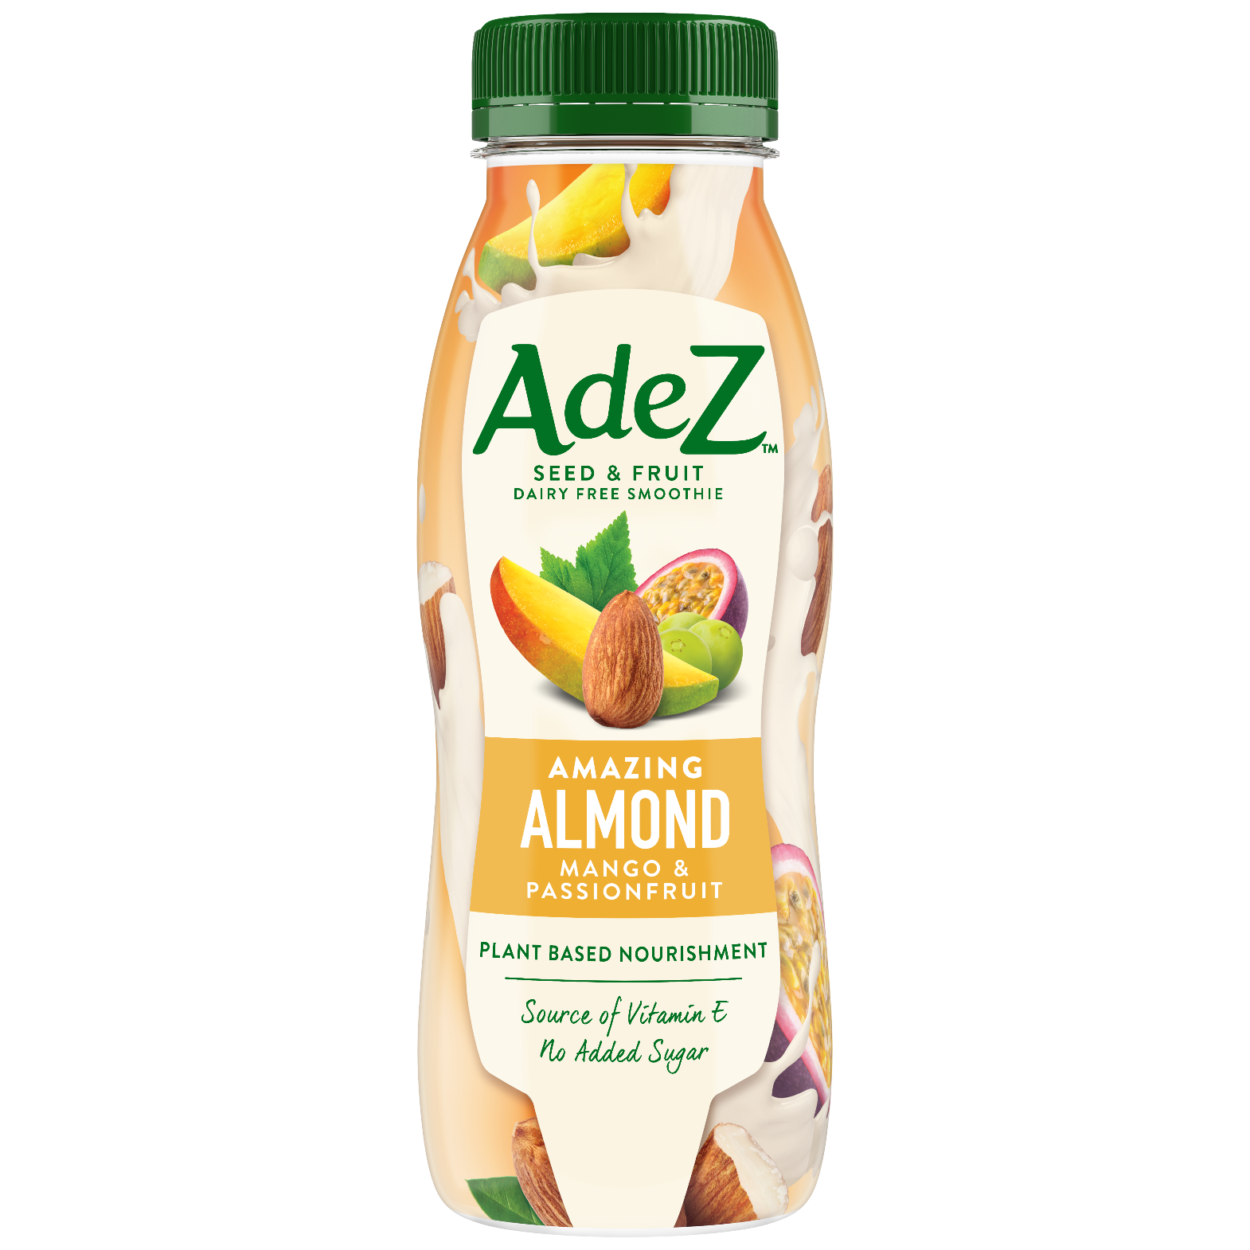
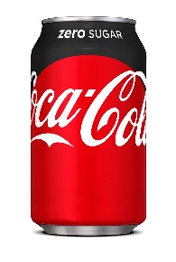
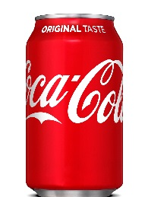
TOGETHER, WE CAN CAPTURE THE ADDITIONAL REVENUE OPPORTUNITY FROM THE ‘AT WORK’ OCCASION THROUGH A JOINT STRATEGIC APPROACH
1
2
3
WINNING
PORTFOLIO
Choice & availability to drive satisfaction and consumption
RIGHT EQUIPMENT
Offering to maximize ROI and better serve customer needs
RIGHT PLACEMENT
& MERCHANDISING
to drive incidence of
beverages and increase transactions & revenue
Note to markets: Insert local data to calculate size of prize

Slide 9
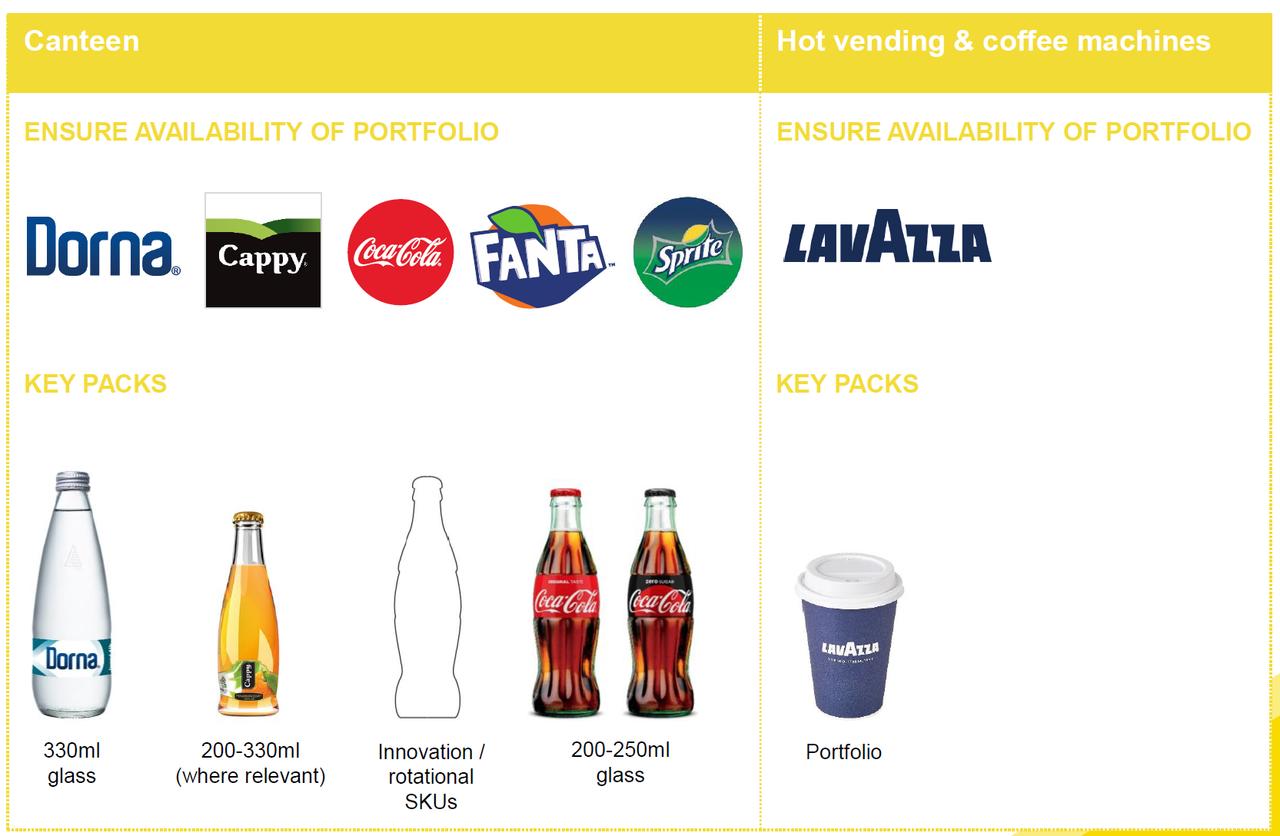

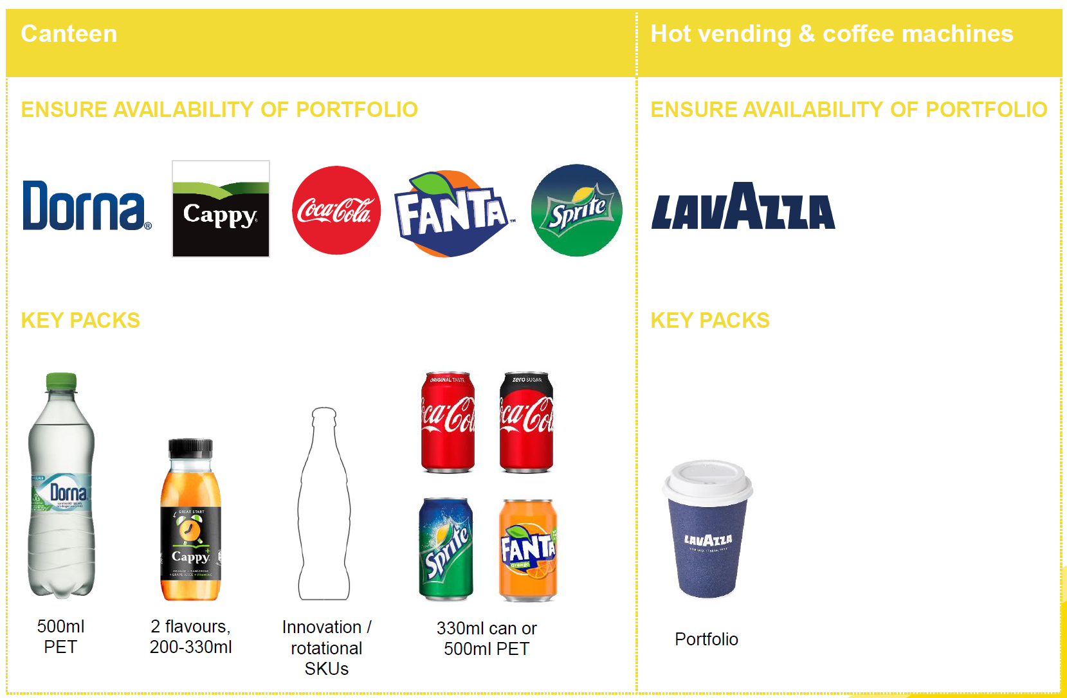
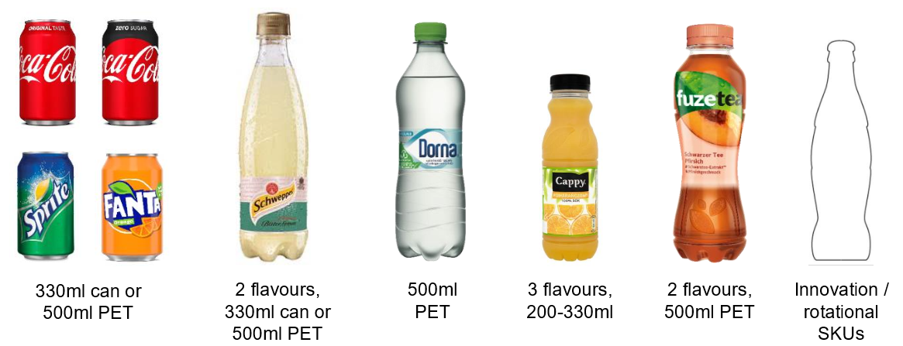

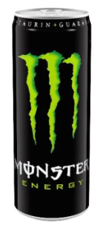
1
WINNING
PORTFOLIO
RIGHT PORTFOLIO CHOICE (CATEGORIES & FLAVORS) WILL COVER DIFFERENT NEEDS THROUGHOUT THE DAY AND WILL DRIVE TRAFFIC, INCREMENTAL TRANSACTIONS & REVENUE
ENABLING CATEGORIES
Ensure availability of portfolio
RANGE
WHITE COLLAR
COFFEE
Key products
WATER
2 flavors, 330ml can or 500ml PET
Portfolio
Innovation / rotational SKUs
330ml can or 500ml PET
500ml PET
3 flavors, 200-330ml
2 flavors, 500ml PET
ENABLING CATEGORIES
Ensure availability of portfolio
COFFEE
RANGE
BLUE COLLAR
Key products
WATER
2 flavors, 330ml can or 500ml PET
Portfolio
Innovation / rotational SKUs
330ml can or 500ml PET
500ml PET
3 flavors, 200-330ml
2 flavors, 500ml PET
2 flavors, 500ml
Note to markets: Replace with country specific product & pack portfolio

Slide 10
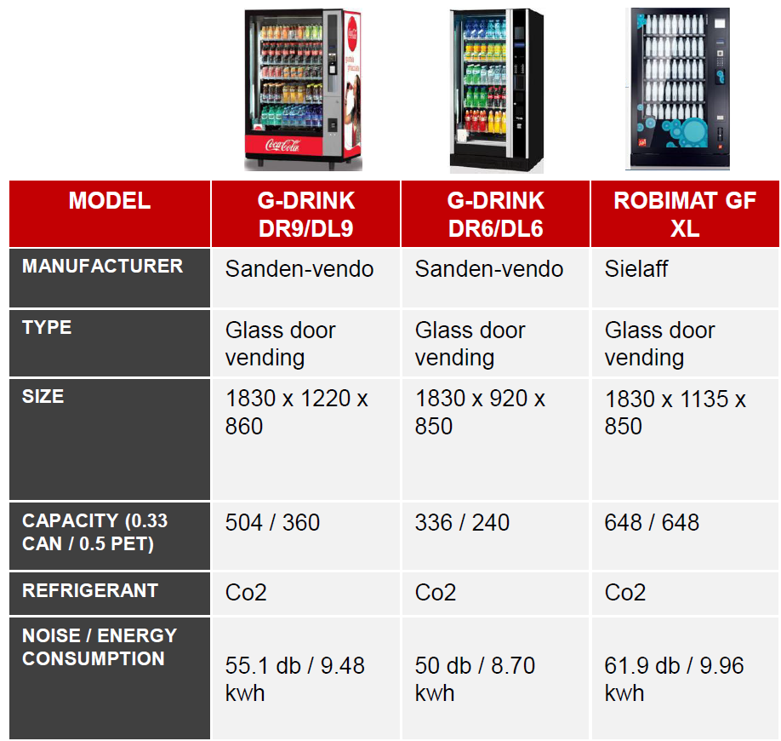
2
RIGHT
EQUIPMENT
RIGHT PORTFOLIO CHOICE (CATEGORIES & FLAVORS) WILL COVER DIFFERENT NEEDS THROUGHOUT THE DAY AND WILL DRIVE TRAFFIC, INCREMENTAL TRANSACTIONS & REVENUE
Vending Machine Portfolio
Lavazza Vending Capsule Machine Portfolio
MODEL | G-DRINK DR9/DL9 | G-DRINK DR6/DL6 | ROBIMAT GF XL
Manufacturer | Sanden-vendo | Sanden-vendo | Sielaff
Type | Glass door vending | Glass door vending | Glass door vending
Size | 1830 x 1220 x 860 | 1830 x 920 x 850 | 1830 x 1135 x 850
Capacity (0.33 Can / 0.5 PET) | 504 / 360 | 336 / 240 | 648 / 648
Refrigeration | Co2 | Co2 | Co2
Noise / Energy Consumption | 55.1 db / 9.48 kwh | 50 db / 8.70 kwh | 61.9 db / 9.96 kwh
MINI VENDING | BRIO UP | CANTO | CANTO BLINDATA
The smallest Vending machine in the market | Full range of drinks for medium offices. Perfect design for any professional environment | Ideal for large office environments and high-traffic public areas | Ideal for open areas and for half traffic public spaces
Single-dose Lavazza BLUE capsules | Single-dose Lavazza BLUE capsules | Single-dose Lavazza BLUE capsules | Single-dose Lavazza BLUE capsules
Espresso in capsule, 1 soluble beverage 700cc | Espresso in capsule, 4 soluble beverages, sugar, cups, stirrers, hot water | Espresso in capsule, 5 beverages, sugar, cups | Espresso in capsule, 5 soluble beverages, sugar, cups, stirrers
Self-supplying system with water container | Self-supplying system with 20 litres water container and water softner | 2 water containers of 10 litres each | GSM moden (EVADTS 6.1) 2 water containers of 10 litres each
37 x 44 x 92cm | 54 x 60.5 x 98 cm | 65 x 76 x 183 cm | 68 x 81 x 183 cm
Accessorised cabinet | Accessorised cabinet |  | Delivery area lighting
Possible connection to payment system (Cashless compact +Coin validator + Coin changer on cabinet)
220-240
240
450
450
SUGGESTED CAPS / MONTH
Note to markets: Replace pictures with real merchandising & equipment solutions available in your market

Slide 11
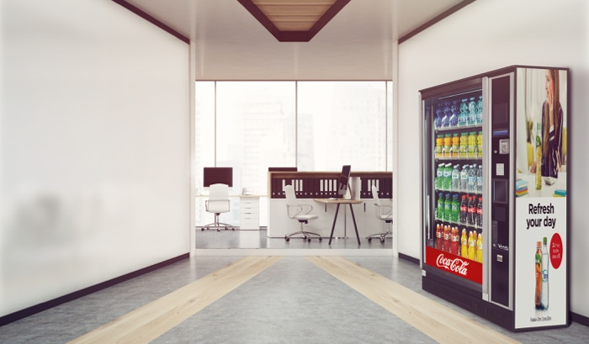
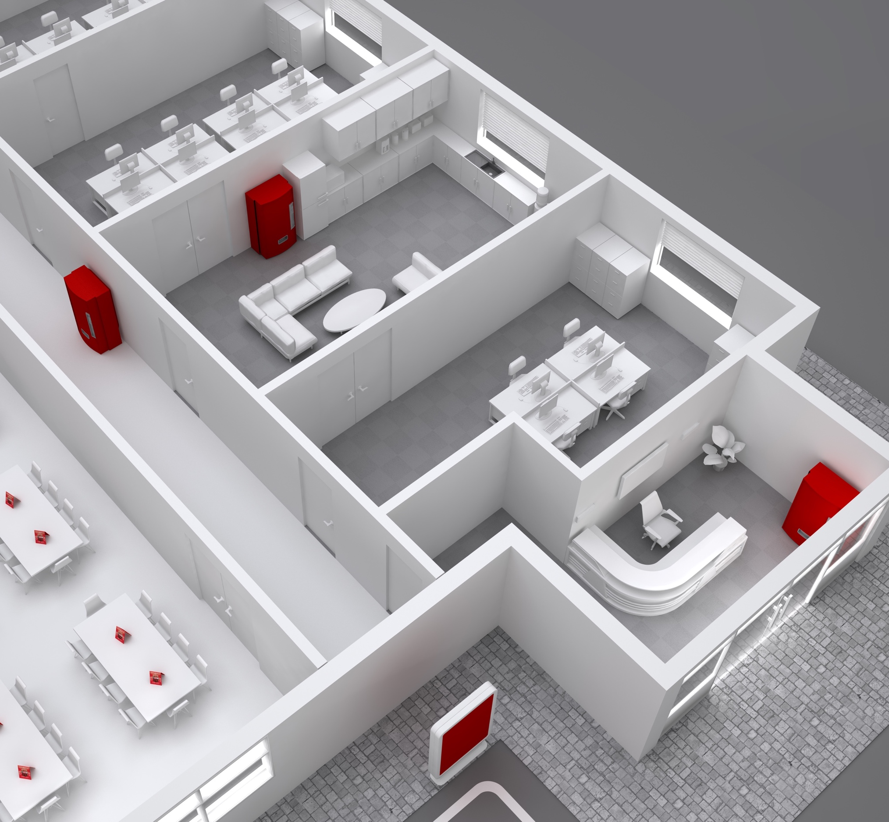
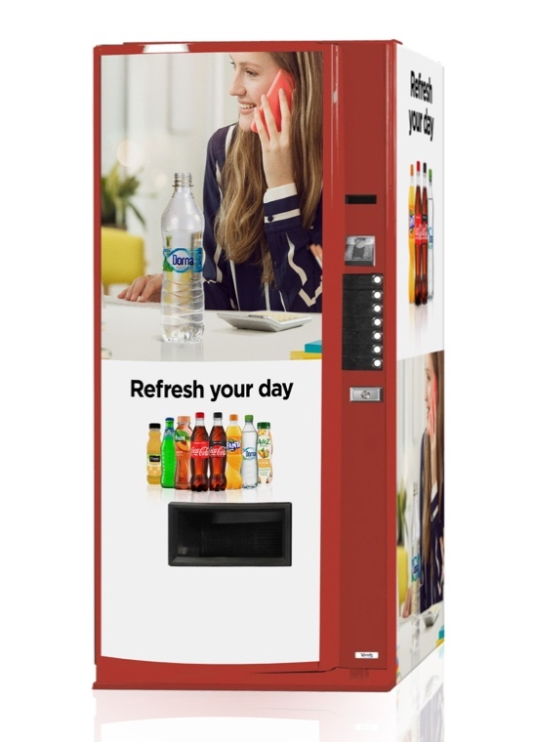
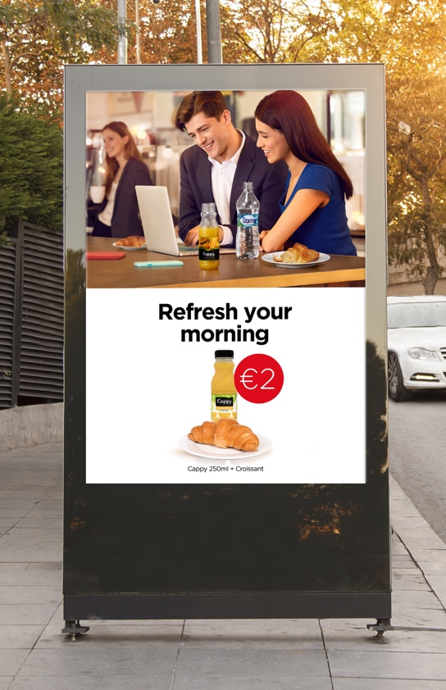
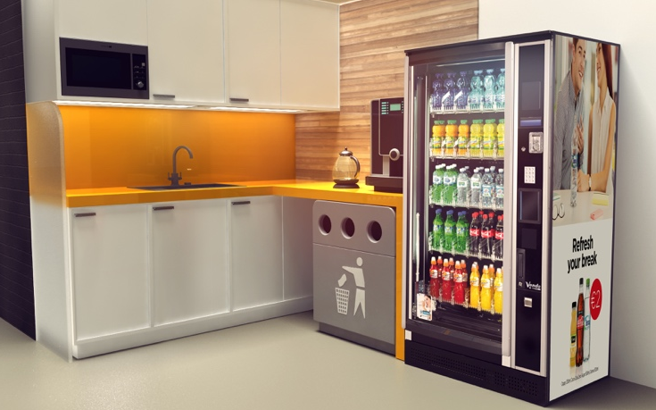
3
RIGHT
PLACEMENT & MERCH
RIGHT PLACEMENT OF VENDING MACHINES IN HIGH TRAFFIC & BREAKOUT AREAS AND WITH RIGHT MERCHANDISING WILL DRIVE TRANSACTIONS AND REVENUE
PICTURE OF SUCCESS – BREAKOUT & GENERAL AREAS
Note to markets: Replace pictures with real merchandising & equipment solutions available in your market

Slide 12
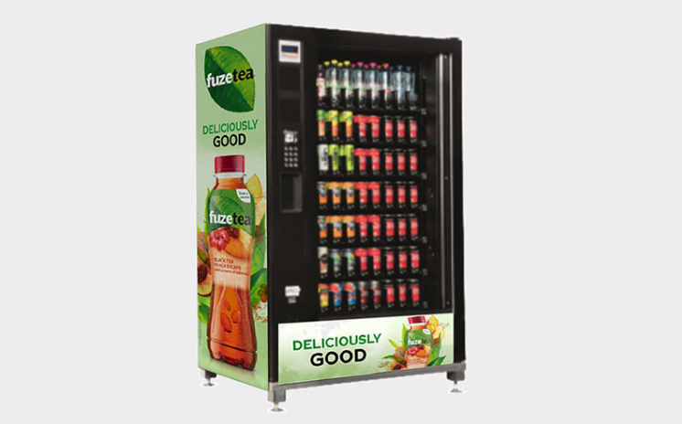
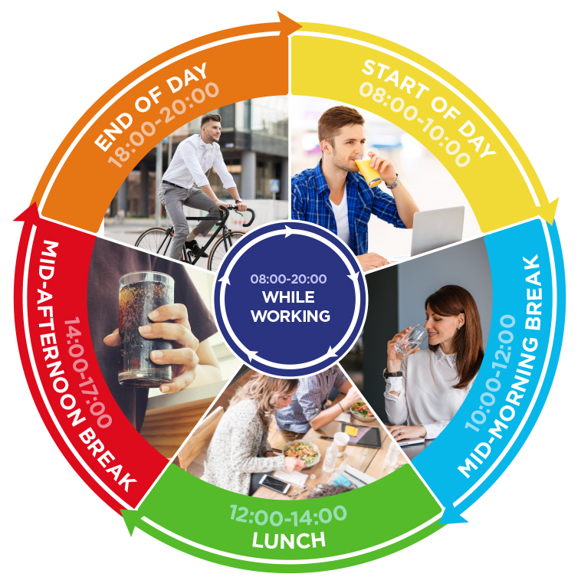

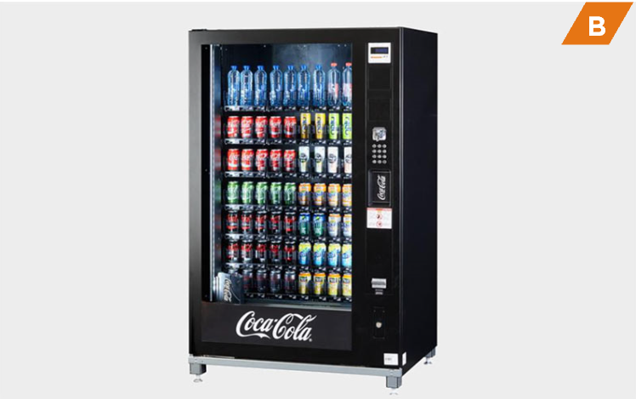
3
RIGHT
PLACEMENT & MERCH
RIGHT PLACEMENT OF VENDING MACHINES IN HIGH TRAFFIC & BREAKOUT AREAS AND WITH RIGHT MERCHANDISING WILL DRIVE TRANSACTIONS AND REVENUE
VENDING MACHINE PLACEMENT GUIDE
Cold drinks availability in high traffic & break out areas and proximity to coffee facilities
Vending in close proximity
to working areas.
PICTURE OF SUCCESS – GENERAL & BREAK-OUT AREAS
General areas
Mid-Afternoon Break: CCR branded glass fronted vending machines in breakout or high traffic areas with occasion communication | Permanent
While Working: CCR branded glass fronted vending machines in high traffic areas with occasion communication | Permanent
End of Day: High visible vending machines at exit and in car park | Permanent
Right range and on-the-go pack formats.
Highly visible vending machines at exit / car park.
Note to markets: Replace pictures with relevant merchandising solutions

Slide 13
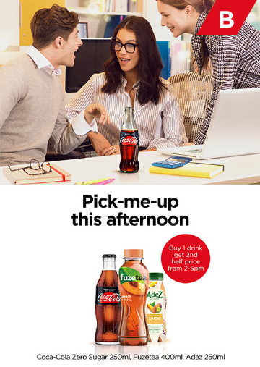
3
RIGHT
PLACEMENT & MERCH
RIGHT PLACEMENT OF VENDING MACHINES IN HIGH TRAFFIC & BREAKOUT AREAS AND WITH RIGHT MERCHANDISING WILL DRIVE TRANSACTIONS AND REVENUE
PROMOTIONAL OFFER IDEAS THROUGHOUT THE DAY
VENDING MACHINE TOKEN DEAL
Buy 10 vending machine tokens for the price of 8 / 5 for the price of 3.
Benefit: Drives repeat purchase and habit.
EMPLOYEE BENEFIT SCHEME
Connect the vending machines to the employee benefits system, so when staff use their pass to purchase beverages from the vending machines, they will receive a % discount.
Benefit: Drives incidence of
priority categories.
VENDING DEALS
Buy 1 drink, get 2nd half price
between 14:00-17:00.
Benefit: Increase of impulse purchases.
Note to markets: Replace with country specific promotional mechanisms

Slide 14
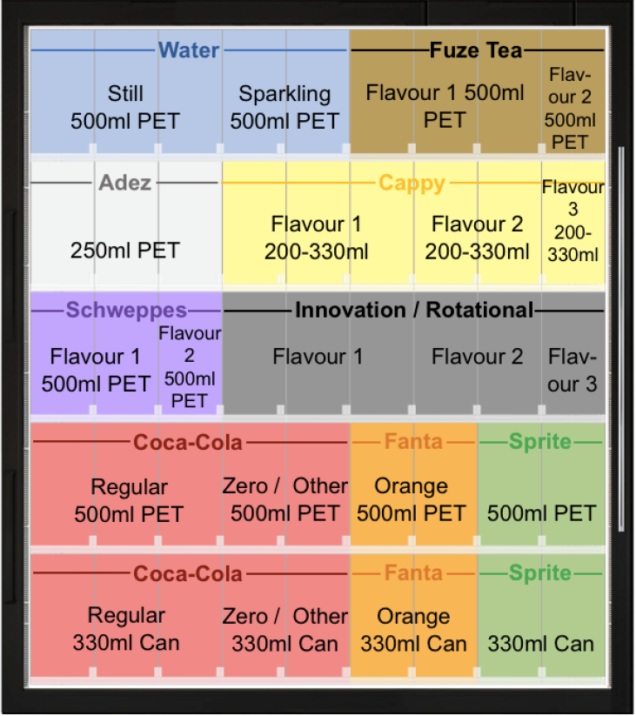
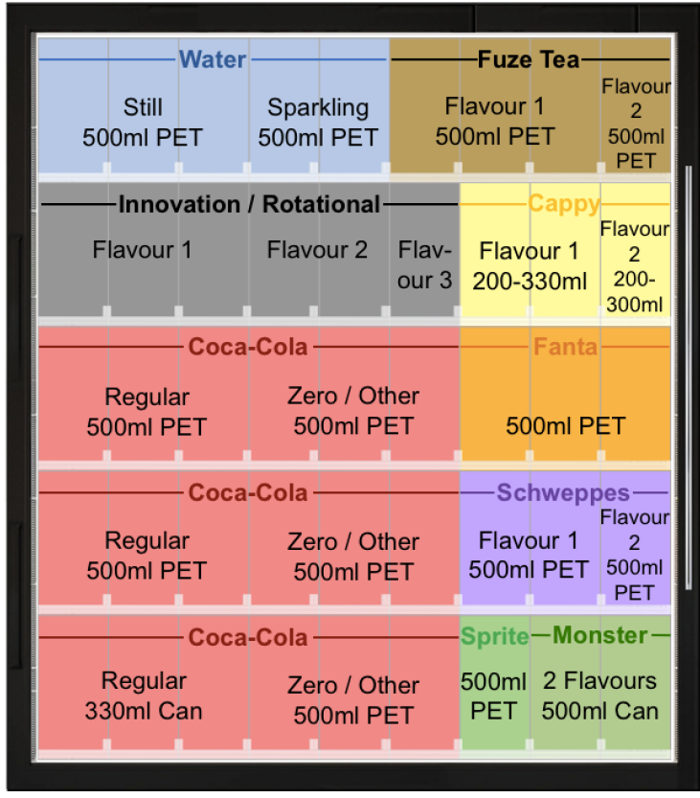
3
RIGHT
PLACEMENT & MERCH
RIGHT MERCHANDISING STANDARDS OF VENDING MACHINES WILL ENSURE PRODUCT AVAILABILITY AT ALL TIMES, MINIMIZE ‘OUT OF STOCK’ AND REDUCE REPLENISHMENT COSTS
MERCHANDISING STANDARDS EXAMPLES
Merchandising - White Collar
Merchandising - Blue Collar
Showcased here is a glass fronted vending machine with 9 facings per shelf.
Note to markets: Develop your own merchandising standards based on opportunities in the market and customer specifics, always with the objective to offer enough choice to consumers.

Slide 15







TOGETHER, WE CAN CAPTURE A BIG REVENUE OPPORTUNITY IN ‘AT WORK’
30Mio EUR
Drive transactions
and revenue
through:
1. Winning portfolio of brands & OTG packs
2. Right equipment offerings to cover different needs
3. Right placement and with right merchandising
Offer choice
through a broad range of categories and packs to fully satisfy different needs throughout the day
Staying hydrated at
work is vital
to our wellbeing and our
ability to perform tasks safely and efficiently
At Work is
The 2nd biggest
OOH occasion
in value
Note to markets: Insert local data to calculate size of prize

Slide 16

NEXT STEPS
<CUSTOMER> FEEDBACK
YOUR FEEDBACK:
NEXT STEPS:
KEY SUCCESS MEASURES:
TIP: Make it an open discussion. Although you already asked for feedback few times its worth reconfirming if there’s anything else
the Customer would like to share.
If you agree on the direction it’s important to:
- discuss key success factors
- align on clear next steps with timelines
- agree how to track and measure the success

Slide 17

Thank You

